Slide 1
DEVELOPING ENTREPRENEURSHIP IN THE AFRICAN AREA
PhD. LEGMAN IOAN DAVID

Slide 2
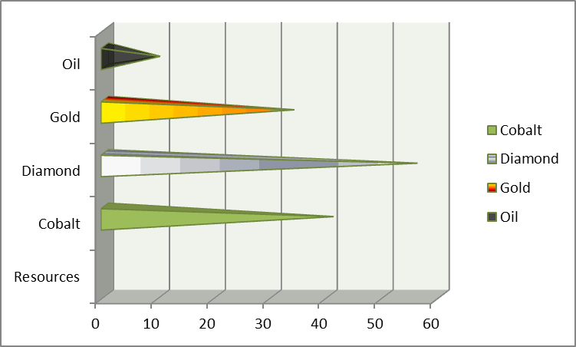
Introduction
The African model is vitiated by a pathological level of clientelism, which is extremely inappropriate for the business climate, investment and development.
Economic growth in recent years has failed, unemployment, demographic change, urban-urban migration, etc. all have contributed to the current situation.
Africa’s resources

Slide 3
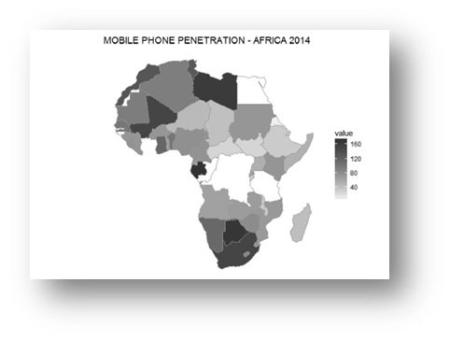
Technology in Africa
Fig. 1 Mobile penetration in Africa 2000-2014

Slide 4
Economic view
Tabel nr. 1 African and Asian economies by nominal GDP and per capita in 1960
Tabel nr. 2 African and Asian economies by nominal GDP and per capita in 2020
bootstraping
strategy
The need for realization
Optimism
Entreprenorial
spirit
Autonomy

Slide 5
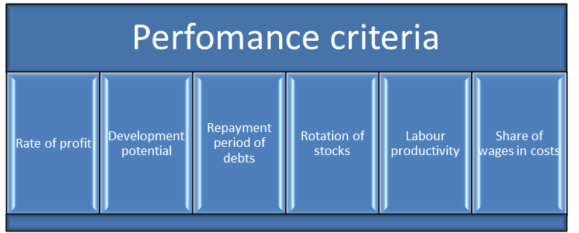
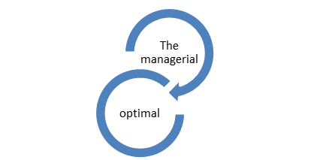
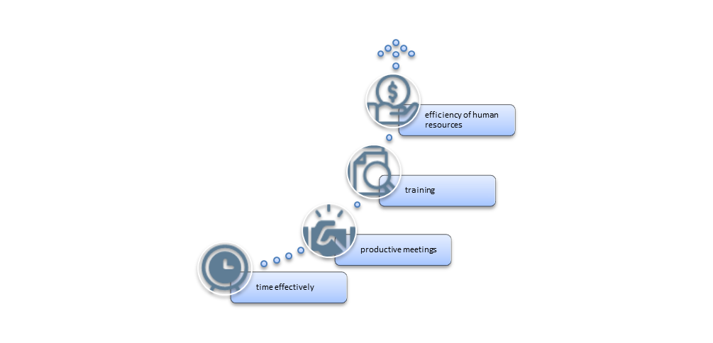
Increase the performance of the company by optimizing the management
Fig. 3 Performance criteria in the evaluation of managerial activity
The success of a company depends on the work of all the employees of the company. Each one has its own role as a puzzle. Even if the managers are the ones who make the decision, it is necessary to evaluate their decisions, because these decisions are not always the best for the companies.
Fig. 4 Elements of increasing the efficiency of the activity
Source: own projection

Slide 6
Egypt 13.7 billlion
Morocco 4.6 billion
South Africa 4.2 billion
Foreign direct investment in major’s economies of Africa
Human Development Index
HDI stands for Human Development Index. It is a composite statistic used to measure the average achievements in three dimensions of human development: a long and healthy life (measured by life expectancy at birth), access to knowledge (measured by years of schooling and expected years of schooling) and a decent standard of living (measured by gross national income per capita).
Labor productivity

Slide 7
There are a few aspects that can be taken into account. In the World Bank’s doing Business ranking in 2020, Morocco ranked 40 in terms of ease of paying taxes, South Africa ranked 29, and Egypt ranked 96. This suggests that South Africa and Morocco could offer a more favorable tax system than Egypt.
TAXATION
Morocco
The income tax 10%-38%
Value Added Tax 20%
Egypt
The income tax 10%-22,5%
Value Added Tax 14%
South Africa
The income tax 18%-45%
Value Added Tax15%
Business environment
World Bank’s doing Business
South Africa
RANK 84
World Bank’s doing Business
Morocco
RANK 96
World Bank’s doing Business
Egypt
RANK 114
From the perspective of the World Bank’s “doing Business” ranking in 2020, Morocco has the most competitive business environment among the three countries mentioned. That year, Morocco ranked No. 53 in the world ranking, followed by South Africa No. 84 and Egypt No. 114.

Slide 8
ACCES TO FINANCE
1
Commercial banks
Microfinance organizations
3
Credit Institutions
SAWIRIS Fondation
QALAA Holdings Group
2
Egypt
Commercial banks
Non governamental organizations
Investment funds
Government fundings: HASSAN II for Economic and Social Development
Morocco
Commercial banks
Microfinance organizations
Investment funds: Africa Investment Forum
South Africa

Slide 9
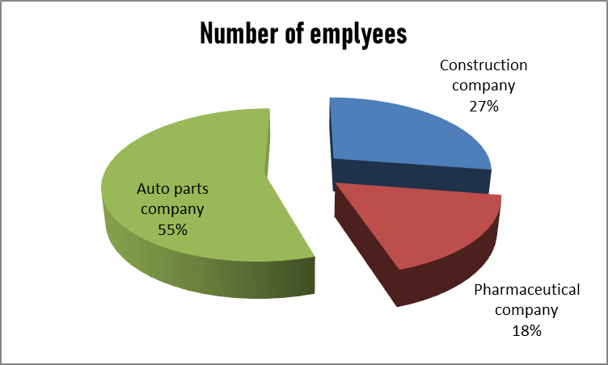
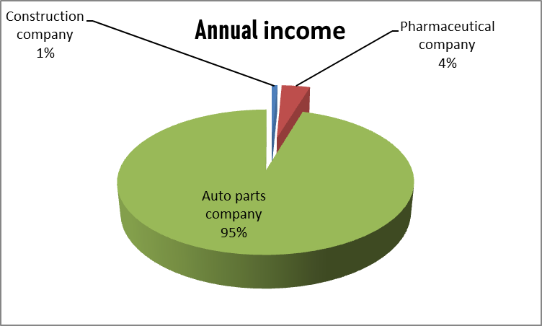
Management influences
Tabel nr 3 The situation of the elements of increasing efficiency
Source: Data collected from companies
The first company is in the construction industry. It is located in South Africa, with about 200 employees, with an income of about 5 million. The second company is from Egypt into the pharmaceutical industry, with 128 employees having an annual income of 25 million. The third company is from Morocco in the auto parts industry, with 400 employees with an annual income of 620 million.

Slide 10
Conclusions
Starting a business in Africa is not a simple task, and achieving profitability and sustainability is even more difficult. Even in the most favorable business environments, about 50% of start-ups fail within 5 years .
Over the past three decades, African economies have faced more problems than global economies. They continue to depend on exports of natural resources, high fiscal deficits, high inflationary trends, large-scale unemployment, underemployment and poor computer infrastructure.
Although some African countries have achieved improvements in some sectors, they are due to macroeconomic structural reforms and the boom in raw material prices.

Slide 11
Bibliography
Ahmad, N. H., & Seet, P. (2009). Dissecting behaviours associated with business failure: A qualita­tive study of SME owners in Malaysia and Australia. Asian Social Science, 5, 98–103.
Arun, Neil. 2019. State Capture: Zuma, the Guptas, and the Sale of South Africa,
July 15. BBC. https://www.bbc.co.uk/news/world-africa-48980964.
Assenova, V. (2019). Why are some societies more entrepreneurial than others? Evidence from 192 countries over 2001-2018. Available at Social Science Research Network (SSRN).
Chua, A. (2003). World on fire: How exporting free market democracy breeds ethnic hatred and global instability. New York: Anchor Books
Comin, D., Hobijn, B. (2004). Cross-country technology adoption: making the theories face the facts. Journal of Monetary Economics, 51(1), 39–83.
Corcoles-Munoz, M. M., Parra-Requena, G., Ruiz-Ortega, M. J., García-Villaverde, P. M., & Ramírez-Fernández, F. J. (2019). Psychological and biographical determinants of entrepreneurial intention: Does the learning environment act as a mediator? Administrative Sciences, 9(2), 33.
Etzo, S., Collender, G. (2010). The mobile phone ‘revolution’ in Africa: rhetoric or reality? African Affairs, 109(437), 659–668.
Frame Lin Mariko, Ecological Imperialism, Development and the Capitalist World-System, ed. Routledge,New York, U.S., 2022, p.59
Fong, M. W. (2009). Technology leapfrogging for developing countries. In: Encyclopedia of information science and technology. 2nd ed. IGI Global, Australia, 3707–3713.
Friedman, T. L. (2006). The world is flat: The globalized world in the twenty-first century. Penguin, London, 593.
George, G., Corbishley, C., Khayesi, J.N.O., Haas, M.R., and Tihanyi, L. (2016). Bringing Africa in: Promising directions for management research. Academy of Management Journal, 59(2): 377–93.
Ghalwash, S., Tolba, A., & Ismail, A. (2017). What motivates social entrepreneurs to start social ventures? Social Enterprise Journal, 13(3), 268–298.
Mthembu, P. 2018. China and India’s Development Cooperation in Africa: The
Rise of Southern Powers. Cham: Palgrave Macmillan, Pretoria, South Africa.
Mthembu, P. 2021. Africa-China Cooperation: Towards an African policy on China? Palgrave Macmillan, Pretoria, South Africa.
McClelland, D. C. (1961). The achieving society. Princeton, NJ: D. Van Nostrand
O’Brien, Chris (2015). “African venture capital: Nigeria and Kenya are leading the continent with startups and fundraising”, https://venturebeat.com/2015/03/25/african-venture-capital-nigeria-and-kenya-are-leading-the-continent-with-startups-and-fundraising/
Otar, C. (2018). “What percentage of small businesses fail – And how can you avoid being one of them?” https://www.forbes.com/sites/forbesfinancecouncil/2018/10/25/what-percentage-of-small-businesses-fail-and-how-can-you-avoid-being-one-of-them/#50d5e16143b5
Rodrik, D. (2018). An African growth miracle? Journal of African Economics, 27(1): 10–27.
Sriram, V., & Mersha, T. (2010). Facilitating entrepreneurship in Sub-Saharan Africa: What gov­ernments can do. Journal of International Business and Entrepreneurship Development, 3(1): 136–151.
Temtime, Z. T., & Pansiri, J. (2004). Small business critical success/failure factors in developing economies: Some evidences from Botswana. American Journal of Applied Sciences, 1(1), 18–25.
Ven Sriram, David Lingelbach, Entrepreneurship in Africa, ed. Routledge, 2021, New York, US
Wang, Y. (2016). What are the biggest obstacles to growth of SMEs in developing countries? An empirical evidence from an enterprise survey. Borsa Istanbul Review, 16(3), 167–176.
Wekesa, B. 2014. Whose Event? Official Versus Journalistic Framing of the Fifth Forum on China Africa Cooperation, Journal of African Media Studies, vol. 6, no. 1, pp. 57–70.
Xing, R. 14 March 2018. ‘Inside China’s Plan to Create a Modern Silk Road’,
https://www.morganstanley.com/ideas/china-belt-and-road, accessed 1 May 2019.
https://statisticstimes.com/economy/african-countries-by-gdp.php
https://statisticstimes.com/economy/asian-countries-by-gdp.php
https://savca.co.za/member-category/

