Slide 1
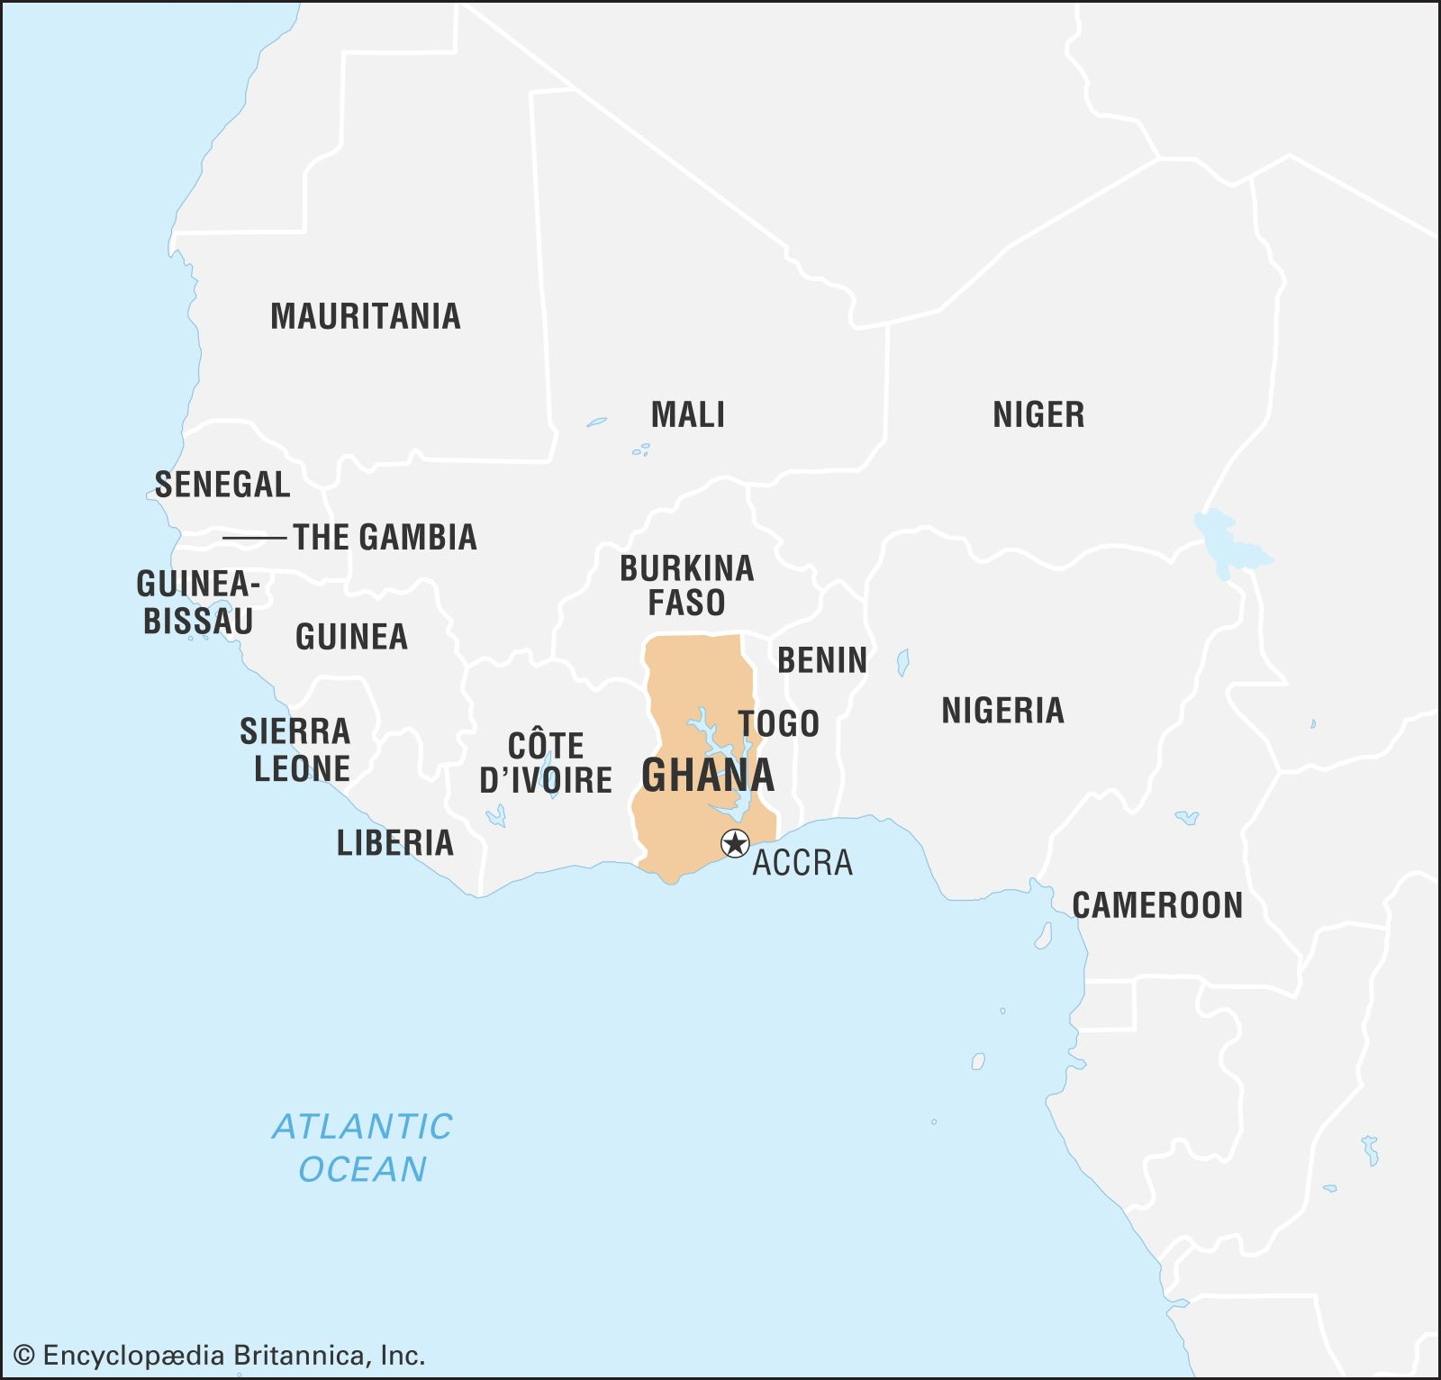
Exploring the Sustainability of NGOs in Ghana to Enhance Community Development
4th Current Business Issues
in African Countries
2023
Agnes Adwoa Anima
UNICAF UNIVERSITY
Dr. Jet Mboga
Dr. Donald Crooks
April 27 – 28, 2023 WWW.CBIAC.NET

Slide 2
Introduction
The NGO sector in Ghana has supported community development in its many years of existence.
Unfortunately, most NGOs in Ghana have become unsustainable.
The purpose of this qualitative study is to explore the factors that make NGOs unsustainable and to conclude if adopting specific operating models will enhance the sustainability of NGOs in Ghana.

Slide 3
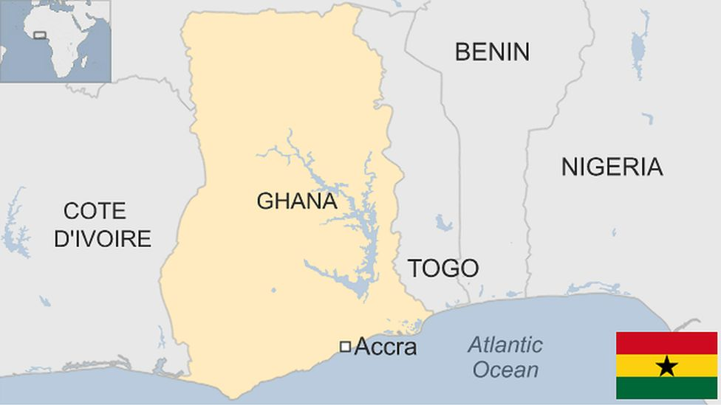
Introduction
The Evolution of NGOs in Ghana
Catalyzing
Convening
Co-ordinating

Slide 4
The Issues facing the NGO Sector
Internal Influences
Governance
External Influences
Government Policies
Human Resource
Financial Resources
Strategic direction
Political Influence
Corruption
Donor conditionalities

Slide 5
Research Objectives
Investigate the external and internal influences that make NGOs unsustainable
Determine the extent of an NGO’s control over the identified factors
Investigate current operating models NGOs in Ghana are using
Recommend specific operating models for NGOs at various stages of growth

Slide 6
Hypotheses
Internal
External
Thematic Areas
The influence of internal organizational factors on sustainability
The influence of external factors on sustainability
The impact of thematic areas of focus on funding and sustainability

Slide 7
Literature Review
Period | Prevailing Theories | Underpinning Concepts | Proponents
1953 - 1987 | Corporate Social Responsibility | Enhancing the appreciation of social responsibility among corporations | (Bowen, 1953) (Baumol et al., 1970) (Carroll, 1974)
1984 – 1997 | Stakeholder Theory | Stakeholder Engagement | (World Commission on Environment, 1987)
1997 - ongoing | Corporate Sustainability | Triple bottom line Green Economy | (Elkington & Jeurissen, 2000)

Slide 8
Literature Review
Key determinants of organizational sustainability
An integrated approach to sustainability
Sustainable Operating Models
Factors that affect sustainability
Organizational Sustainability
Sustainability methodologies

Slide 9
Conclusions
This paper contributes a holistic view of sustainability from the perspective of local NGOs in Ghana – the challenges and the opportunities that are presented to these organizations.
We have found that external and internal factors influence the sustainability of NGOs in Ghana and that some external factors can also present some opportunities.
The ability of a local NGO to respond effectively to the business environment will determine its sustainability.

Slide 10
Questions and Discussion
United Nations Sustainable Development Goals
https://sdgs.un.org/goals
Discussion questions
How does the topic relate to issues of public concern or the common good?
What communities might be involved in or affected by the topic? What are the histories, social contexts, assets, and needs of these communities?
What community partners (e.g., public offices, nonprofit organizations, social enterprises, faith-based organizations) could collaborate on your topic for mutual benefit and growth?

Slide 11
Thank You
Questions / Feedback

