Slide 1
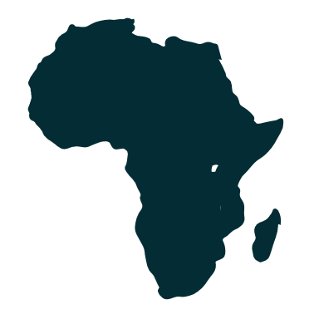
Challenges to the Development of African Infrastructure: Before During and After the Pandemic
Vuk Balajic, Nicholas Cartwright-Atkins, Raquel Rubalcava Reyes, Sara Rutherford, Thomas Scarpello, Mackenzie Vogler
Under the Direction of Dr. Cathyann D. Tully
Wagner College
Current Business Issues
in African Countries
2022
April 7 – 8, 2022 WWW.CBIAC.NET

Slide 2
Importance for FDI and infrastructure in Africa
Boosts the manufacturing and services - creation of jobs
Accessibility to the latest financing tools, technologies, and operational practices (intro of newer tech)
High FDI has a has a positive long-run effect on GDP
Short- and long-term economic growth

Slide 3
Benefits of infrastructure development to the investors
Growing population (youthful)
Large deposits of natural resources
Leads Africa's integration into the global economy
Africa is the world’s next growth market
Africa is the most profitable region in the world

Slide 4
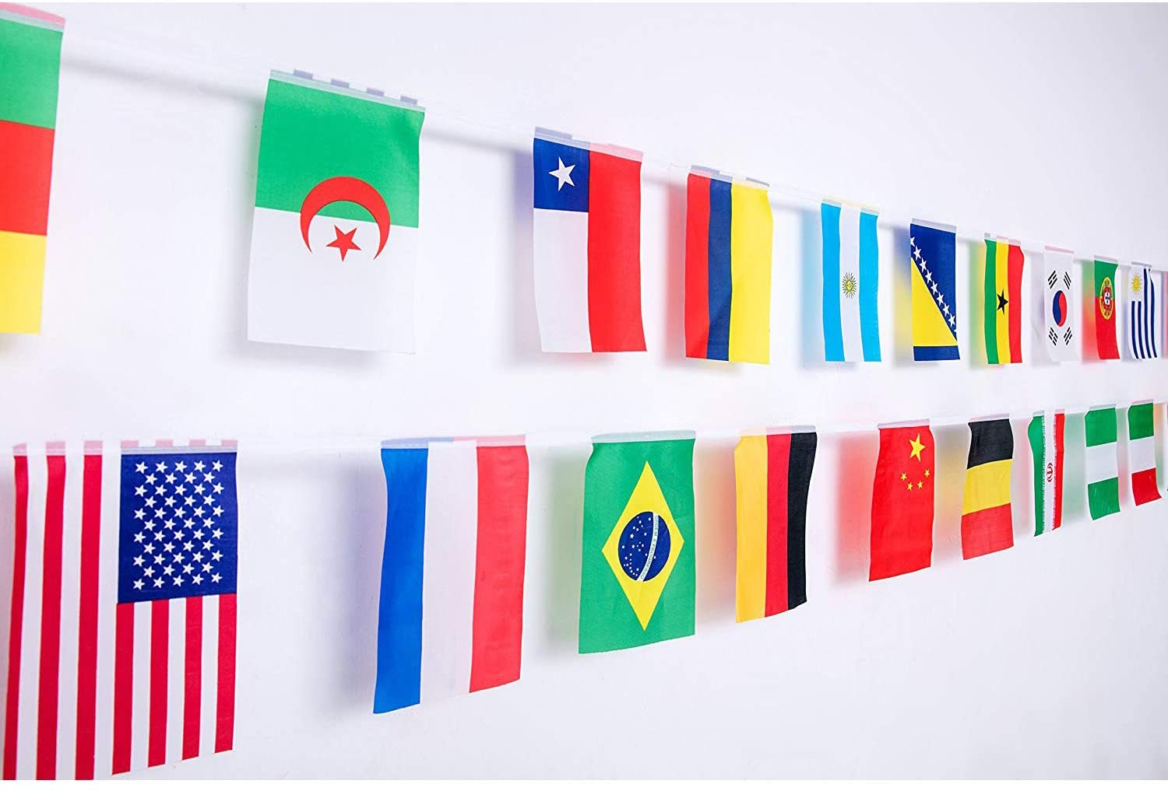
Who are the biggest investors?
China
United States
France
Turkey
UK
Germany
India
Source: World Bank 2022

Slide 5
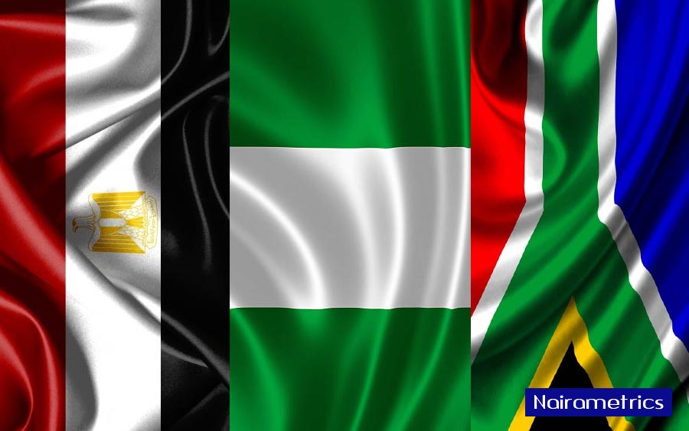
African Countries with the Highest FDI
South Africa
Egypt
Nigeria
Source: World Bank 2022

Slide 6
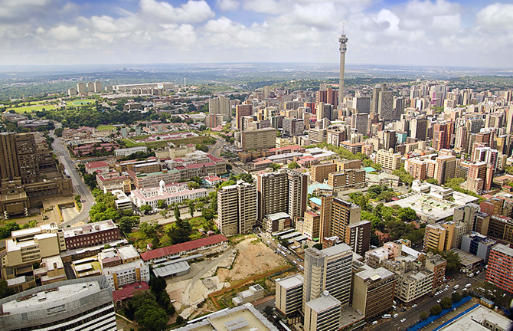
South Africa
Attractiveness
Relatively low tariffs
Best transport infrastructure
Highest performer in trade facilitation logistics
Obstacles
Rigid labor policies
High levels of crime
Poor quality of education
Source: Infrastructure Financing Trends in Africa (2022)

Slide 7
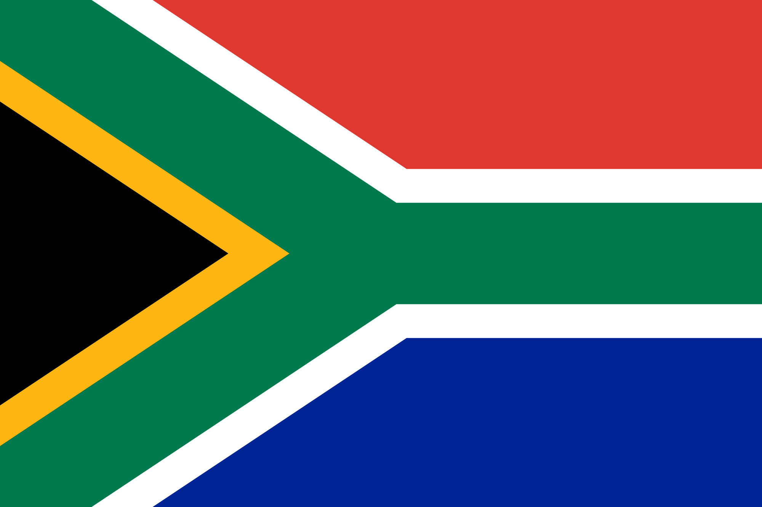
Pre Covid-19 (2015-2020)
How much FDI
Annual funding from 2015-2017 was $7 billion
Plans for infrastructure
National Development Plan
During Covid-19 (2020-present)
How Covid affected infrastructure development
New National Infrastructure Plan
Source: Infrastructure Financing Trends in Africa (2022)

Slide 8
Egypt
Attractiveness
Population - more than 100 million
Preferential access to Europe
Free trade agreements
Macroeconomic reforms - healthy growth trajectory (GOE)
Well-qualified production and low-cost workforce
It is rich in natural resources
Obstacles?
CBE switched from a managed to a free-floating exchange rate
Exchange rate settled
Less volatility - less risk
Source: Egypt emerges as a top FDI destination (2021). Ghoneim H.

Slide 9
Pre-Covid 19 (2013-2020)
2013 - Egyptian pound devalued by 15.9%
Egypt and the EU signed the DCFTA
2014 - investments came up
Egypt - unique Afro-Asian country
Sinai/Suez Canal - Asia and Europe
2014 - China turned into a major investor
2015 - FDI inflows exceeded US$6 billion
Flexible exchange rate regime - fiscal consolidation
2017 - business-friendly investment law
Domestic firms = Foreign firms
Tax deduction for CSR/R&D
Environmental protection, health care, and cultural enrichment
Source: Egypt emerges as a top FDI destination (2021). Ghoneim H.

Slide 10
During Covid-19 (2020-present)
Pandemic – FDI in Africa declined by 16%
Economic and health challenges
Low prices of energy commodities
Cross-border mergers and acquisitions fell by 45% - 2019
International project finance notices dropped by 74%
CBE - more than half of FDI inflows in 2019-2020 were for new businesses or expansion of operations
2020 - USD 5.9 billion of FDIs
Business, financial services, and software
14.5% of the USD 40.5 billion invested in the region
2nd after the UAE in FDIs
2030 goal - generate half of the country’s electricity using renewable sources
Source: Egypt emerges as a top FDI destination (2021). Ghoneim H.

Slide 11
Nigeria
Attractiveness
Africa’s most populous country
Africa's Highest GDP
High agricultural potential
Important hydrocarbon resources
Relatively low public and external debt
Obstacles
Poorly developed transport and energy infrastructure
High operating costs
High tax burden
Oil and gas are 90% of the exports
Source: Effect of Covid19 on the FDI in the Nigerian economy (2021). Ogundipe S.A., Fasola L.O., & Ajayi O.A.

Slide 12
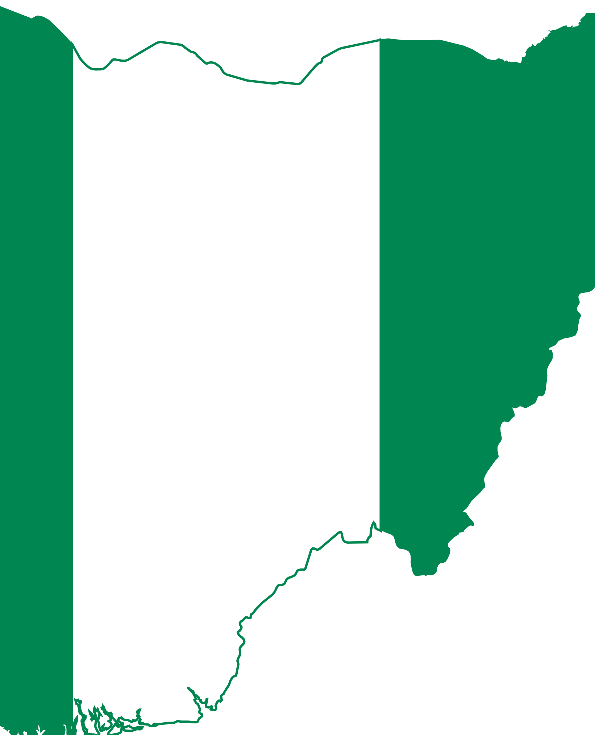
Pre Covid-19 (2015-2020)
How much FDI
Annual funding from 2015-2019 was $14.37 billion
Plans for infrastructure
Nigerian government and the World Bank – Power Sector Recovery Plan (PSRP) USD 1 billion loan.
During Covid-19 (2020-present)
How Covid affected infrastructure development
Bilateral investment conventions signed by Nigeria
Source: Effect of Covid19 on the FDI in the Nigerian economy (2021). Ogundipe S.A., Fasola L.O., & Ajayi O.A.

Slide 13
Government Intervention
Nigerian Investment Promotion Commission Act (NPIC)
Dismantle years of controls and limits on FDI
Allows 100% foreign ownership in all sectors (exception of petroleum)
Tax incentives for foreign and domestic investors
Government sponsored programs to boost FDI:
Agriculture
Exploitation and mining
Oil and gas extraction
Export sector
Source: Effect of Covid19 on the FDI in the Nigerian economy (2021). Ogundipe S.A., Fasola L.O., & Ajayi O.A.

Slide 14
Data Analysis
Foreign Direct Investment
Corruption Perception Index
African Infrastructure Development Index

Slide 15
Source: World Bank 2022

Slide 16
Source: World Bank 2022

Slide 17
Source: World Bank 2022

Slide 18
Where do we see infrastructure development in Africa heading?
Technological Infrastructure
First half of 2021, Sub-Saharan Africa saw over 333 mergers and acquisitions - $51 billion.
More than $2.9 billion has been raised by African tech startups – Nigeria at least 60% of it.
Equinix (world’s digital infrastructure company) acquired MainOne - $320 million. A West African data center present in Nigeria, Ghana, and the Ivory Coast.
Source: Effect of Covid19 on the FDI in the Nigerian economy (2021). Ogundipe S.A., Fasola L.O., & Ajayi O.A.

Slide 19
Where do we see infrastructure development in Africa heading?
Healthcare Infrastructure
COVID-19 uncovered serious gaps in healthcare systems.
Access to clean water and suitable sanitation are only available to half of sub-Saharan health care facilities.
The private sectors within African Healthcare are significantly more popular than public sectors - half of them delivering half of healthcare’s services and products.
Source: International Finance Corporation 2022

Slide 20
United Nations Sustainable Development Goals Goal 9: Build resilient infrastructure, promote inclusive and sustainable industrialization and foster innovation
Discussion
How does the topic relate to issues of public concern or the common good?
What communities might be involved in or affected by the topic? What are the histories, social contexts, assets, and needs of these communities?
What community partners (e.g., public offices, nonprofit organizations, social enterprises, faith-based organizations) could collaborate on your topic for mutual benefit and growth?

Slide 21
Thank you

