Slide 1


Strategies for Promoting Entrepreneurship and Self Employment in West Africa
Current Business Issues
in African Countries
2022
Abou Sy Diakhate, MSW, TS
Programme Management
April 7 – 8, 2022 WWW.CBIAC.NET

Slide 2
Introduction
7 out of the 10 fastest growing economies are African, and throughout the continent there is a need for small businesses and trades.
The African Entrepreneur Mentor Incubator will provide burgeoning entrepreneurs with skill training, mentorship, and guidance on developing resources to build infrastructure and capital.

Slide 3
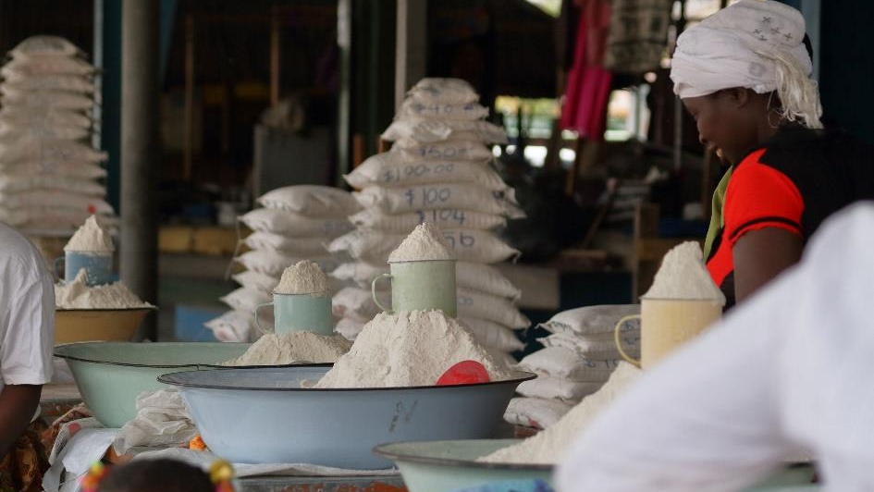

Slide 4
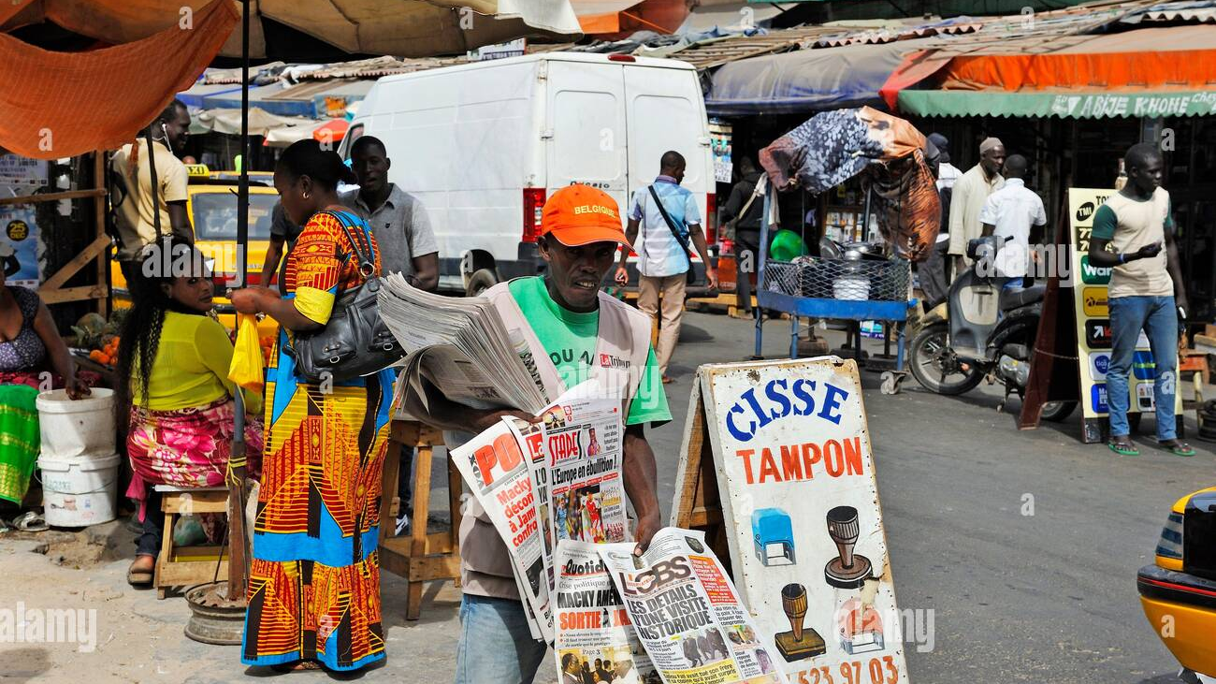

Slide 5
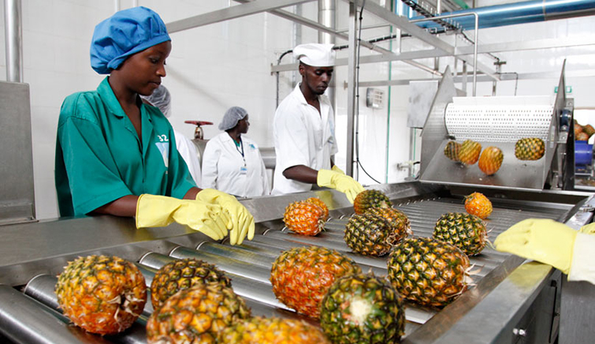

Slide 6
Some Facts
Africa has the world’s youngest population.
According to the African Development Bank, the youth in Africa constitutes about 37 percent of the total labor force but make up about 60 percent of total unemployment.
High unemployment and insufficient income for those who are employed are factors negatively affecting communities throughout Africa.

Slide 7
Mission
Address these unemployment challenges by building a strong coalition of resource builders in Senegal and neighboring West African communities
Build entrepreneurship and enterprise development. Our main objective is to facilitate the creation of self-sustaining work for young Africans both as means of self-employment and as job creation for others through entrepreneurship.

Slide 8
Why is the topic important?
The topic of entrepreneurship and self-employment is critically important and relevant to African communities for the following reasons:
(1) There is a lack of jobs and employment in the job sector in these communities.
(2) There is a lack of sufficient income to meet daily needs such as rent, health care, food security, day care, etc.

Slide 9
Why the topic is important? Con’t
(3) These problems leads to issues such as mental and physical health care crises, and problems such as crime, and academic struggles, due to the stress that children in low-income communities undergo, as well as lack of funding and resources in schools due to low tax income base.

Slide 10
Synergies of employment & entrepreneurship as pathways to the SDGs
GOAL 8: Decent Work And Economic Growth
Sustainable economic growth will require societies to create the conditions that allow people to have quality jobs.

Slide 11
Relevance
My proposal addresses the UNCTAD goal of promoting Sustainable Development Goal (SDG) throughout Africa, involving technology, outcomes on fisheries subsidies, agriculture, artisanal crafting, and water security as well as other sectors throughout Africa.

Slide 12
Target Population
Desired candidates for the African Entrepreneur Incubator are individuals who have been undermined and marginalized in capitalist markets.
The communities involved are low-income communities in Africa. Historically, these communities have suffered due to colonial exploitation for over the 100 years.

Slide 13
Target Population Con’t
Due to colonial exploitation of these communities' resources as well as political corruption, there is a lack of revenues needed to sustain these communities thereby leading to poverty in these communities
Many in these communities need and seek alternative sources of income to meet their economic needs that fall outside of the job sector and traditional employment. A viable alternative is entrepreneurship and self-employment.

Slide 14
Target Population Con’t
Low income in relationship to the cost of living, loss of jobs due to loss of industries, crime especially gang related crime, and declines in the quality of education.

Slide 15
Challenges
Low-income African communities lack access to capital to start businesses due to low income which effects credit rating and access to bank loans.
These communities also lack the infrastructures needed to launch and implement these ventures.
To identify markets which are outside the scope of foreign investors and corporations and require the skills and labor of individuals within these communities.

Slide 16
Challenges Continued
There also needs to be the availability of grants and funds to pay for such training as well as meet the need of implementing these businesses and enterprises.

Slide 17
Strategies
Promoting entrepreneurship culture through active recruiting of resource partners, venture capitalists, government grants, and those undermined and marginalized in the traditional job market.
Entrepreneur and skill-building education including being a solution provider, actualizing a vision, building the right team.

Slide 18
Strategies Con’t
Developing a viable product/service, marketing, building partnerships and capital and preparing for growth
Promoting/providing evidence-based advocacy
Funding and access to financing for young entrepreneurs
Business development services

Slide 19
Considering Gender
Young people are also gendered. Thus, women may perceive and experience entrepreneurship opportunities differently than men.
The World Development Report (2013) identifies that many more women than men are in non-wage work in low- and lower-middle income countries. Many women in developing countries are juggling childcare, household and farming commitments; leaving little time or flexibility for starting a new venture.

Slide 20
Conclusions and Next steps
Within African communities there is a need for businesses and entrepreneurial ventures to bring in revenue and income that leads to better educational and health and social services, due to the creation of jobs by these entrepreneurs and businesses started by them. It is important for these businesses and entrepreneurial ventures to be created by individuals from our communities so that the wealth generated benefits the local communities and leads to their development.

Slide 21
References
www.un.org/sustainabledevelopment/sustainable-development-goals/ accessed 23 June 2019
www.worldbank.org/en/news/press-release/2012/10/01/jobs-cornerstone-development-says-world- development-report
See also Kauffman Compilation: Research on Gender and Entrepreneurship 2016. https://www.kauffman.org/- /media/kauffman_org/resources/2016/gender_compilation_83016.pdf
www.afdb.org/fileadmin/uploads/afdb/Documents/Generic-Documents/Ministerial_Conferences_Report_En.pdf

Slide 22

Questions & Discussion

