Slide 1


Monetary Policy and Current Account Balances in Nigeria (1981-2020)
Current Business Issues
in African Countries
2022
Mustapha-Jaji Olaide Kafayat
Ph.D. Student, Department of Economics, Nile University, Abuja, Nigeria.
Nargiza Alymkulova, Ph.D.
Department of Economics, Nile University, Abuja, Nigeria.
April 7 – 8, 2022 WWW.CBIAC.NET

Slide 2
1. Introduction
The Nigerian economy has been characterized by excessive imports of consumables and production inputs, unstable oil prices, weak non-oil export structures, and a fragile financial system to boost foreign capital inflows. These factors have created current account imbalances.
The need to address the problem of current account imbalance has solicited the implementation of monetary policy instruments, which have been noted as an indispensable toolkit in ensuring the competitiveness of an economy and in reducing the deficit in current account balance disequilibrium.

Slide 3
1. Introduction: Cont.
Literature has identified adjustment in domestic interest rate as an incentive for increasing domestic investment and capital inflows into the domestic economy, which can reduce the deficit in the current account balance.
More so, the domestic currency (Naira (₦)) has been devalued at different occasions, and interest rate and domestic money supply have equally experienced adjustments in the pasts in Nigeria.
However, the extent to which these measures have influenced the current account balances have remained unresolved, due to the under-representation of this issue among indigenous studies in Nigeria.

Slide 4
1.2 Research Objectives
Main Objective
The main objective of this study is to examine the relationship between current account balances and monetary policy in Nigeria.
Specific Objectives
a. To appraise current account balance positions and monetary policy development in Nigeria during the period 1981-2020.
b. To analyze the impact of monetary policy on current account balances in Nigeria over the period of 1981 to 2020.

Slide 5
2. Theoretical Framework and Model Specification
Theoretical Framework
This study rest on the monetary and elasticity approaches to the balance of payment position. The monetary approach emphasis the importance of monetary policy instrument such as money supply as a key driver of balance of payment while the elasticity approach emphasis the importance of exchange rate in explaining the current account balances.
  Model Specification
  This study employed the auto-regressive distributed lag (ARDL) estimation method. The ARDL helps to examine both the long run and short run relationship between economic variables. Thus, in line with the ARDL method, the long run model is specified as:

Slide 6
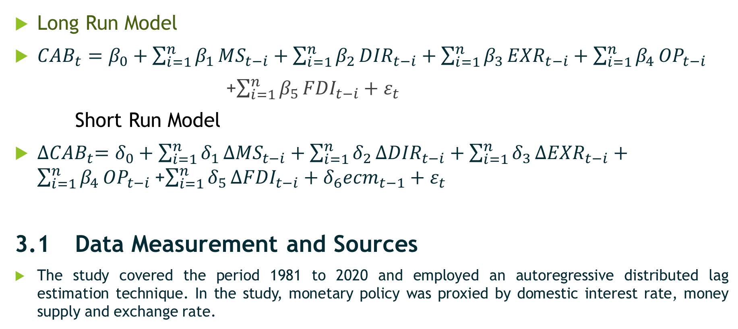
3. Model Specification: Cont.
Long Run Model
${CAB}_{t}=β_{0}+\sum_{i=1}^{n}{β_{1}}{MS}_{t−i}+\sum_{i=1}^{n}{β_{2}}{DIR}_{t−i}+\sum_{i=1}^{n}{β_{3}}{EXR}_{t−i}+\sum_{i=1}^{n}{β_{4}}{OP}_{t−i}$
    +$\sum_{i=1}^{n}{β_{5}}{FDI}_{t−i}+ε_{t}$
    Short Run Model
${∆CAB}_{t}=δ_{0}+\sum_{i=1}^{n}{δ_{1}}{∆MS}_{t−i}+\sum_{i=1}^{n}{δ_{2}}{∆DIR}_{t−i}+\sum_{i=1}^{n}{δ_{3}}{∆EXR}_{t−i}+\sum_{i=1}^{n}{β_{4}}{OP}_{t−i}$+$\sum_{i=1}^{n}{δ_{5}}{∆FDI}_{t−i}+δ_{6}{ecm}_{t−1}+ε_{t}$
3.1 Data Measurement and Sources
The study covered the period 1981 to 2020 and employed an autoregressive distributed lag estimation technique. In the study, monetary policy was proxied by domestic interest rate, money supply and exchange rate.

Slide 7
4. Stylized Facts on Current Account Balances and Monetary Policy
4.1 Current Account Balances (CAB) in Nigeria 1981-2020
As noted in Figure 1, the Nigerian economy experienced high surplus in the current account balances in 2005 estimated at ₦4,698.05b while the worst deficit in the current account balances was witnessed in 2020 with an estimated value of ₦-3,346.51b in 2020 due largely the impact of the current ravaging global health pandemic.
Figure 1. Current Account Balances in Nigeria

Slide 8
4.2 Stylized Facts on Monetary Policy
Monetary policy development has majorly operated under two distinct regimes in Nigeria –
A. REGULATED REGIMES (pre 1986):
During the regulated regime, monetary policy variables such as the domestic interest rate and exchange rate were fixed by the monetary authority.
B. DEREGULATED REGIME (1986 to date).
During the deregulated regime, monetary policy variables are relatively determined by market forces, and the monetary sector experienced significant changes which are:
Reduction in maximum credit ceilings on banks in 1986;
Devaluation of the Domestic currency (₦)
Increase in commercial bank capital base to ₦25b in 2005;
Reduction in the number of commercial bank from 89 to 25 banks in 2005.
Introduction of the Monetary Policy Rate (MPR) as a replacement for the Minimum Rediscounted Rate (MRR)

Slide 9
4.2 Stylized Facts on Monetary Policy in Nigeria (1981-2020)

Slide 10
4.3 Regression Estimate and Discussion
In the long run, the study observed that monetary policy (measured by money supply (LMS) and domestic interest rate (DIR)) had insignificant impact on current account balances, indicating that the changes in money supply and domestic interest rate during the study period had insignificant influence on current account balances in Nigeria. This result is in contrast with the findings of Oshota and Badejo (2015) and Danmola and Olateju (2013).
More so, the long run estimate showed that monetary policy (measured by exchange rate (LEXT)) had positive and significant impact on current account balances in Nigeria. The significance of the exchange rate can the attributed to the rising depreciation of the domestic currency resulting from the escalating importation of both households and manufacturing inputs in Nigeria. The result is in line with Iyeli and Ovat (2017) but in contrast to Olanipekun and Ogunsola (2017) and Nwanosike et al. (2017).
In the short run, the results showed that the first lagged value of money supply (∆LMS(-1)) and current values of domestic interest rate (∆DIR), and exchange rate (∆LEXT) had insignificant impact on current account balances in the short run.

Slide 11
Regression Estimate
Regressors | Estimated Co-efficient | Standard Error | t-Statistics | Prob.
LONG RUN REGRESSION ESTIMATE
C | -0.01065 | 0.06278 | -0.16961 | 0.8666
LMS | -0.01738 | 0.01015 | -1.71291 | 0.0986
DIR | -0.01227 | 0.01495 | -0.82036 | 0.4195
OP | 0.00072 | 0.00032 | 2.26697** | 0.0319
LFDI | 0.01634 | 0.00438 | 3.73158* | 0.0007
LEXT | 0.01891 | 0.00628 | 3.00921* | 0.0048
SHORT RUN REGRESSION ESTIMATE
ECM(-1) | -0.81247 | 0.19887 | -4.08542* | 0.0004
∆(CAB(-1)) | 0.46434 | 0.17794 | 2.60941* | 0.0148
∆(LMS(-1)) | -0.05053 | 0.03887 | -1.30004 | 0.2050
∆(DIR) | -0.00316 | 0.00156 | -2.03340 | 0.0523
∆(OP) | 0.00058 | 0.00029 | 2.03751 | 0.0519
∆(LFDI) | 0.02219 | 0.00903 | 2.45801** | 0.0210
∆(LEXT) | 0.00997 | 0.01162 | 0.85711 | 0.3992

Slide 12
5. Conclusions
This study examined the relationship between monetary policy and current account balance in Nigeria for the period spanning 1981 to 2020. drawing from the findings of the study, the study concluded that the impact of monetary policy on current account balance depends on the measures of monetary policy employed. Consequently, Policy must be designed to strengthen macroeconomic shock absorbers in the country.
More so, demand management policies should be encouraged to enhance the performance of the real sector of the economy that would encourage capital inflows. As it would contribute to the inflow of more foreign exchange into the economy and also reduce the negative pressure on the current account balance position in Nigeria. More so, there is the need for appropriate devaluation of the domestic currency by the monetary authority in order to promote exports of locally produced commodities while at the same time discouraging imports of consumables with indigenous substitutes.

Slide 13
THANKS
FOR
LISTENING

