Slide 1
Evolution and dynamic of multidimensional poverty in times of crisis: the case of Morocco
4th Current Business Issues
in African Countries
2023
Hassan REHAIMI
Research Professor in Economics
FLESS Ait Melloul, Ibn Zohr University
Mohamed IMLOUI
PhD student in economics at LSREM
FLESS Ait Melloul, Ibn Zohr University
April 27 – 28, 2023 WWW.CBIAC.NET

Slide 2
Plan
1
2
5
3
4
Context & interest of the research
Problematic & Objectives of the research.
conceptual & Theoretical framework
Methodology adopted
Evolution of poverty in Morocco: An overview
6
Impacts of Covid-19 on multidimensional poverty in Morocco
Conclusion
7

Slide 3
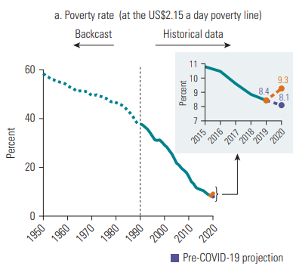
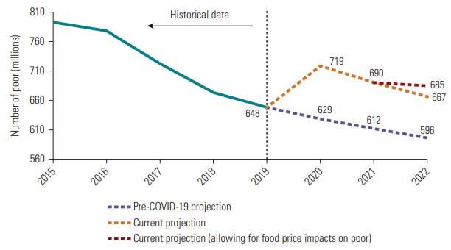
Context and interest of the research
Global context
The COVID-19 has triggered a historic shock to global poverty
Sanchez Paramo (2020), the crisis of Covid-19 was one of the worst in terms of potential social and economic impact.
World Bank (2020), projected that Covid-19 would push between 71 and 100 million people into extreme poverty, after 4 months into the pandemic.
Source: WBG, POVERTY AND SHARED PROSPERITY 2022
Notes:
1: Today, The economics of poverty has became a major issue, and poverty continues to be a serious challenge in many countries around the world.
2: the impact of COVID-19, and the conflict Russia-Ukraine, has pushed millions more people fall into poverty around the world.
3: The poverty rate increased from 8.4% in 2019, to about 9.3% in 2020 and that generates more than 700 million people live in extreme poverty.
3. in 2022, at least 667 million people were predicted to be living in poverty. In the worst-case scenario, up to 685 million people might be living in poverty

Slide 4
Context and interest of the research
Moroccan context
Poverty and vulnerability rates (%) before, during the Covid-19
The COVID-19 pandemic has hit the Moroccan economy hard, as elsewhere in the world.
According to HCP data, about 3.2 million more people have fallen into poverty or vulnerability :
Poverty (1.15 million)
Vulnerability (2.05 million).
before the pandemic, 2019 | pandemic period, 2021 | before the pandemic, 2019 | pandemic period, 2021
poverty rate |  | vulnerability rate
Source: HCP, National Survey of Income Sources 2019, 3rd Household Panel 2021/2022
Notes:
The Moroccan economy has been affected by supply shocks.
2: at the national level, the poverty rate increased from 1.7% in 2019 to 3% in 2021, from 3.9% to 6.8% in rural areas and from 0.5% to 1% in urban area.

Slide 5
Context and interest of the research
A. Touhami (1999). Poverty has always existed in various forms in Morocco like in every country in the world. Yet, for various reasons and for a long time, even while recognized
Amartya Sen (Noble Prize 1998), Ravallion, and Rawls, have traced a path that will allow us to better define the subject of poverty.
Alkire & Santos (2013), Poverty has probably always been understood as a multidimensional problem, yet traditionally it has been measured with one dimension income.
Bourguignon and Chakravarty (2003), Atkinson (2003) and Alkire and Foster (2007), all argue that poverty is multidimensional and should be measured in the multidimensional perspective.

Slide 6
Context and interest of the research
Interest of the study
Is to focus on the evolution of multidimensional poverty in Morocco in times of crises

Slide 7
2. Problematic & Objectives of the research
Problematic of the study
How can we describe the effects of the COVID-19 (coronavirus) pandemic on multidimensional poverty in Morocco ?

Slide 8
2. Problematic & Objectives of the research
Work objectives
Impacts of Covid-19 on poverty in Morocco and the measures implemented to reduce poverty
To contribute to the clarification of the concept of poverty and its approaches.
The diagnosis and the situation of poverty evolution in Morocco through multidimensional approach

Slide 9
3. conceptual & Theoretical framework
Rowntree (1901),
was the first to propose the definition of a minimum consumption level, in his first study of the poor living in York in 1899. Lollivier, S. (2008).
Sen, (1985). “poverty is not just a lack of income or material possessions, but a lack of the capability to live a fulfilling life”.
M. Ravallion (1994).
poverty as the inability to attain a particular standard of living, which is often measured by a poverty line.
Peter towsend (1979).
‘’Poverty in the United Kingdom” Poverty is defined objectively and applied consistently. The term is understood objectively rather than subjectively. Vogel, L. H. (1982).
Rawls (1970), et Streeten et al. (1981).
‘’Poverty is defined as the lack of achievement of a group in meeting certain basic needs’’.

Slide 10
3. conceptual & Theoretical framework
The monetary approach
The non-monetary approach
A welfarist approach based on neo-classical economics
Ravallion, (1994), takes a mostly unidimensional view of poverty based on well-being.
For the welfarist, «something» means economic well-being.
There are two main types of non-monetary approaches:
The capability approach: Developed by Amartya Sen
The Basic needs approach: “something” refers to a set of essential goods and services (food, water, education, health services
Notes:
In the theoretical literature there are two approaches about the concept of poverty
This approach takes into account multiple dimensions of well-being

Slide 11
4. Methodology adopted
As follow-up to these observations, we have envisaged a methodological reflection which is based on a descriptive analysis, in order to respond to the problem raised.
This study is based on data collected from HCP (from the National Survey on Household Consumption and Expenditure and the General Census of Population and Housing) and the World Bank are used in this research.

Slide 12
5. Evolution of poverty : An overview
1: Evolution of poverty in Morocco before Covid-19 : Some Benchmarks
Evolution of the poverty rate by area of residence (1959-2001)
The poverty rate by area of residence (in %) before Covid-19 in Morocco (2001-2014).
 | 1959-1960 |  | 1971 |  | 1984-1985 |  | 2000-2001
Area | Headcount | % | Headcount | % | Headcount | % | Headcount | %
Urban | 1750 | 43.8 | 2072 | 38.3 | 1300 | 13.8 | 1560 | 9.6
Rural | 3995 | 60.0 | 4457 | 44.7 | 3300 | 26.7 | 3622 | 28.2
National | 5745 | 55.7 | 6529 | 42.4 | 4600 | 21.0 | 5182 | 17.8
Source: HCP, 2017. Poverty and shared prosperity in Morocco in the third millennium, 2001 /2014
Notes:
As you see in this table, it show us a significant decrease at the national poverty from 55.7% in 1959 to about 17.8 in 2000.
In urban areas, the poverty rate decreased from 43.8% in 1959 to 38.3% in 1971 and then to 17.8% in 2000.
As for rural poverty, it also recorded a significant decline from 60.0% in 1959 to 28.2 % in 1971.
2:
At the national level, the incidence of poverty decreased from 15.3% in 2001 to 8.9% in 2007 and 4.8% in 2014. In terms of urban areas, the incidence of poverty decreased from 7.6% to 4.9% and 1.6%, and from 25.1% to 14.4% and 9.5% in rural areas,

Slide 13
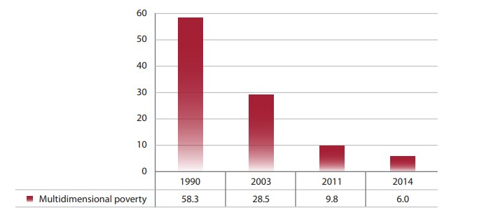
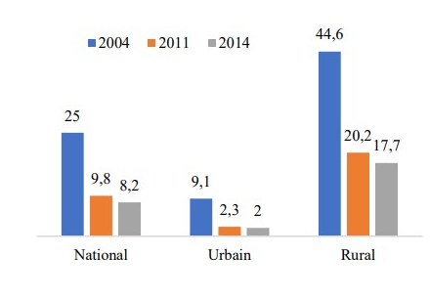
5. Evolution of poverty : An overview
2: Trend of Multidimensional Poverty in Morocco before Covid-19
Evolution of the poverty rate by area of residence(1990-2014)
The incidence of multidimensional poverty (%) before Covid-19
Source: HCP, 2015. « Morocco between Millennium Development Goals and Sustainable Development Goals Achievements and Challenge ».
Source: HCP - GCPH 2014 and 2004, and National Anthropometric Survey 2011.
Notes:
The trend of multidimensional poverty in (%) in Morocco has significantly decreased over the years, dropped from 58.3% in 1990 to 6 % in 2014.

Slide 14
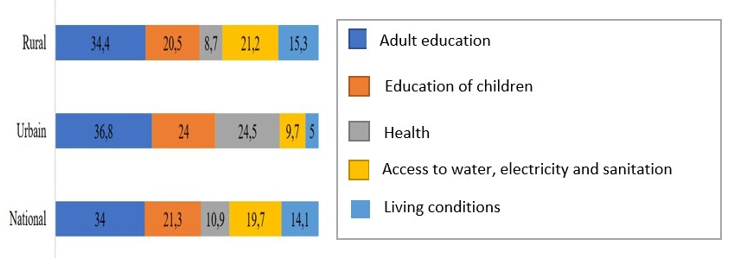
5. Evolution of poverty : An overview
2: Trend of Multidimensional Poverty in Morocco before Covid-19
The decomposition of multidimensional poverty by the source of deprivation (%) in 2014
Source: HCP - GCPH 2014 and 2004, and National Anthropometric Survey 2011.
Notes:
This Figure shows the poverty decomposition by source of deprivation in 2014. The poverty decomposition by source of deprivation in 2014 shows that adult education alone accounts for 34% of national poverty, while non-enrollment of children accounts for 21.3%. Access to basic social infrastructure accounts for 19.7%, while housing and health-related deprivations account for 14.1% and 10.9%.

Slide 15
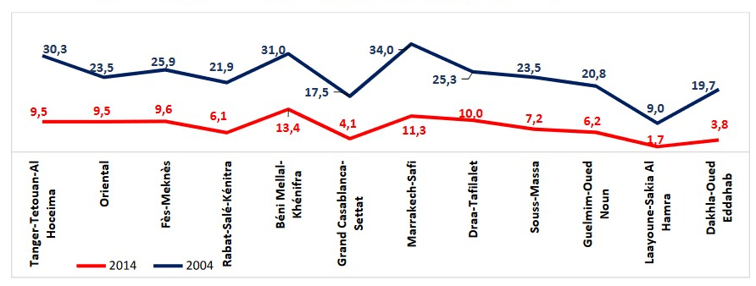
5. Evolution of poverty : An overview
2: Trend of Multidimensional Poverty in Morocco before Covid-19
Situation of multidimensional poverty at the regional level 2004-2014
Source: HCP - GCPH 2014 and 2004, and National Anthropometric Survey 2011.
Notes:
At the regional level, poverty incidence also declined across all regions of the country
The poorest regions in 2004 experienced the greatest decline in poverty, namely Marrakech-Safi (from 34.0% to 11.3%), Tangier-Tétouan-Al Hoceima (from 30.3% to 9.5%), and Béni Mellal-Khénifra (from 31.0% to 13.4%).

Slide 16
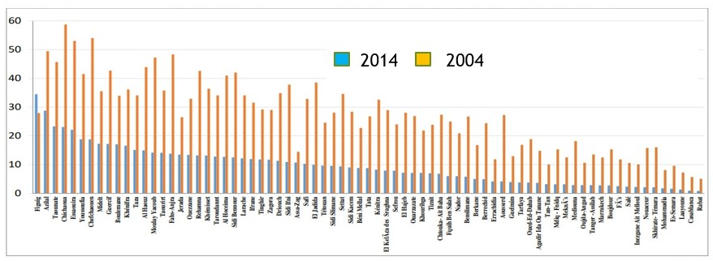
5. Evolution of poverty : An overview
2: Trend of Multidimensional Poverty in Morocco before Covid-19
Situation of multidimensional poverty at the provincial level 2004-2014
Source: HCP - GCPH 2014 and 2004, and National Anthropometric Survey 2011.
Notes:
During this period, the incidence of multidimensional poverty decreased in all provinces except for Figuig province, where the poverty rate increased from 28% in 2004 to 34.5% in 2014.

Slide 17
6. Impacts of Covid-19 on multidimensional poverty in Morocco
Impacts of the Covid-19 pandemic on poverty in Morocco
COVID-19 Impacts on Global Poverty in 2020
Label region | sector | Variable Poverty headcount ratio at $1.90 a day (2011)
World | Economy-wide | 19.81
 | Rural population | 14.95
 | Urban population | 34.74
Africa | Economy-wide | 22.89
 | Rural population | 14.68
 | Urban population | 41.45
Morocco | Economy-wide | 8.51
 | Rural population | 8.62
 | Urban population | 8.43
Source: IFPRI, MIRAGRODEP Simulations, Laborde, Martin and Vos (2020)
Note: Changes are computed compared to the estimates for 2020 before the Covid-19 disruption
Notes:
, in this table it appears that an increase of 8.51% could push 30,000 people into extreme poverty in Morocco.

Slide 18
6. Impacts of Covid-19 on multidimensional poverty in Morocco
1: Economic impact
In terms of GDP, The three Moroccan organizations have revised their forecasts for the country's economic growth from 3.8% to 2.3% for the (BAM), 3.5% to 2.2% for the (HCP), and 4.5% to 0.8% for the (CMC). (Touhami Abdelkhalek et al., 2022)
The most affected sectors are tourism, followed by the transport sector, construction and manufacturing. (Haut-Commissariat au Plan (2020)
The HCP estimates that 20%, or approximately 726,000 jobs, have been lost, mostly (57%) in very small, small, and medium-sized enterprises due to Covid-19, and that lead to an increase in poverty rates. (HCP, 2020)
The HPC (2022), has released data for the month of March, indicating that the CPI increased by 0.4% and it also notes a 1.5% increase in CPI over 12 months.
Notes:
Centre Marocain de Conjoncture

Slide 19
6. Impacts of Covid-19 on multidimensional poverty in Morocco
The HCP, approximately 3.2 million more people have fallen into poverty (1.15 million) or vulnerability (2.05 million) as a result of the combined effects of the Covid-19 pandemic and inflation. As of 2022, Morocco has returned to the poverty and vulnerability levels seen in 2014.
The HCP report titled "Evolution of social inequalities in a context marked by the effects of Covid-19 and rising prices" states that almost 45% of the increase in poverty and vulnerability is attributable to the pandemic, while the remaining 55% is due to rising consumer prices.
According to a HCP survey (2020), over 41% of Moroccan households have seen a decrease in their income because of the pandemic, with 14 % reporting difficulty in obtaining enough food for their family.
2: On poverty

Slide 20
6. Impacts of Covid-19 on multidimensional poverty in Morocco
2: On poverty
HCP (2020) in the early stages of the pandemic that 30,000 people could fall into poverty in Morocco, an increase of 8.5%.
In Morocco, the Covid-19 pandemic has exacerbated multidimensional poverty, affecting the most vulnerable households, approximately 8.9 million people, which accounts for 26.2% of the population affected by multidimensional poverty in Morocco. (HCP, 2020)
The HCP, over 2.6 million people will be living below the multidimensional poverty line by 2020, accounting for approximately 7.2% of the Moroccan population. (HCP, 2020)

Slide 21
7. Conclusion
COVID-19, conflict, and climate change have an impact on poverty in Morocco and that generates a higher rate and millions of Moroccan people are once again pushed into poverty, aapproximately 3.2 million people have fallen into poverty (1.15 million) or vulnerability (2.05 million).
the national rate of multi-dimensional poverty in Morocco, has significant decreased over the last years, dropped from 25.0% to 8.2%.
The Multidimensional poverty remains primarily a rural phenomenon: in 2014, 85.4% of poor people lived in rural areas compared to 80.0% in 2004
Poverty is predominantly a rural phenomenon, with 85.4% of the population living in multidimensional poverty in rural areas, while urban poverty incidence is statistically insignificant.
Multidimensional poverty is characterized by education deficits account for 34% of national poverty, while non-enrollment of children accounts for 21.3%. Access to basic social infrastructure, housing and health-related deprivations account for 19.7%, 14.1% and 10.9% respectively.
Although several social development programs and strategies have been adopted by the government, the issue of poverty remains a serious challenge to economic growth.

Slide 22
Bibliography
Touhami Abdelkhalek, Dorothée Boccanfuso, & , Luc Savard. (2022). Impact of the Covid-19 Pandemic on Monetary Child Poverty in Morocco. International Journal of Micro-simulation, 15(3). https://doi.org/10.34196/IJM.00268
Alkire, S., & Santos, M. E. (2013). A Multidimensional Approach : Poverty Measurement & Beyond. Social Indicators Research, 112(2), 239‑257. https://doi.org/10.1007/s11205-013-0257-3
Atkinson, A. B. (2003). Multidimensional deprivation : Contrasting social welfare and counting approaches.
Bouhadi, E. (2012). THE MULTIDIMENSIONAL APPROACH TO POVERTY MEASUREMENT: CASE OF MOROCCO. 12.
Dinia, M., & Bouslihim, M. (2020). Problématique de la pauvreté au Maroc : Quelle approche ? Problematic of poverty in morocco : What approach? 3.
HCP, e. l. (2017). la pauvreté et la prospérité partagée au Maroc du troisième millénaire, 2001 - 2014. Rabat
Haut-Commissariat au Plan. 2020c. Enquête Sur l’impact Du Coronavirus Sur La Situation Économique, Sociale et Psychologique Des Ménages. Note de synthèse

Slide 23
Bibliography
9. Haddad EA, El Aynaoui K, Ali AA, Arbouch M, Araujo IF. 2020. The Impact Of Covid-19 In Morocco: Macroeconomic, Sectoral And Regional Effects, Policy Center for the New South. [Research Paper 20-17, Rabat].
10. Haddad, E. A., Araújo, I. F., Zineb Sijelmassi-Idrissi, Ihezagire, C., & Youness El-Bouazzaoui. (2020). MULTIDIMENSIONAL POVERTY IN MOROCCO : AN EXPLORATORY SPATIAL APPROACH. https://doi.org/10.13140/RG.2.2.36102.40000
11. Ravallion, M. (1994). Measuring Social Welfare With and Without Poverty Lines. The American Economic Review, 84(2), 359‑364.
12. Sen, A. (1992). Inequality Reexamined. The Journal of Philosophy, 92(5), 275‑288. https://doi.org/10.2307/2940919
13. Touhami, A. (1999). La pauvreté au Maroc : une approche basée sur la satisfaction des besoins de base, dans « Pauvreté, satisfaction des besoins essentiels et variables démographiques au Maroc ». Rabat: Série Études de l’INSEA,.
14. Townsend, P. (1962). The Meaning of Poverty. The British Journal of Sociology, 13(3), 210‑227. https://doi.org/10.2307/587266
15. World Bank. (2022). Poverty and Shared Prosperity 2022 : Correcting Course. The World Bank. https://doi.org/10.1596/978-1-4648-1893-6

