Slide 1
The role of financial technology in advancing financial inclusion for SMEs in Morocco
^{6th} Current Business Issues
in African Countries
2025
Bakki Hind
Adaskou Mohamed
Boutbhirt Naima
Research Laboratory in Entrepreneurship, Finance, and Organizational Management (LAREFMO), Ibn Zohr University, Agadir,Morocco
April 28-29, 2025 WWW.CBIAC.NET

Slide 2
01
02
03
04
05
Introduction
Literature review
Research Methodology
Data Analysis and Research Findings
Conclusion

Slide 3
Introduction
(Kim, Park, Choi, and Yeon ,2015) define FinTech as an innovative service that delivers differentiated financial solutions by integrating new technologies such as mobile platforms and social media.
Limited access to traditional financial services is a major obstacle to economic growth and the development of small and medium-sized enterprises (SMEs).
Despite efforts by the authorities, a significant portion of the population and SMEs still encounter difficulties in accessing financing.
It is in this context that FinTech emerges as a catalyst for improving financial inclusion.

Slide 4
Fintechs
According to the definitions of the FSB and BCBS, FinTech encompasses technology-driven financial innovations.
Online banking represents a major revolution in expanding access to financial services., M-banking represents a new stage in delivering financial services to financially excluded populations. Fall and Birba (2019)
M-Payment is a type of financial process, either private or commercial, in which an electronic mobile communication device is used to initiate, authorize, and complete a financial transaction.(Luna ,2017)
Online banking
Mobile payment
Mobile payment and online banking are essential components of FinTech services.

Slide 5
Financial inclusion
(The Central Bank of West African States,2019) defines financial inclusion as "permanent access to a diversified range of financial products and services that are tailored, affordable, and effectively utilized (both efficiently and effectively) ".
financial inclusion refers to the provision of financial services to commercial and retail customers who are excluded from the traditional system, ensuring accessibility and affordability. (Singh and Roy ,2015)
Financial inclusion includes three key dimensions: access (financial supply), usage (effective demand), and affordability (cost efficiency).

Slide 6
How does FinTech enhance SME financial inclusion in Morocco?

Slide 7
Research Hypotheses
H1: The use of online banking by SMEs improves access to financial services.
H2: The use of mobile payments enhances the financial management of SMEs.

Slide 8
Literature review
Online banking offers numerous advantages to SMEs. Many transactions that were previously conducted in branches can now be carried out online at a lower cost. This includes information requests (account balance inquiries), transfers, recurring payments, and foreign exchange transactions (buying and selling). The main advantage of online banking is that bank accounts can be managed directly by the business owner or financial managers of SMEs ( Akter, 2009).
Nyaga (2013) in his research on "The Impact of Mobile Money Services on the Performance of Small and Medium Enterprises in an Urban City in Kenya," the study revealed that mobile money has made a significant contribution to the SME sector. The majority of traders rely on these services rather than the formal banking sector for their daily transactions.
Asif, Khan, Tiwari, Wani, and Alam (2023) analyzed the impact of FinTech and digital financial services on financial inclusion in India using regressions and data from the Reserve Bank of India (RBI). Their findings show that FinTech has significantly contributed to financial inclusion, particularly for the middle class and SMEs.

Slide 9
Methodology research
Quantitative research
Target population
Questionnaire administred via google forms .
Data was collected over a one-month period
The Likert scale and categorical questions were used to collect data.
Contingency tables were used to analyze the relationship between qualitative variables.
Chi-square tests were applied to assess the statistical significance of these associations.
Moroccan SMEs
Tool
SPSS version 25
45 respondants , 75% of whom are from the Souss-Massa region .
Simple Size

Slide 10
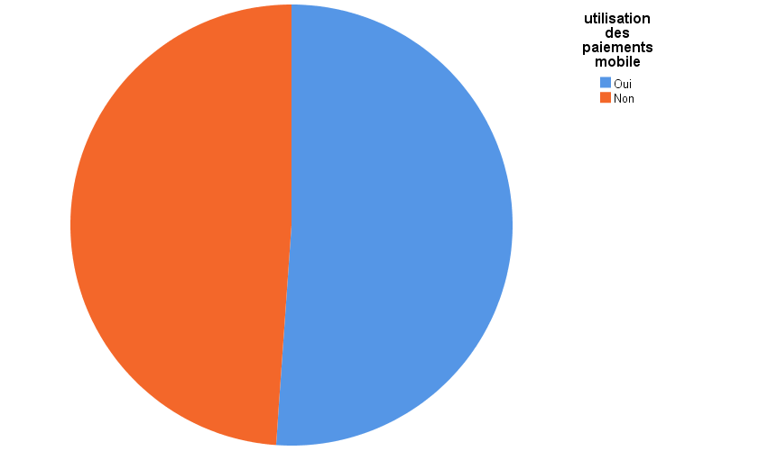
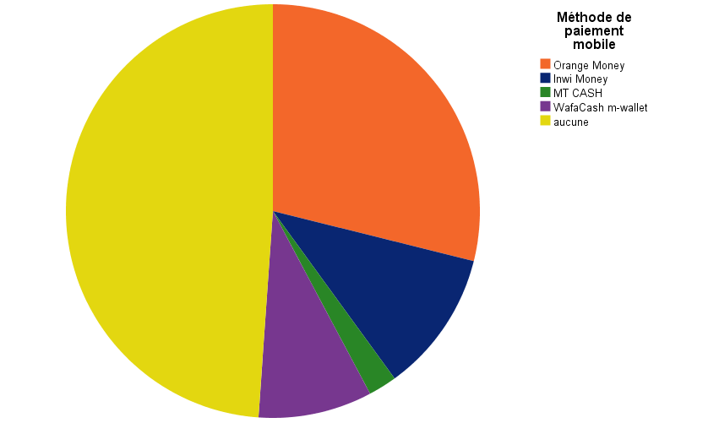
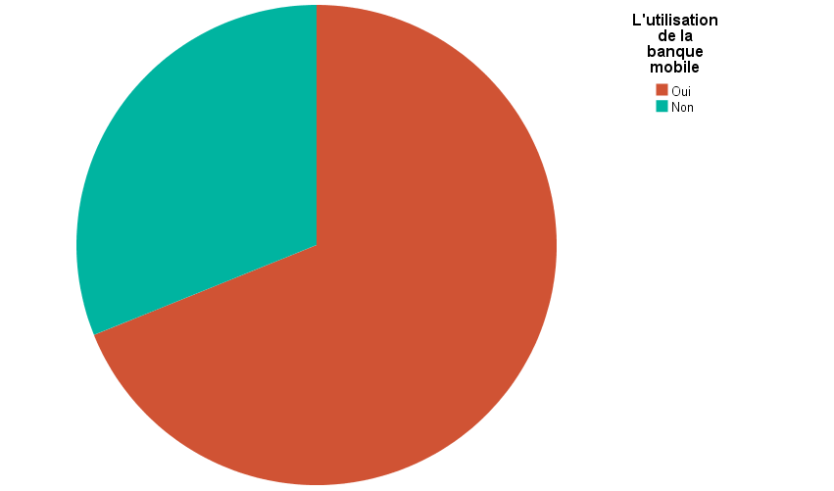
Figure 1 :The proportion of SMEs using mobile payment
Figure 2 :The form of mobile payment used
Source: Author
Source: Author
Figure 3:The proportion of SMEs using Online banking
Source: Author

Slide 11
Summary of Likert Scale Responses:
Questions | Disagree | Neutral | Agree | Strongly Agree
Do you use mobile payment for paying bills and taxes? | 20% | 30.33% | 40.2% | 9.47%
Do you prefer receiving your salary via mobile payment instead of bank transfer? | 73.3% | 15% | 11.7%
Does Online banking improve fund security? | 50% | 15.7% | 34.3%
is online banking convenient in terms of time and cost? | 20% | 20% | 60%
Do you find online banking solutions reliable and secure? | 32% | 15.6% | 48% | 4.4%
Are mobile payment services more accessible than traditional banking ? | 8.9% | 32.9% | 52% | 6.2%
Does mobile payment improve cash flow management and financial planning? | 20% | 17.8% | 52% | 10.2%
is Mobile payment convenient in terms of time and cost | 13.4% | 28.9% | 52% | 5.7%
Source: Author

Slide 12
Cross-tabulation 1: The adoption of Online banking* Level of Improvement in Access to Financial Services
 |  | The level of improvement in access to financial services |  | Total
 |  | strong | Mean
The adoption of Online banking | yes | 24 | 5 | 29
 | No | 4 | 12 | 16
Total |  | 28 | 17 | 45
Source: Author
Chi-Square Tests 1:
Chi-Square test
 | Value | ddl | Asymptotic Significance
Pearson's Chi-Square | 14,634ª | 1 | ,000
Likelihood Ratio | 15,010 | 1 | ,000
Number of Valid Observations | 45
H0: There is no association between the use of online banking and the level of improvement in SMEs' access to financial services | Rejected
H1.1: There is an association between the use of online banking and the level of improvement in SMEs' access to financial services. | Accepted
Source: Author

Slide 13
Cross-tabulation 2:The adoption of Mobile Payments * Perceived Improvement in Financial Management of Operating Costs by SMEs
 |  | Perceived improvement in the financial management of your SME |  | Total
 |  | Strong | Mean
The adoption of mobile Payments | yes | 23 | 3 | 26
 | No | 8 | 11 | 19
Total |  | 31 | 14 | 45
Source: Author
Chi-Square Tests 2:
Chi-Square Test
 | Value | ddl | Asymptotic Significance
Pearson's Chi-Square | 11,007ª | 1 | ,001
Likelihood Ratio | 11,338 | 1 | ,001
Number of Valid Observations | 45
H0: There is no association between SMEs' use of mobile payments and the improvement of their financial management of operating costs. | Rejected
H1.2: There is an association between SMEs' use of mobile payments and the improvement of their financial management of operating costs. | Accepted
Source: Author

Slide 14
Discussion
Mobile payment adoption remains moderate, with higher trust in online banking for time and cost efficiency rather than fund security.
Salary payments via mobile remain unpopular, likely due to preference for traditional banking methods.
Accessibility of mobile payments is recognized, but concerns over security and system reliability persist.
FinTech solutions positively impact financial management, but some users still face barriers in fully adopting mobile financial services.

Slide 15
Discussion
The results of the cross-tabulation tables and Chi-square tests show a significant association between the use of mobile payments and the improvement of financial management of operating costs in SMEs.
The results of the cross-tabulation tables and Chi-square tests also indicate a significant association between the use of online banking and the level of satisfaction with access to financial services.
According to the study, FinTech services have significantly improved the financial inclusion of SMEs in Morocco.
Although users recognize the importance of these services and are willing to use them, their usage remains limited to basic functions such as information consultation or simple online transactions

Slide 16
Conclusion
The questionnaire responses indicated a notable improvement due to the use of mobile banking services. These services are perceived as accessible, flexible, and fast, eliminating traditional barriers to financial services access for SMEs.
Although FinTech has brought some noticeable improvements, its overall impact on SME financial inclusion has not yet reached all SMEs.
These findings highlight the need to continue developing and promoting FinTech solutions for SMEs in Morocco to further strengthen their financial inclusion.

Slide 17
Recommendations
Mobile service providers should actively promote their services to maximize SME adoption of mobile payment solutions, fostering broader financial inclusion.
Financial institutions should leverage the growing use of mobile payment services to establish partnerships with mobile service providers and offer flexible financial solutions to SMEs.
Limitations
There is a lack of extensive literature on how FinTech impacts SME financing and its role in SME financial inclusion, particularly in Morocco.
This research is limited by a small sample size, which affects the generalizability of the findings.
The data collected in this study may not fully reflect the reality.

Slide 18
Bibliography
Akter, S. (2009). The Adoption of E-banking in Developing Countries: A Theoretical Model for SMEs, International Review of Business Research Papers, vol. 5, no. 3, mai, pp. 212-230.
Asif, M., Khan, N., Tiwari, S., Wani, M., & Alam, F. (2023). The impact of FinTech and digital financial services on financial inclusion in India. Journal of Risk and Financial Management, 16(2), 122. https://doi.org/10.3390/jrfm16020122
Banque Centrale des États de l'Afrique de l'Ouest (BCEAO). (2019). Annual report on the state of financial inclusion in the WAEMU for the year 2019. Dakar, Senegal.
Fall, F., Birba, O. (2019). L’inclusion financière par le mobile-banking au Sénégal : l’analyse des facteurs socio-économiques d’adoption. Mondes en développement, 185, 61-82.
Financial Stability Board (FSB). (n.d.). Financial innovation. Retrieved from https://www.fsb.org/work-of-the-fsb/financial-innovation-and-structural-change/financial-innovation/
Luna, I. R. de, Liébana-Cabanillas, F., Marinkovic, V., & Kalinic, Z. (2018). Predicting the determinants of mobile payment acceptance: A hybrid SEM-neural network approach. Technological Forecasting and Social Change, 129, 117–130. https://doi.org/10.1016/j.techfore.2017.12.015
Kim, Y., Park, Y.-J., Choi, J., & Yeon, J. (2015). An Empirical Study on the Adoption of 'Fintech' Service: Focused on Mobile Payment Services, Soongsil University, vol. 114 , pp. 136-140. http://dx.doi.org/10.14257/astl.2015.114.26
Nyaga, J. (2013). Mobile Banking Services in the East African Community (EAC): Challenges to the Existing Legislative and Regulatory Frameworks in the EAC, SSRN Electronic Journal.
Singh, R., & Roy, S. (2015). Financial inclusion: A critical assessment of its concepts and measurement. Asian Journal of Research in Business Economics and Management, 5(1), 12. https://doi.org/10.5958/2249-7307.2015.00002.X

