Slide 1
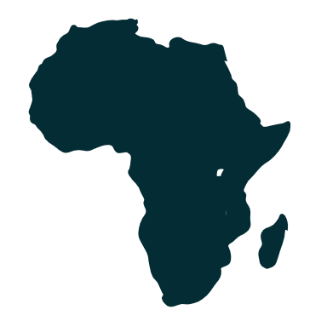


BUSINESS AND WOMEN THE CASE OF AFRICAN WOMEN (LIBERIA AS A CASE STUDY)
4th Current Business Issues
in African Countries
2023
Evelyn Kpadeh Seagbeh
Founder Just A Girl Initiatives
April 27 – 28, 2023 WWW.CBIAC.NET

Slide 2
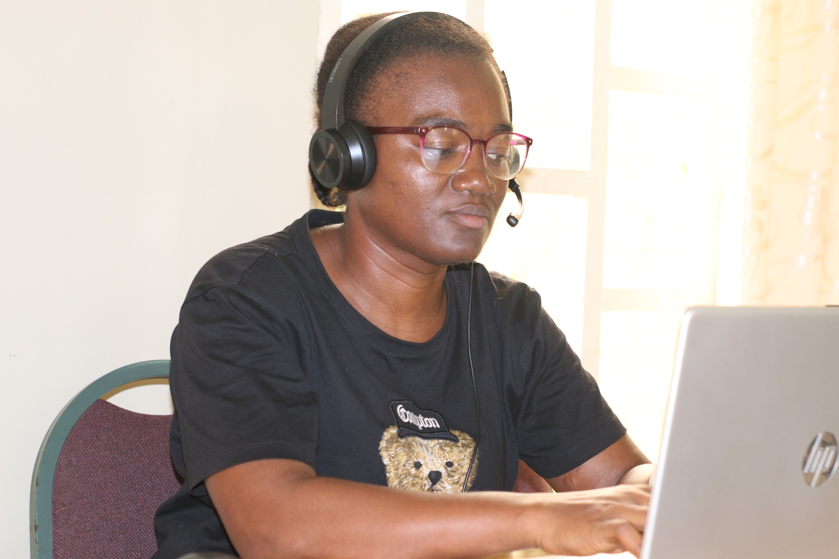
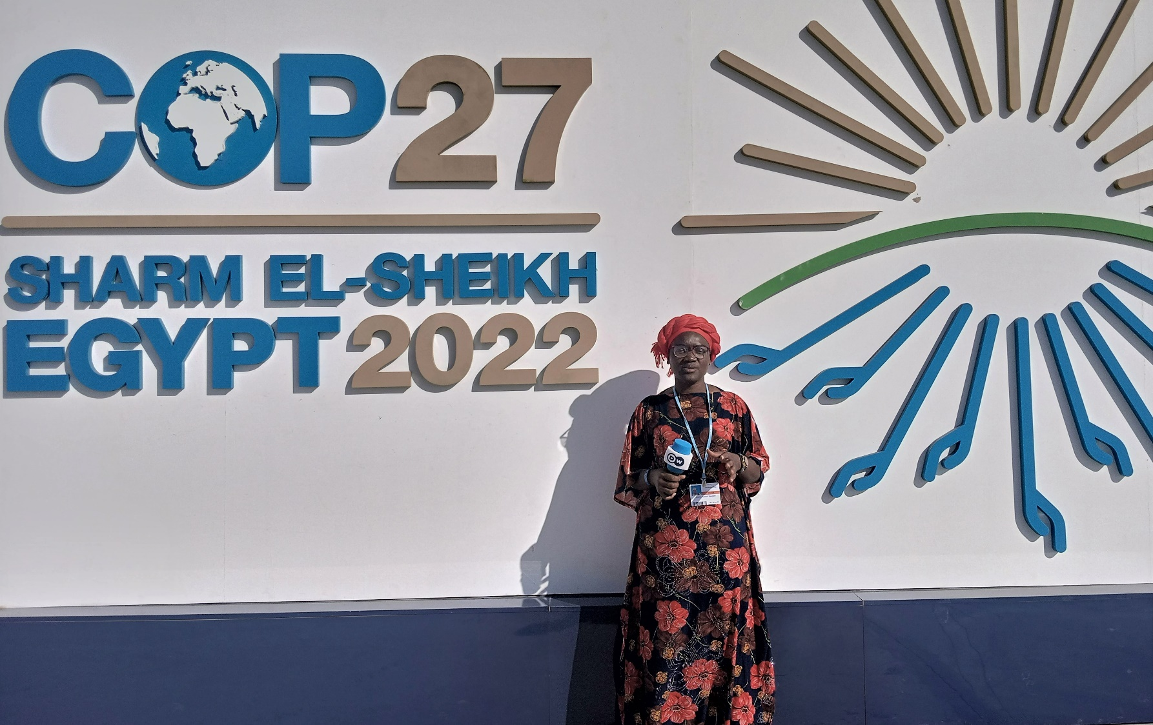
Introduction

Slide 3
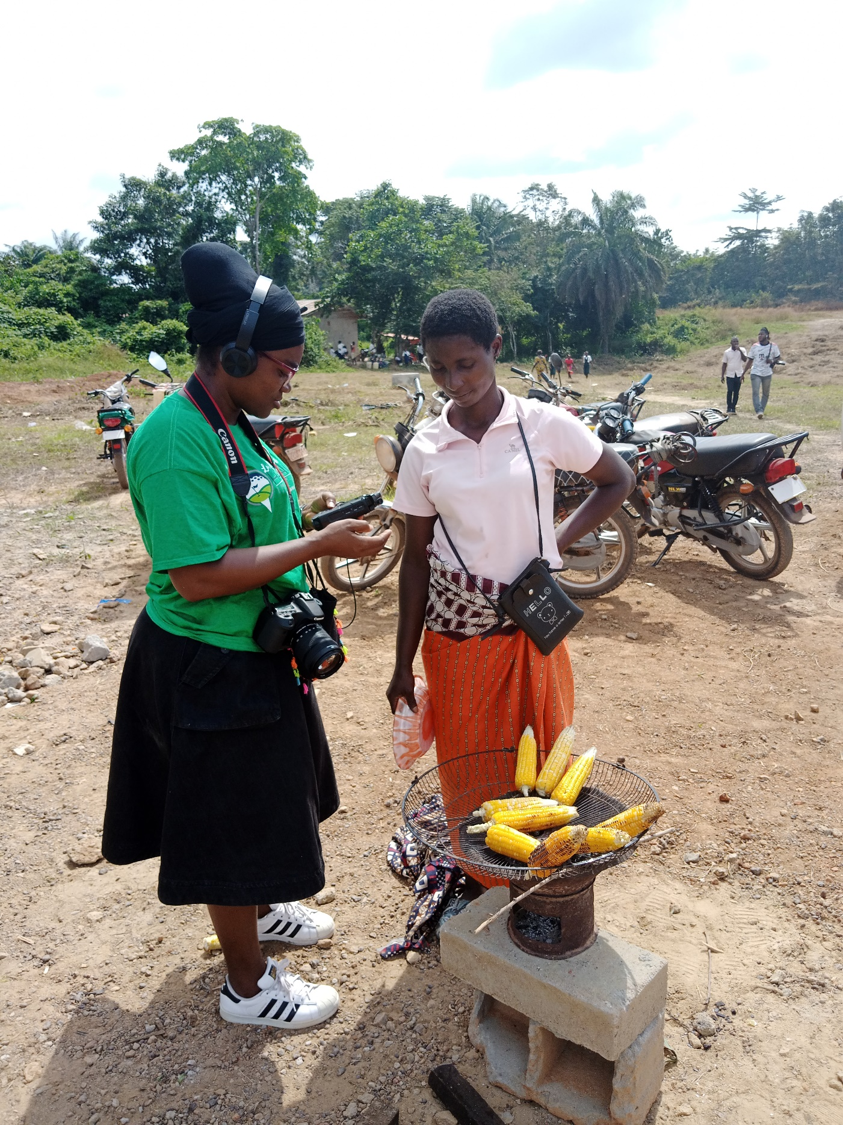
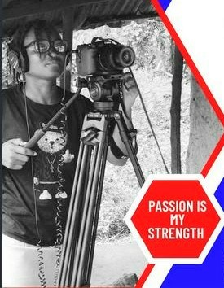
Passionate About Storytelling

Slide 4
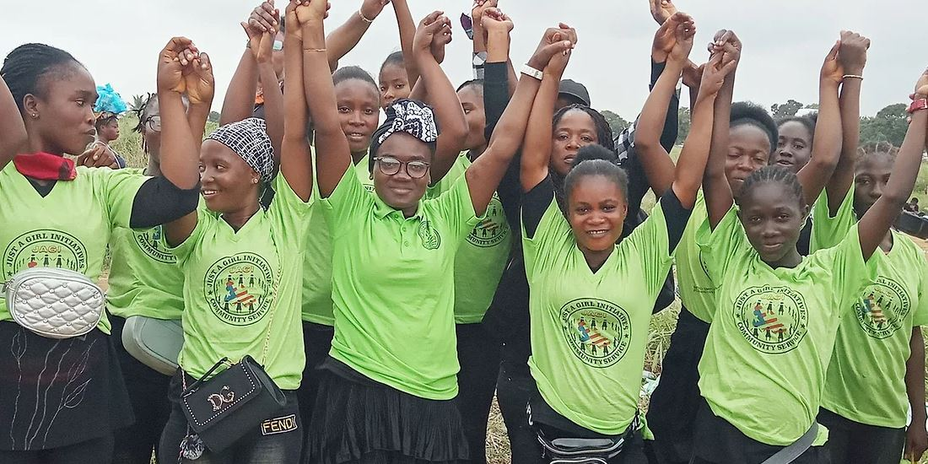
An Advocate of Girls and Women’s Rights

Slide 5
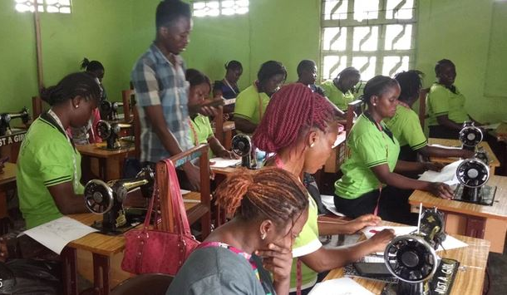
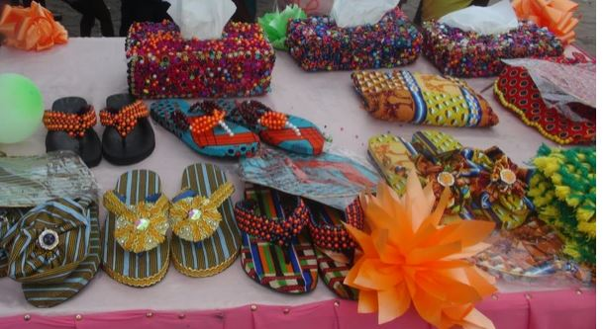
& Their Economic Empowerment

Slide 6
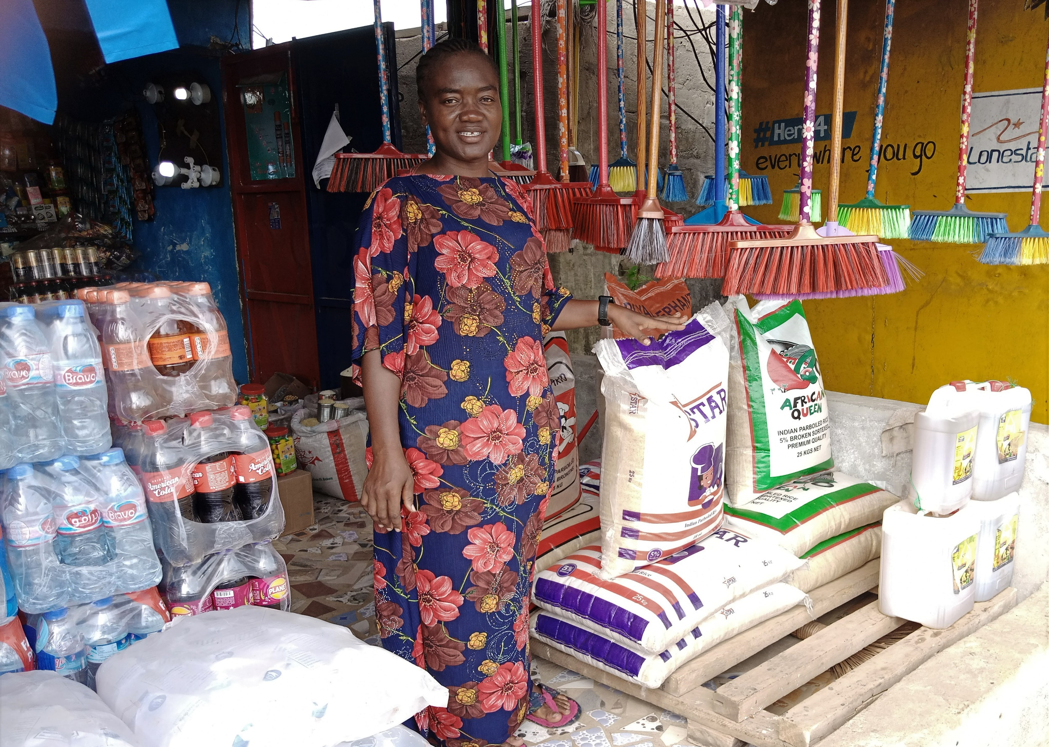
An Entrepreneur
2019/2020 COVID 19 Started it all
Everywhere was closed
Food, Water & medication were of priority

Slide 7

Business and Women, the case of African Women- Liberia as a case study
In Africa, women make up over 50% of the population. They play an integral part in Africa’s economy for several decades.
Their contributions are even more valuable in the case of countries emerging from conflict, such as Liberia, a post-war country & COVID 19 that wrecked havoc globally
In Liberia Women make up the larger part of the population (60%) in order to earn a living and sustain and provide for their families and communities they build or set up businesses.
I am not an economist
Don’t Claim to be one
Not a business experts
Just Passionate about Storytelling,
Research & My journalism work
and advocacy put these matters to my heart.

Slide 8
Few Years Back
In Liberia, post-conflict and COVID 19 economies face a number of challenges.
A few years ago women’s businesses stay at embryonic stages while just a few of them make big gains mainly due to three key limitations: knowledge of business vision, management; access to finance (constraints to accessing bank loans, high-interest rate and markets (retailer’s rights, high customs/tariff/taxes for importation).

Slide 9

Women Startup Businesses VS Loan
Women’s access to loans and one of the biggest challenges they face across the continent, especially for start-up businesses to support their small businesses.
Banks would rather give their loans to S.M.Es, multinational corporations, and big businesses with longer payment terms, and lower interest rates as compared to loans awarded to women and small businesses.
Their payment terms are shooters and the interest rates are even higher (especially for micro loan)
When Liberian women do succeed getting bank’s loans, it is almost as if they are doing their business for the banks
The stress of paying back the money on time in order not to default

Slide 10
Banks In Liberia
Eco Bank Liberia Limited
United Bank For Africa (UBA)
Global Bank Liberia
Guaranty Trust Bank (GT)
Liberia Bank For Development & Investment (LBDI)
Keystone Bank
International Bank Liberia Limited (IBL)
Access Bank
Afriland Bank
SIB Bank- Formerly GN Bank
Liberian Enterprise Development Finance Company (LEDFC) Bank
World Bank Report on Liberian Women Entrepreneurs
2012 -Women Entrepreneurs, Liberian women are dynamic entrepreneurs. They are predominant among informal businesses in small-scale retail and trade.
Women in Liberia are much more likely than men to be self-employed (69 % of women compared to 56 %).

Slide 11
3 Banks as Case Studies
Bank’s Name |  | Interest Rate |  | Amount & Other Narratives
Access Bank
Express Loan | 7% |  | ($1,000 USD)no collateral is needed the payment term is 1 to 3 months
Micro Finance Loan | 5.5% |  | ($100 to $1,000) 6 to 10 months and sometimes a year depending on the creditor’s daily/ monthly sales and collateral
Small Business Loan | 3.5% |  | ($7,000 USD to $25,000 ) and the payment depends on the requested amount. 2 to 3 years (often accessed by big businesses). Must have bank accounts, and tax adherence
Small and Medium Enterprises (S.M.E) | 2.5% |  | ($25,000 US up to $300,000) payment can be up to 3 to 5 years. These businesses have financial statements, meet all tax regulations and have bank accounts
Cost of Borrowing | $6,000 LD $ 12,000 |  | Of every $10,000 that is borrowed Of every 200,000 that is borrowed these do not include the interest

Slide 12
Loan Process with a few Banks in Liberia
NO. | Bank | Interest Rate | Amount | Payment Term
IB Bank
1. | Micro Finance Loan | 6% | $100 USD up to 4,000 | 6 months to a year depending on sales records
2. | Small Business Loan | 8% | $7,000 | 1 to 2 years
3. | Small and Medium Enterprises | 3% | $20,000 and above | 2-5 years
SIB Bank
1. | Micro finance loan | Maximum is 14% | $1,000 USD to 5,000 | 1 Years
2. | Small Business Loan | 2% | $ 5,000 to 7,000 … | 2 years or more

Slide 13
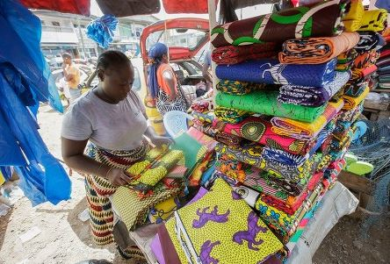
The WB Data Furthers
34%
of Liberian women manage a fairly significant share of registered small.

Slide 14
Business Registration Process In Liberia
For small businesses, it’s fairly much easier & faster than it was 10 years ago www.lbr.gov.lr
For Sole Proprietorship- It takes at most 2 weeks for a business Registration document to be ready for pick up after the form is filled out, payment done, and submitted to the Liberia Business Registry (LBR) https://revenue.lra.gov.lr/businesses/
Business registrations are valid for a period of 12 months
Fees for small business registration is $ 2,000 Liberian Dollars (USD 12.5)
Corporations & foreign businesses: setup costs in Year 1 will amount to US$3,750 and annual company costs in Year 2 and thereafter will amount to US$1,050.

Slide 15
Gain Changing & Upside of Liberian Economy for Women
It’s Easy to get a business started in Liberia
The economy is still fairly young (not much competition)
Price bargaining is allowed and deals can be somewhat amazing between the seller and the buyer
If women have access to finances (S.M.E or Small Business Loans) with a good or reasonable time frame for repayment, within the space of 3-5 years her business is far more likely to be bigger and she’s able to pay back loans and stand on her own
Scores of Liberian Businesses have made some real gains, from small scale they are not

Slide 16
The Downside
Women-owned businesses continue to be particularly vulnerable especially when it comes to expanding their investment,
The laws to protect Liberian/ small businesses are not that very strong and (Retailers’ Rights(A healthy Retailers Right gives birth to ‘Consumer Rights Protection) but the case of Liberian women wholesalers pricing are in a way where retailers make at most a dollar profit (rice, oil, other provisions)
The World Bank, “countries that do not have strong laws that support and protect local businesses over foreign businesses struggle” as in the case of Liberia.
Foreign/Big businesses become the movers and shakers of the economies, the business climate is not very super for smaller businesses,
lack of electricity,
Dual Currency (USD again the Liberian Dollars
High customs duties on importation (women that do foreign businesses and ship goods into Liberia complain of this challenge

Slide 17
Conclusion: Women Game Changers
There are Liberian women who have successfully grown their businesses from smaller to bigger skill managing to navigate between the odds
There are women entrepreneurs that are now shipping goods from Togo, Dubai,
The UN Women's Next Level Business Program for Market Women brought financial literacy skills to women in the marketplaces of Monrovia, and provided &in those workshops, women learn about budgeting principles for small businesses and how to open a bank account, and save profits.

Slide 18
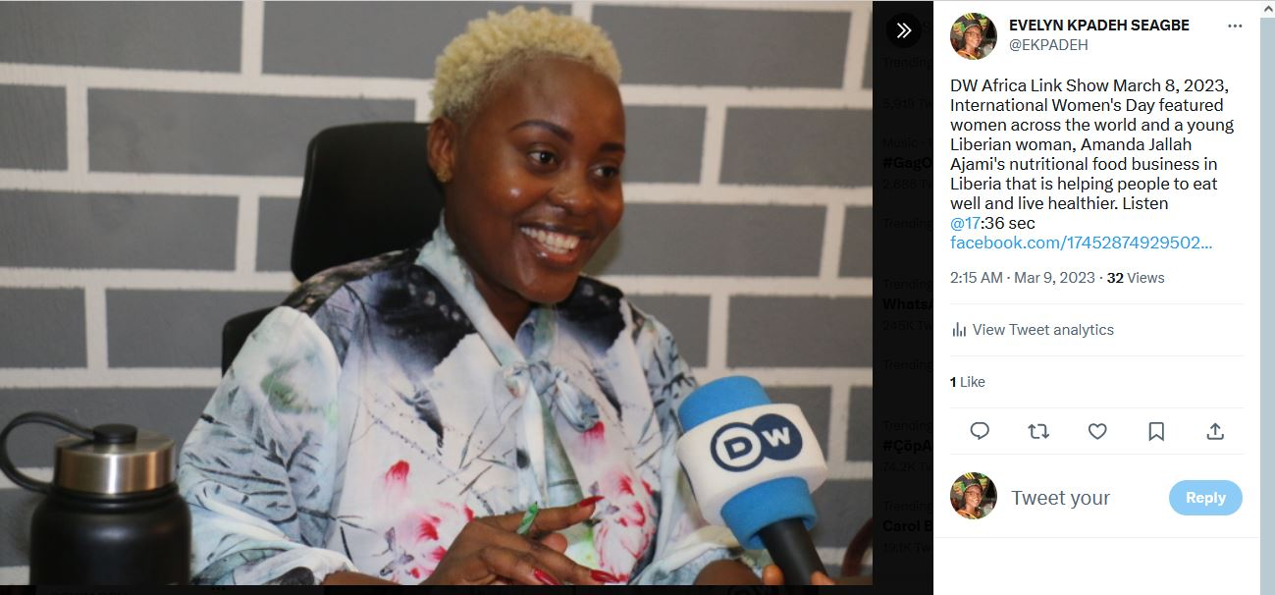
A Great Business Success Story of Amanda Ajami, a Nutritional Food Practitioner Featured on the German Radio-DW Africa (IWD March 8, 2023)

