Slide 1



Climate change impact on the ocean economy and policy implications for South Africa
4th Current Business Issues
in African Countries
2023
Moctar Doucouré, Laura Best, Odwa Mtati
Nelson Mandela University
April 27 – 28, 2023 WWW.CBIAC.NET
Notes:
Greetings all
Thank you Shani and your co-organiser for this opportunity, to present on the Ocean Economy and Climate Change.
Bonjour a toutes et tous

Slide 2
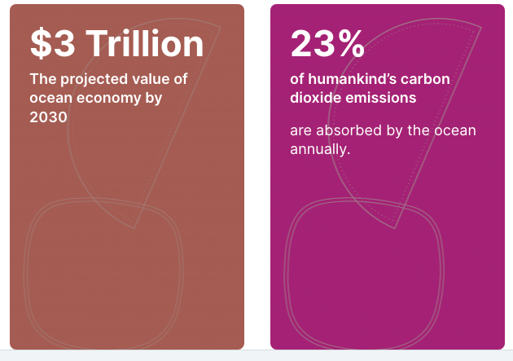
Introduction
Ocean Economy and Climate Change are both significant globally
Both impact on the lives of many
people, in many countries and
across geo-political boundaries
Both are multi-facetted, with intersecting dimensions
How these are managed is critical to ensure sustainability
This requires unique and break-through policy frameworks
[UNESCO’s Ocean Action]
Notes:
The Ocean economy and climate change are significant globally, and the UNESCO estimated its Ocean Action Programme, that the ocean economy will have a value of 3trillion dollars by 2030, and that 23% of anthropogenic carbon emissions are absorbed by the ocean annually.
How these are managed is critical to ensure sustainability and requires unique break-through policy frameworks

Slide 3



To unlock the potential of the ocean economy, the South African government adopted a methodology* focused on priority growth areas:
aquaculture | marine transport and manufacturing | small harbours development |
offshore oil and gas exploration | Coastal and Marine Tourism| Ocean Governance and Protection
These potential growth areas of the economy fall under multiple government departments^ (without a central point to coordinate policies)
* BFR – Big Fast Results
^ public sector architecture is vertical
Notes:
In South Africa, government placed its focus on 6 growth areas of the ocean economy
In the following I will only mention aquaculture and fisheris, marine transport and small harbours, and oil and gas exploration.
There is no central point from which to coordinate policies pertaining to these growth areas.

Slide 4

An implementation framework was developed:
Operation Phakisa [“hurry-up”]
This required a comprehensive national policy
Delivery has been uncoordinated and driven by past mandates of the various line-function departments
Impact has been sub-optimal as a result
Notes:
South Africa developed an implementation framework under Operation Phakisa which means hurry-up.
This required a comprehensive national policy.
And because of the lack of coordination between various line-function departments, impact has been sub-optimal.

Slide 5

South Africa lacks ocean economy policy with a connected climate change policy
This affects the impact – positive and negative; short and long term, on people’s lives, particularly poor people and under-resourced communities
SA Climate
Response
Notes:
The SA white paper on climate response cl
Early shows this lack. This particularly affects poor people and under-resourced communities.

Slide 6
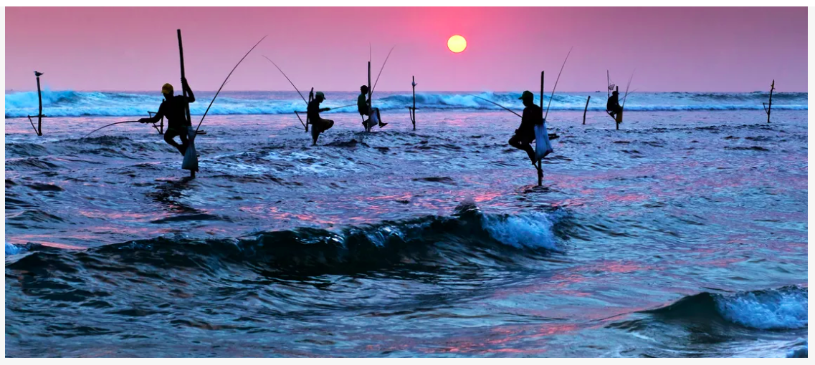
The Ocean Economy – a baseline definition
The Ocean Economy is generally defined as all economic activities that are linked to the oceans natural resources and environment and/or are dependent to a degree on the ocean.
aquaculture and fisheries
|
marine transport and manufacturing
|
small harbours
|
offshore oil and gas exploration
|
coastal and marine tourism |
ocean governance
Silhouettes of traditional stilt fishermen at sunset in Sri-Lanka – a technique born out of necessity as regular fishing spots were inaccessible and fish scarce [World Bank Blogs 2021]
Notes:
Read Definition
Usefulness of this baseline definition is that it can be included in line-function/sector-based policies and legislation to bring cohesion and collaborative effort for better/bigger impact.

Slide 7
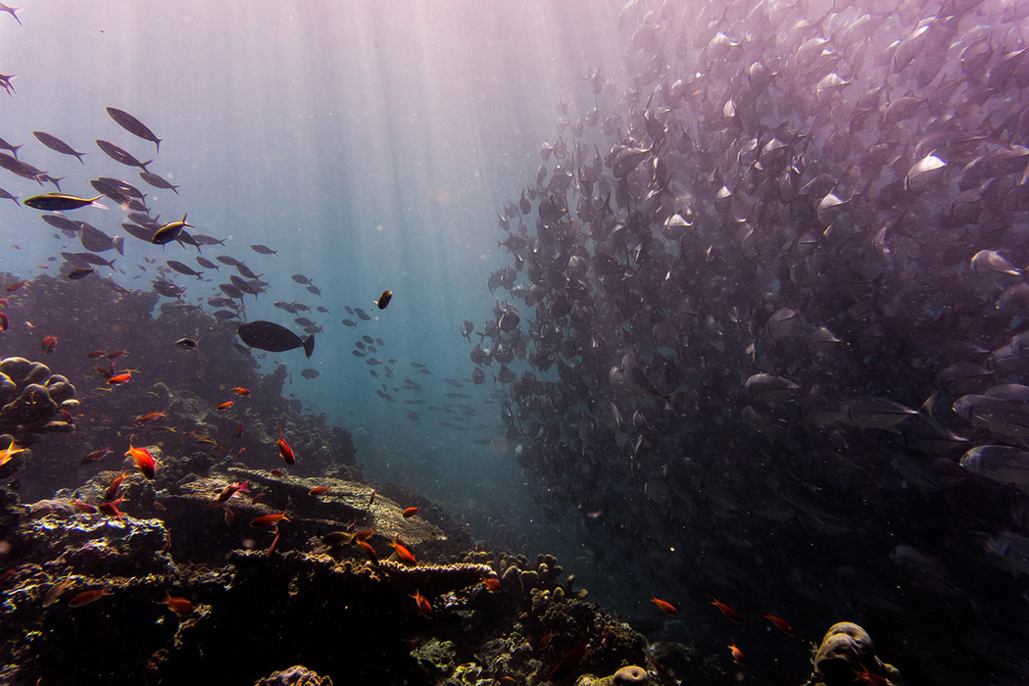
Understanding the potential Effects of
Climate Change on the Ocean Economy
Needed to support decision-making for mitigation and policy development.
The degradation of the marine environment, falling biodiversity and aggravated effects of climate change of Africa’s oceans and seas was recognized by the African Union in its Africa Integrated Maritime strategy.
Marine heatwaves in oceanic waters are becoming stronger and more common as the climate warms (McDonald, 2019).
Notes:
Understanding the potential effects of climate change on the ocean economy is needed to support decision making for mitigation and policy.
In its Integrated Maritime Strategy, the African Union recognised the degradation of the marine environment and falling biodiversity.
The image on the right illustrates heatwaves in oceanic waters.
[2050 Africa’s Integrated Maritime Strategy document, AU Commission, 2012]

Slide 8
Climate Change and Ocean Economy
The ocean is overall an important carbon sink that helps mitigate climate change, and the impact of climate change related events in turn would significantly impact on the ocean economy
Observational evidence from most oceans shows that many natural ecosystems are being affected by climate change specifically through temperature increase, sea-level rise, extreme weather conditions, and ocean acidification . Displacement from natural habitat
Analysis of the key climate change impact factors on the ocean economy shows that the growth areas of the economy are all affected by climate change related risks under the projected 1.5◦C global warming.
Notes:
Observational evidence shows that the growth areas of the ocean economy are all impacted by climate change, under the projected 1.5deg global warming,
through temperature increase, extreme weather conditions, sea-level rise, acidification and others.

Slide 9
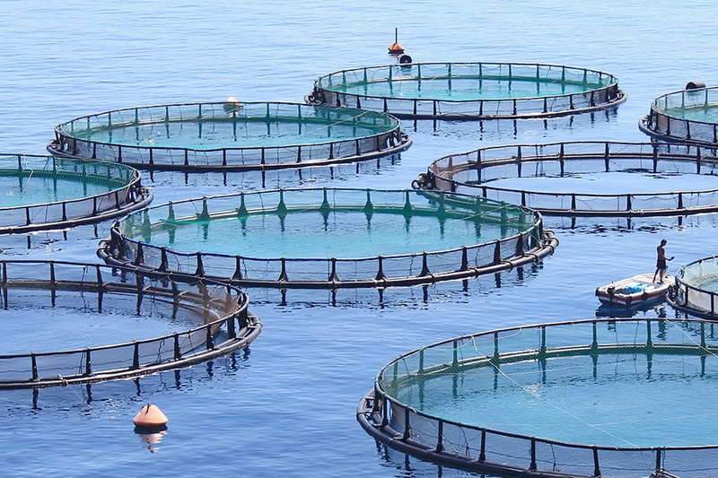
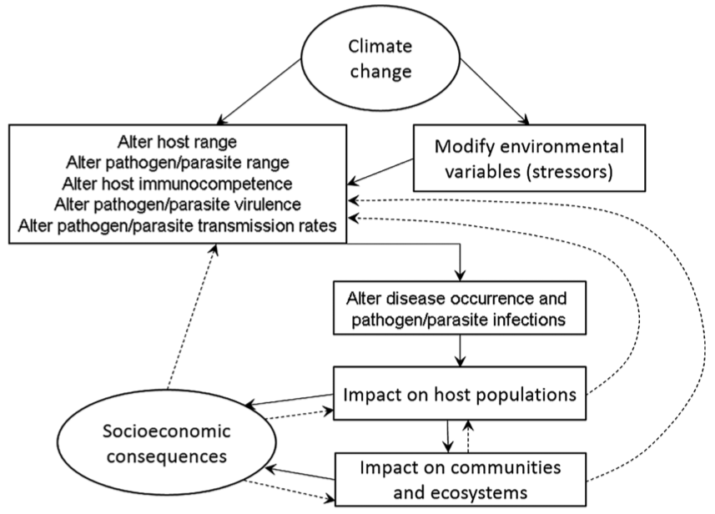
Aquaculture and Fisheries
Provide much-needed food security, job opportunities and local business prospects.
The implications of climate change-mediated physiochemical outcomes important to the sustainability of aquaculture include alteration of productivity and pricing as well as other goods and services needed by ﬁshers and aquaculture producers [Maulu et al., 2021]
[https://www.news.uct.ac.za/article/-2019-10-15-research-projects-boost-aquaculture-in-africa]
Climate change effects on pathogens parasites and their hosts, impacting host populations, communities, and ecosystems (solid lines) [Reid et al., 2019]
Notes:
This slide shows that while aquaculture and fisheries provide much needed food security and jobs, climate change can have severe impacts on these sectors of the ocean economy.
The diagram to the left shows the feedback loop between aquaculture and climate change stressors.
____________________
Effects will be further modified by interactions with other stressors and environmental variables. Population and community effects will feed back to hosts, their pathogens, and parasites (dashed lines).
Reid et al.: Climate change and aquaculture: considering biological response and resources, In Aquacult Environ Interact, Vol. 11: 569–602, 2019https://doi.org/10.3354/aei00332

Slide 10
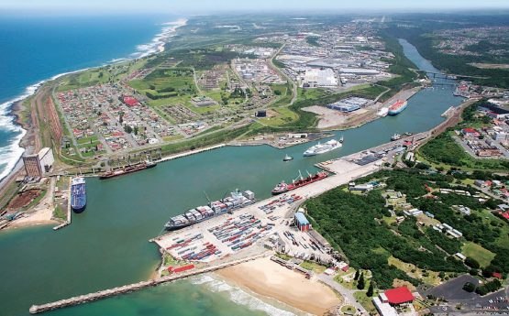
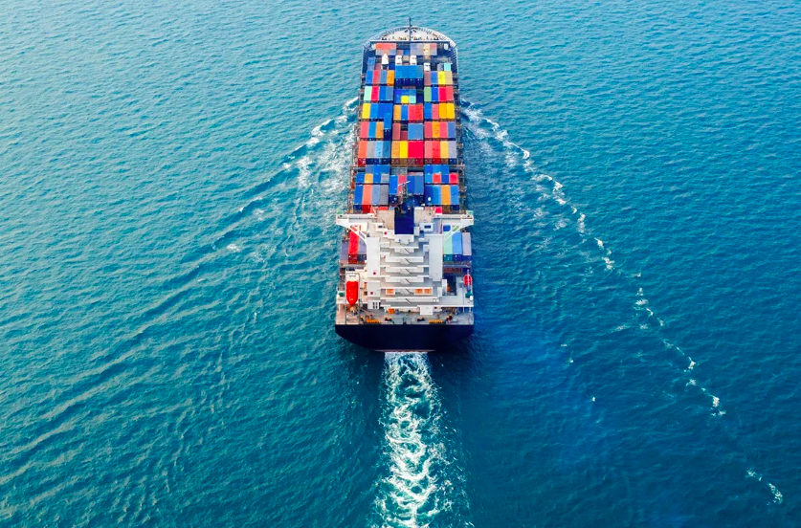
Marine transport and (small) harbours
The International Maritime Organization de-carbonization targets are the shipping industry's biggest challenge yet.
The harbours provide access to markets and supply-chains and are integral to many economic activities
in coastal zones
Shipping of containers crucial to global trade is affected by weather systems. Credit WÄRTSILÄ Portal
Port in the Buffalo City metro in the Eastern Cape, the East London IDZ. Credit Moneyweb portal
Notes:
The same goes for Harbours which provide access to markets.
The picture below shows a south african harbour in Buffalo City.
The IMO recognised the need for decarbonisation in Marine Transport and has set stringent targets for the industry.

Slide 11
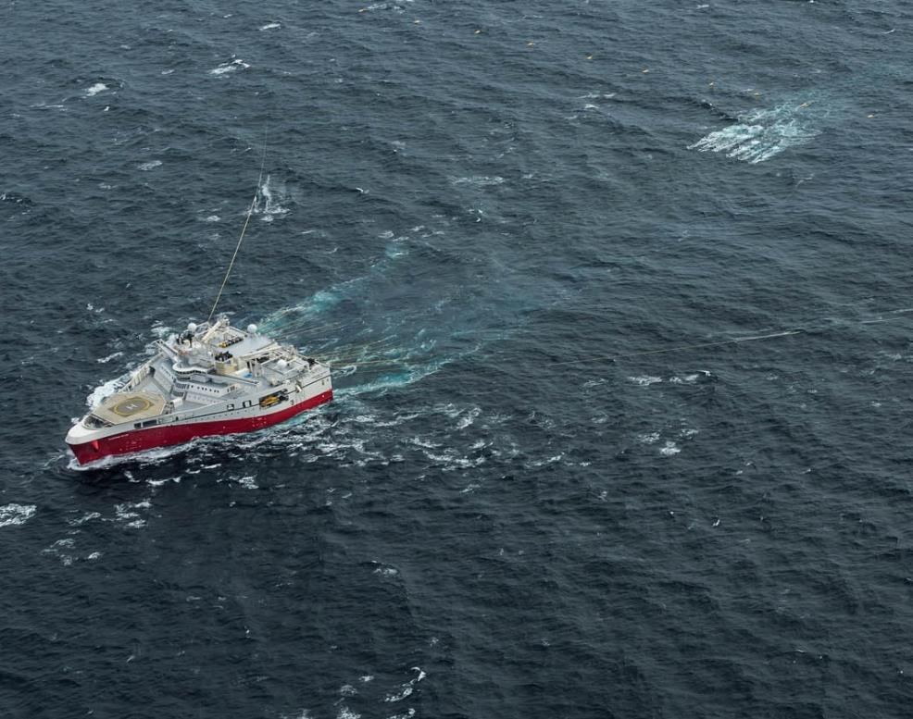
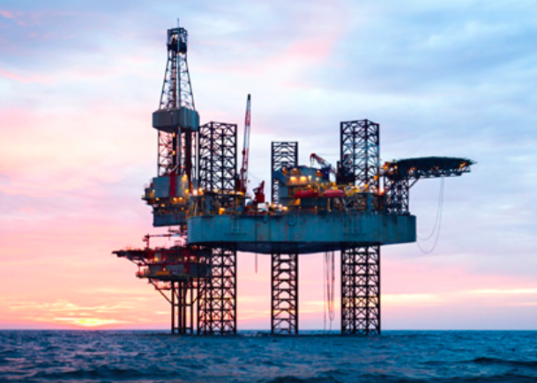
Offshore Oil and Gas Exploration
Climate change poses challenges to the coastal and offshore oil and gas infrastructure with associated oil spill risk
[Dong et al., 2022]
3D seismic acquisition seismic vessel during an offshore survey [PGS, 2019]
Climate-related threats to the oil and gas industry have already begun to manifest, and oil and gas reserves could be threatened by climate change
[https://www.maplecroft.com/insights/analysis/40-of-oil-and-gas-reserves-threatened-by-climate-change/]
Credit: International Energy Agency [2021]
Notes:
Climate related threats have already begun to manifest for the oil&Gas industry, and offshore exploration is facing serious environmental challenges

Slide 12
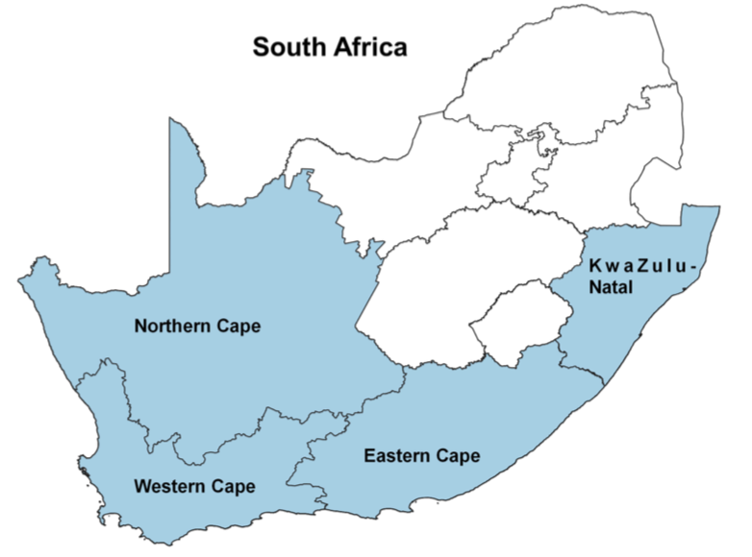
Climate change presents a tangible threat to sustainable trade and development, and will impact on the potential of the ocean economy.
Climate Change Factors | Economy Focus Area Affected | Impacts
Temperature [high temperatures, melting ice, large variations (spatial and temporal), frequent freeze and thaw cycles] | Aquaculture | Seafood industries adversely affected through vulnerability of fisheries and marine ecosystems, including shifts in species ranges and local extinctions.
 | Coastal & Marine Tourism | Variable extent and dependence but high temperatures tend to attract more tourism.
 | Marine Transport & Manufacturing | Longer shipping season and new sea route; additional support services and navigation aids such as ice-breaking search and rescue; damage to infrastructure, equipment and cargo; increased construction and maintenance costs; new ship design and strengthened hulls; environmental, social, ecosystem related and political considerations; higher energy consumption in ports; challenge to service reliability.
 | Offshore Oil & Gas | Maintenance problems; degradation of structures
 | Small Harbours | Deterioration of paved areas; damage to equipment (e.g. cranes); higher energy consumption and CO2 emissions due to refrigeration needs for perishable goods and air conditioning.
Sea-Level Rise [flooding and inundation, erosion of coastal areas] | Aquaculture | Breeding programs and the economic sustainability of the sector affected through destruction of seed supply for aquaculture production
 | Coastal & Marine Tourism | Coastal erosion (of beaches) reducing the value of these destinations for tourism; damage to infrastructure, settlements and facilities that support livelihood in small communities
 | Marine Transport & Manufacturing | Damage to infrastructure, equipment and cargo; increased construction and maintenance costs; variation in demand for and supply of shipping and port services; challenge to service reliability and reduced dredging; reduced safety and sailing condition; higher insurance premium.
 | Small Harbours | Damage to infrastructure; high cost of port performance; reduced shipping activity.
Extreme Weather Conditions [hurricanes, storms, floods, increased precipitation, wind] | Aquaculture | Increased production cost; damage to production facility; water quality deterioration/pollution
 | Coastal & Marine Tourism | Beach tourism very sensitive to weather conditions.
 | Marine Transport & Manufacturing | Damage to infrastructure, equipment and cargo; reduced safety and sailing conditions, challenge to service reliability; variation in demand for and supply of shipping and port services; change in trade structure & direction.
 | Offshore Oil & Gas | Affect exploration, transportation and other production activities including platforms, drilling rigs, offshore pipelines, and mobile offshore drilling unit; storm surge flooding can affect storage tanks.
 | Small Harbours | Damage to infrastructure, equipment and cargo; disruption of services; reduced safety conditions.
Ocean Acidification # | Aquaculture | Water quality deterioration radically alter aquatic ecosystems, leading to poor productivity.
 | Coastal & Marine Tourism | Coral reefs tourism including diving/undersea activities are adversely affected.
[Ortega-Cisneros et al., 2021]
Notes:
Clearly, Climate Change presents a threat to sustainable trade and development and will impact on the potential of the ocean economy.
The maps shows the SA Fisheries Coastal Provinces

Slide 13
Policy implications – achieving impact
Achieving the full potential of the ocean economy whilst simultaneously mitigating the knock-on impact of climate change requires a horizontally integrated public policy framework –
Policy implementation needs to enable sustainable development and growth for sustainability
Policy to have a deliberate intention contribute to global commitments eg SDGs – “one world” consciousness
Policy to aim to strengthen and build regional geo-political linkages and foster collaboration
Leadership and champions
Notes:
The key policy implications toward achieving impact are
A horizontally integrated public policy framework is required
Implementation needs to enable sustainable development by contributing to the SDGs
Strengthening regional geo-political linkages
Will not happen without leadership and champions

Slide 14
Conclusion
The ocean economy could contribute to the economic growth of South Africa and have reciprocal impact across businesses, government and society;
Ocean economy and climate change are constructs that are multi-dimensional in essence, and span a range of public policy domains;
Joined up integrated policy is essential to realise full socio-economic potential of the ocean economy whilst mitigating climate change impacts;
It is complex policy terrain, but it is essential for desired positive socio-economic impact.
Notes:
In Conclusion
The ocean economy and climate chnage are multidimensional constructs that span a range of public policy domains;
Horizontal integration is essential to realise full socio-economic potential;
But is it a complex policy terrain.

Slide 15
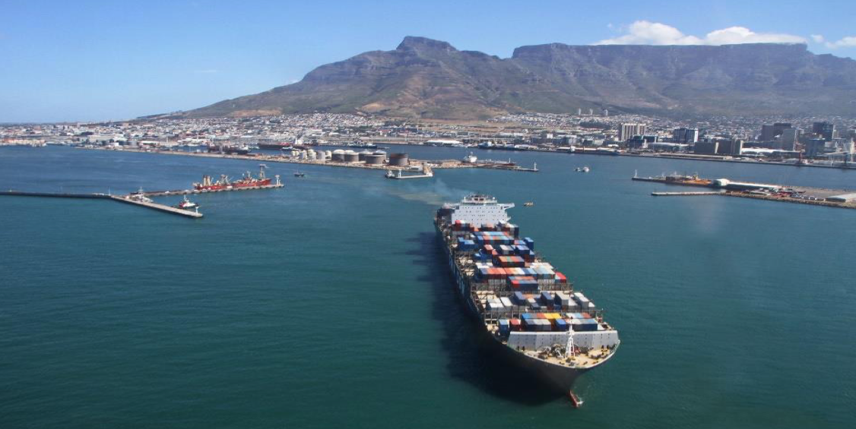
Thank you ! Je vous remercie!
Credit: Comprehensive Maritime Transport Policy for South Africa, 2017

