Slide 1
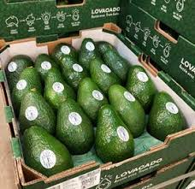
ICT use for an integrated traceability system: A case study of the avocado value chain in Nandi County, Kenya
4th Current Business Issues
in African Countries
2023
Cynthia Onyangore
International Sustainability Academy (Germany) and Trade Up Commodities Ltd (Kenya)
April 27 – 28, 2023 WWW.CBIAC.NET

Slide 2
Introduction
Commissioned by FORQLAB (Food Loss Reduction and Food Quality Living Lab) Project and Nandi Avocado Cooperative Society.
Aim: Structural reduction of food loss and wastage
Research Problem: Fragmented ICT solutions in traceability in the avocado value chain
Research Objective: ICT readiness assessment --→ integrated chainwide traceability system

Slide 3
Research Questions
ICT tools for an integrated traceability system in the avocado value chain in Nandi County
Value chain stakeholders
Value chain governance structure
Current ICT tools/solutions
Preparedness in adopting ICT for traceability

Slide 4
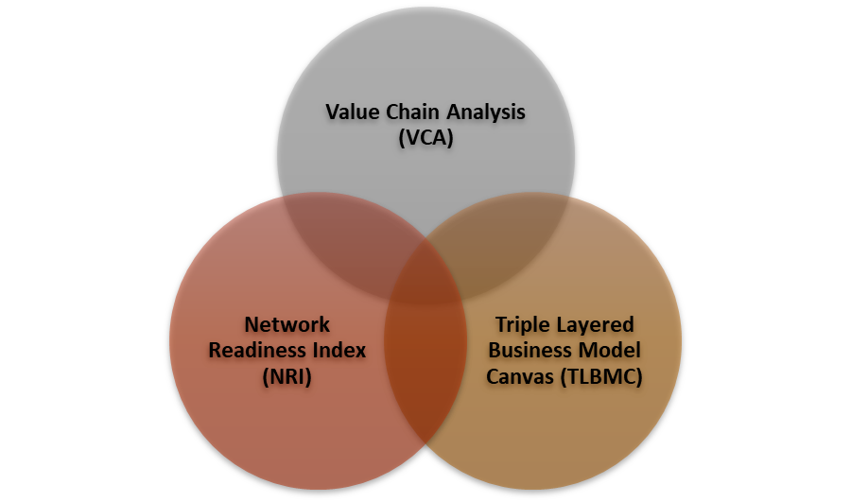
Conceptual Framework
Research Problem
Research Questions
Output
.Knowing the level of readiness in adopting ICT
.Inventory of ICT solutions that can be used in traceability
Fragmentation of ICT solutions in traceability in Avocado Value Chain
Outcome
Impact
Less food loss and wastage
Quality and less variance in avocados
Better prices
Integrated ICT enabled chain wide traceability system
Solutions from other studies and interventions
Slide 4

Slide 6
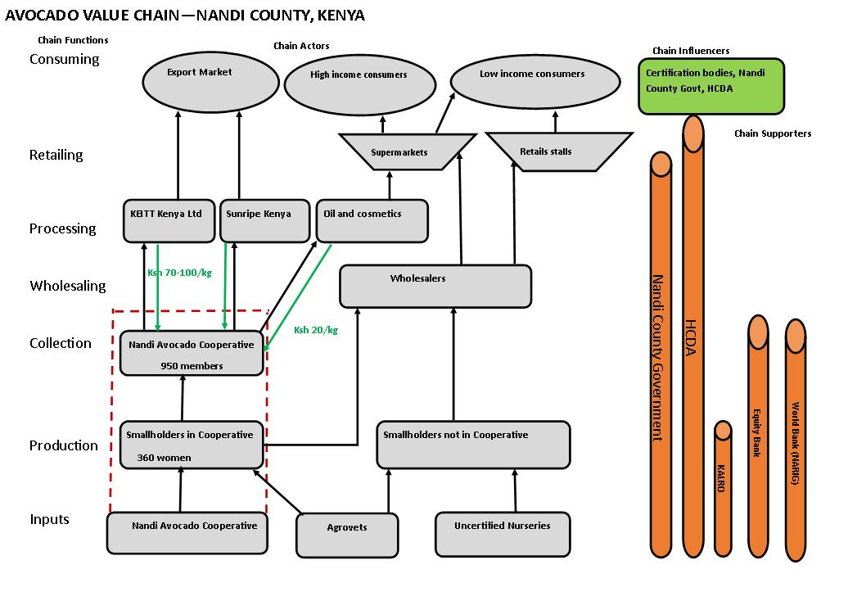
Nandi Avocado Value Chain

Slide 7
What is an integrated traceability system?
Source: Bosona and Gebresenbet (2013)

Slide 8
ICT Options
Analog records in Nandi Avocado Value Chain
Existing Technologies
KALRO Avocado Apps
SokoFresh
UjuziKilimo
DigiFarm by Safaricom
GTNet by TraceSoft
Emerging Technologies
Blockchain Technology
IoT Sensor Technologies
Enabling Platforms e.g., cloud computing and open – source software

Slide 9
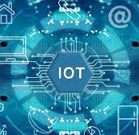
Emerging Technologies
Blockchain
Distributed, immutable, decentralized ledger
Internet of Things (IoT) Sensor Technology
Physical objects with sensors, processing ability and software and able to exchange data

Slide 10
Blockchain
Source: https://medium.com/@ipspecialist/how-blockchain-technology-works-e6109c033034

Slide 11
IoT Sensor Technology
Source: Tagarakis et al (2021)

Slide 12
Conclusion
Integrated ICT enabled traceability system:
Information transparency and symmetry
Trust
Valid Transactions
Harmonization
Simple user interface

Slide 13
Hybrid integrated ICT enabled traceability system
Source: Author’s compilation

Slide 14
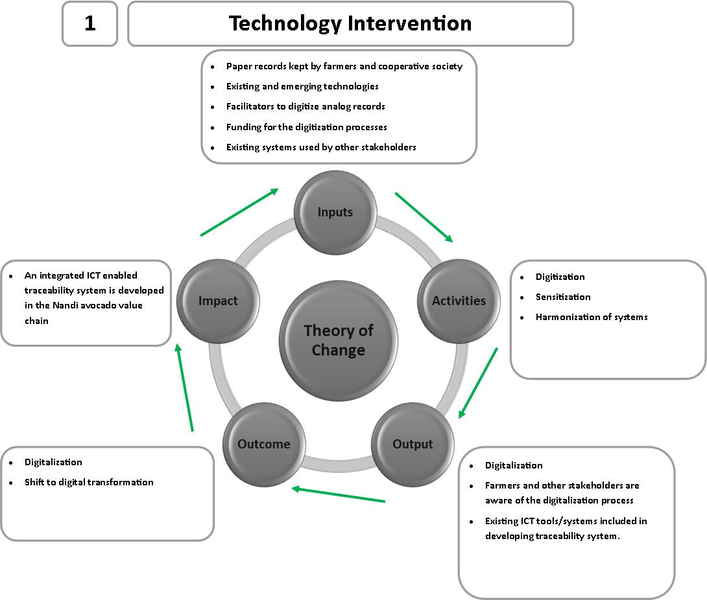
Technology Intervention

Slide 15
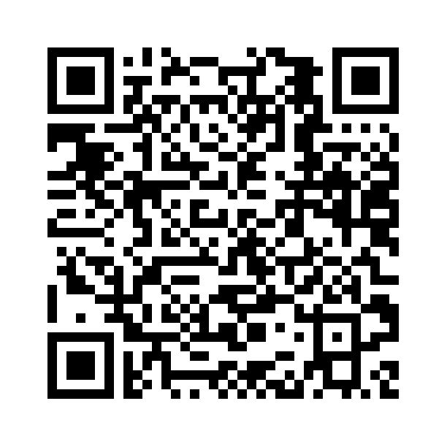
Traceability using Blockchain Technology

Slide 16
Questions and Discussion
United Nations Sustainable Development Goals
SDG 2 – No Hunger
SDG 12 – Responsible Production and Consumption
SDG 1 - No Poverty
Discussion questions
How does the topic relate to issues of public concern or the common good?
What communities might be involved in or affected by the topic? What are the histories, social contexts, assets, and needs of these communities?
What community partners (e.g., public offices, nonprofit organizations, social enterprises, faith-based organizations) could collaborate on your topic for mutual benefit and growth?

