Slide 1
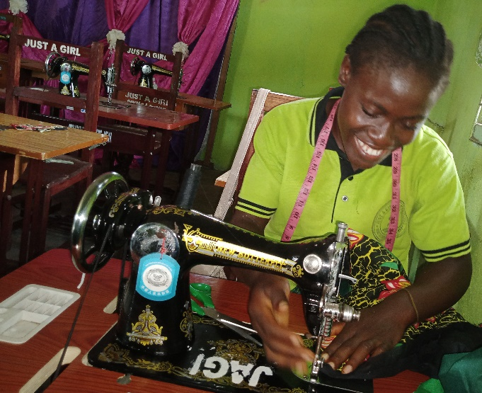
Investing in Girls and Women for Sustainable Development
By: Evelyn Kpadeh Seagbeh
Founder & CEO- Just A Girl Initiatives (Liberia)

Slide 2
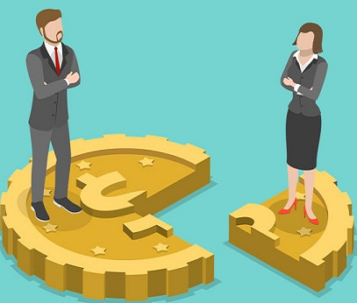
Why Girls and Women Empowerment?
1. Huge Gender Inequality in all sector
We cannot bridge the gap if we forget about the issue of empowerment. Gender inequality remains a major barrier to human development. All too often, women and girls are discriminated against education, political representation, access to health, education, political representation, labor market including basic human right enjoyment and face all forms of physical and domestic violence …..
Gender inequality has and continues to remain a major barrier to human development. The human development includes both men and women. But the truth is one group that is far ahead, leading everything and often at the table and deciding everything evening for and about us and we (women) become the end users.

Slide 3
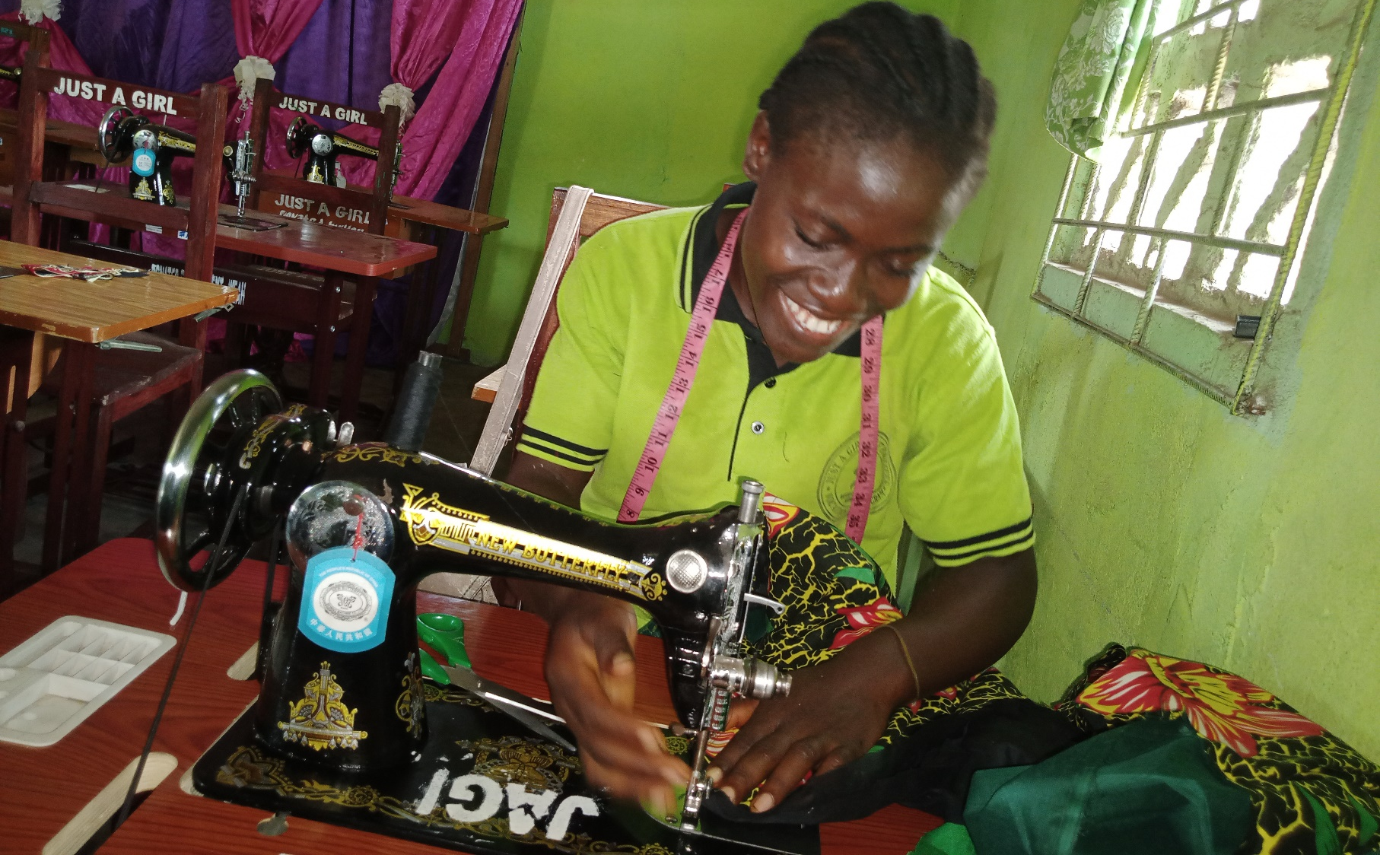
Slide 3
Ending all discrimination against women and girls is not only a basic human right, it’s crucial for sustainable future; it’s proven that empowering women and girls helps economic growth and development.

Slide 4
The Figures
2
Global Gender Gap
68%.
The World Economic Forum has said, globally, it’s going to take 108 years to close the Global Gender Gap, which now stands at 68%. That adds eight years to the 2017
In Africa
70%.
Women are excluded financially. The continent has a US$42 billion financing gap between men and women.
So what about into 2022
?
It means we have 102 more years to close the Global Gender Gap
Notes:
When conducting research, it is easy to go to one source: Wikipedia. However, you need to include a variety of sources in your research. Consider the following sources:
Who can I interview to get more information on the topic?
Is the topic current and will it be relevant to my audience?
What articles, blogs, and magazines may have something related to my topic?
Is there a YouTube video on the topic? If so, what is it about?
What images can I find related to the topic?

Slide 5
GWE- Is one of the Surest Ways to reducing poverty & advancing women
Investing in girls and women economic empowerment and skills development would drive progress and help to minimize the effects of extreme poverty to bring about inclusive growth. I want to tell you my story
Notes:
Once you find your sources, you will want to evaluate your sources using the following questions:
Author:
Who is the author?
Why should I believe what he or she has to say on the topic?
Is the author seen as an expert on the topic? How do you know?
Current:
How current is the information in the source?
When was the source published?
Is the information out-of-date?
Accuracy:
Is the content accurate?
Is the information presented objectively? Do they share the pros and cons?

Slide 6
When Girls and women Are Empowered, Everyone Wins
Goal 5
GENDER EQUALITY
Some countries around the world have made significant progress in closing the gap more than 85 percent of their overall gender gap. The top four countries are all Nordic nations: with Norway, Sweden and Finland coming second, third and fourth.
Other nations are Namibia Rwanda
Notes:
After consulting a variety of sources, you will need to narrow your topic. For example, the topic of internet safety is huge, but you could narrow that topic to include internet safety in regards to social media apps that teenagers are using heavily. A topic like that is more specific and will be relevant to your peers. Some questions to think about to help you narrow your topic:
What topics of the research interest me the most?
What topics of the research will interest my audience the most?
What topics will the audience find more engaging? Shocking? Inspiring?

Slide 7
The benefits theory
Investing in girls and women's empowerment is promoting and giving women the right tools needed to enable them succeed in every aspect of life. It's also promoting women's sense of self-worth, their ability to determine their own choices, and their right to influence social change for themselves and others and having equal access to opportunities as me do.
Studies show that empowerment is closely linked to education. How?
1. The higher educated women are, the more likely they are to exercise control over household decisions,
2. They are less likely to accept domestic violence and
3. They generally have greater freedom to lead independent lives.
Notes:
Now, that you have narrowed your topic, you will want to organize your research in a structure that works. There are some common organizational patterns based on the kind of research you are doing.
Organizational Structures:
Cause and Effect- this kind of structure is great for explaining the causes and effects of a topic
Compare and Contrast- in this pattern you highlight the similarities and differences of the topic
Explain process- this structure is great for outlining a series of steps to follow;
Definition- if you want to make sure your audience understands what something is using illustrations, meanings, clarifying misconceptions, you may want to use this structure
Classification- a common organizational structure is grouping like topics or facts from the research together. For instance, in the internet safety about social media apps, you may organize the research where you look at each social media app one at a time

Slide 8
Inspiration
I don’t not wish ( women) have power over men,
but power over themselves
Mary Wollstonecraft, English writer and advocate for education
I don’t not wish ( women) have power over men,
but power over themselves
Mary Wollstonecraft, English writer and advocate for education

Slide 9
In the developing world (poor countries) girls and women are often seen as less valuable than boys. Instead of being sent to school, they are often made to do domestic work at home or are married off for a dowry before they are adults. As many as 12 million underage girls are married every year.
Notes:
After you’ve done your research, it’s time to put your presentation together. The first step in the process is to introduce the topic. This is a great time to connect your topic to something that your audience can relate. In other words, why should they listen to all the information you will be sharing in your research presentation? What is in it for them? You may also want to include a graphic or image to grab their attention.
Feel free to duplicate this slide by right-clicking on this slide in the slides pane to the left and select Duplicate Slide.
The next step in your presentation is to state your claim or topic clearly. Your teacher may even call this your thesis. As you state your thesis, you may find that this layout is not the best layout for your claim or topic. You can change the layout by clicking the drop-down menu next to the Layout in the Slides menu section. You can choose Two Content, Comparison, or Picture with Caption. Note: A different layout might change the look of the icons on this page.
You will also want to state your facts. You have done the research now share some of the interesting facts with your audience. Facts do not have to be boring; you can communicate facts in a variety of ways by going to the Insert Tab. In the Insert tab you can:
Insert pictures from your computer or online.
Add a chart
Create some SmartArt
Insert a variety of icons to help your facts come to life. Note: You can change the color of the icons by selecting the icon and then click on the Format tab and then Graphics Fill. From there, you will choose a color from the list or choose More Fill Colors to give you more options.
Since this research presentation is a result of your hard work and searching, you want to make sure you support the claims or points in your presentation with facts from your research findings. Make sure you give the author proper credit for helping you share your ideas. If one of your sources has a video that is relevant to your topic, you can add the video as added support. Keep in mind the length of the video and the amount of time you have for your presentation. For a 5 minute speech, the video should be no longer than 30 seconds.
Questions to consider:
How will you state the author of the source?
Will you need to cite the source on the slide?
What are some ways you can engage your audience so they feel like they are a part of the presentation? Some ideas to consider is by taking a quick poll like: by a show of hands, how many of you think school uniforms are a way to cut down on bullying? Another suggestion is to have them hold up a certain number of fingers to see if they agree or disagree. Finally, you can share a story that the audience can relate to that makes them laugh.
After all the applause, your audience may have some questions. Be prepared to answer some of their questions by making a list of questions you think they might ask. You may also want to share the presentation with them by providing the link to your presentation, if they want more information.

Slide 10
The Reality
In this present day and age A typical African (Liberia a struggling parents and with many children who do not the funs needed to enroll all their children in school would rather the boys start during the first half of the school year while the girls wait for 2nd semester (3-4 months later into the academic year).
During this period, the girls are doing almost all the domestic work and when the boys come from school food is ready. This is just one in several challenges why girls and women empowerment is essential for sustainable development.

Slide 11
The world’s 2030 SDG 5
“Achieve gender equality and empower all women and girls“
SDG 5 has nine targets and 14 indicators. Six of the targets are "outcome-oriented": ending all forms of discrimination against all women and girls everywhere;
Ending violence and exploitation of women and girls;
Eliminating harmful practices such as child, early and forced marriage and female genital mutilation;
Increasing value of unpaid care and promoting shared domestic responsibilities
Ensuring full participation of women in leadership and decision-making
Ensuring access to universal reproductive rights and health.
Fostering equal rights to economic resources, property ownership and financial services for women; promoting empowerment of women through technology; and adopting, strengthening policies and enforcing legislation for gender equality.

Slide 12
The Hard Truth of GWE
Putting women and girls at the centre of economies will fundamentally drive better and more sustainable development outcomes for all. This include
More access to quality education & inclusive education
(appropriate skills development, gender parity, relevant school infrastructure, equipment, educational materials and resources, scholarships or teaching force.
Effective adult literacy education for Women who miss out on education during their teens – giving them basic reading and writing skills to help end the kind of suffering a woman would go through because of her inability to read
Technical and Vocational Learning opportunities for women and girls – marketable skills to get absorbed into the job market- women as technicians and at all level
Education about their rights-
Eliminating harmful practices such as child
(FGM/FGC, Early marriage, unacceptable cultural norms,

Slide 13
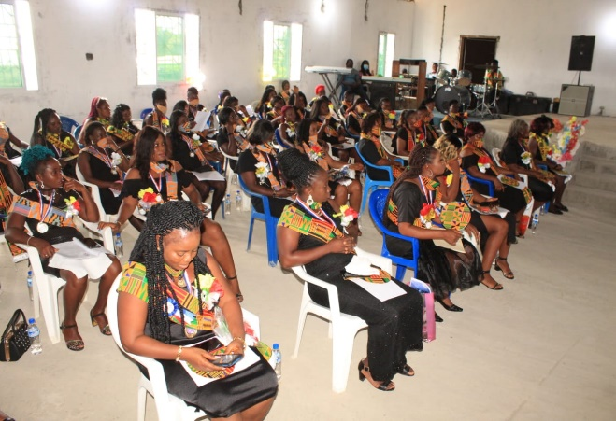
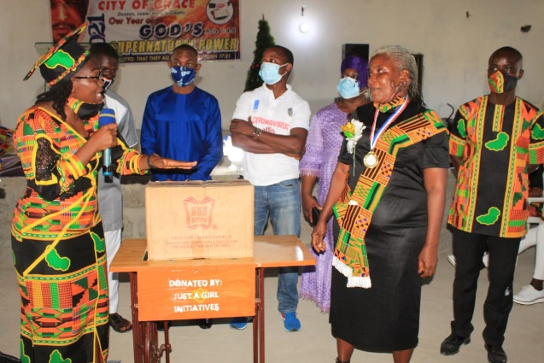
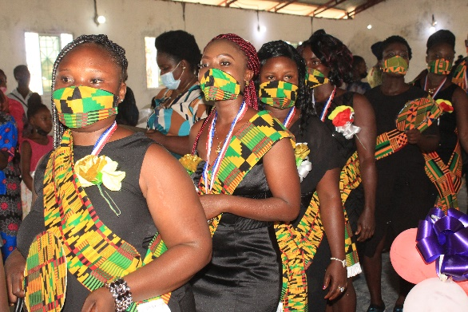
Just A Girl Initiatives Empowerment Impact stories
Notes:
You can use this slide as your opening or closing slide. Should you choose to use it as a closing, make sure you review the main points of your presentation. One creative way to do that is by adding animations to the various graphics on a slide. This slide has 4 different graphics, and, when you view the slideshow, you will see that you can click to reveal the next graphic. Similarly, as you review the main topics in your presentation, you may want each point to show up when you are addressing that topic.
Add animation to images and graphics:
Select your image or graphic.
Click on the Animations tab.
Choose from the options. The animation for this slide is “Split”. The drop-down menu in the Animation section gives even more animations you can use.
If you have multiple graphics or images, you will see a number appear next to it that notes the order of the animations.
Note: You will want to choose the animations carefully. You do not want to make your audience dizzy from your presentation.

