Slide 1
FINANCIAL LITERACY: DO UNDERGRADUATESTUDENTS 1. NEED AND 2. DESIRE FINANCIAL LITERACY SKILLS? A STUDY OF UNDERGRADUATE BUSINESS STUDENTS AT WAGNER COLLEGE
Cathyann D. Tully
Nicolais School of Business
Wagner College
Staten Island, New York, USA
April 28, 2023 WWW.CBIAC.NET

Slide 2
College in the U.S.

Slide 3
Average Cost of College in the U.S.
Public institution: $25,707 per year or $102,828 over 4 years
Private institution: $54,501 per year or $218,004 over 4 years

Slide 4
College students fully paying for their own education:
67%

Slide 6
40% of students during the past year have considered leaving their institutions
Cost of tuition
Affordability
Pulse Study, 2022

Slide 7
Stats from U.S. Department of Education
60% of college students have experienced base needs insecurity, meaning they are at risk of homelessness, hunger, or reduced access to basic needs
In the Fall of 2020, 29% of students at 4-year colleges experienced food insecurity within the previous 30 days
14% of college students report experiencing homelessness in a year
48% of college students experience housing insecurity in one year
34% of students applied for emergency aid in the Fall of 2020; 94% of them received some form of aid

Slide 8
Problematic and Frightening
Speaks to the need for financial literacy

Slide 9
Would students be interested in Financial Literacy >Survey Wagner College students

Slide 10
Profile of students surveyed
18.7% are first in family to attend college
52% intend to graduate in 2024
34% intend to graduate in 2025
55% reside in Metropolitan area
23% reside outside USA
85% did NOT receive financial literacy as part of K-12 curriculum
97% are Nicolais School of Business students

Slide 11
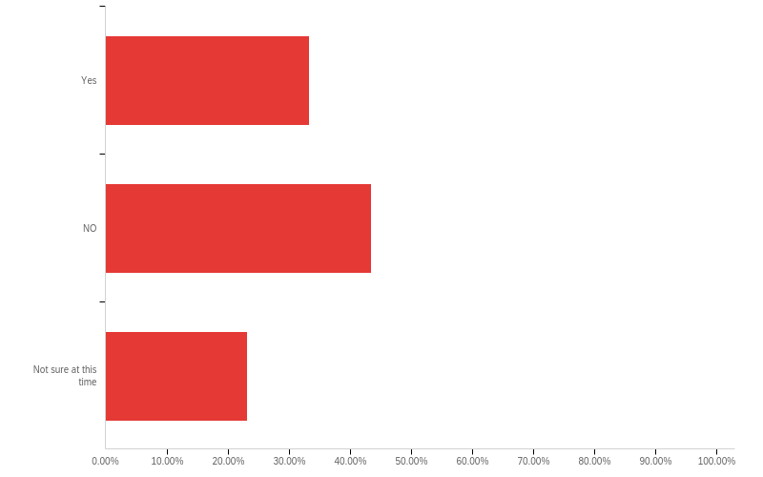
Will you incur student debt while attending college?

Slide 12
If you incur student debt, are you concerned about how you will pay off?

Slide 13
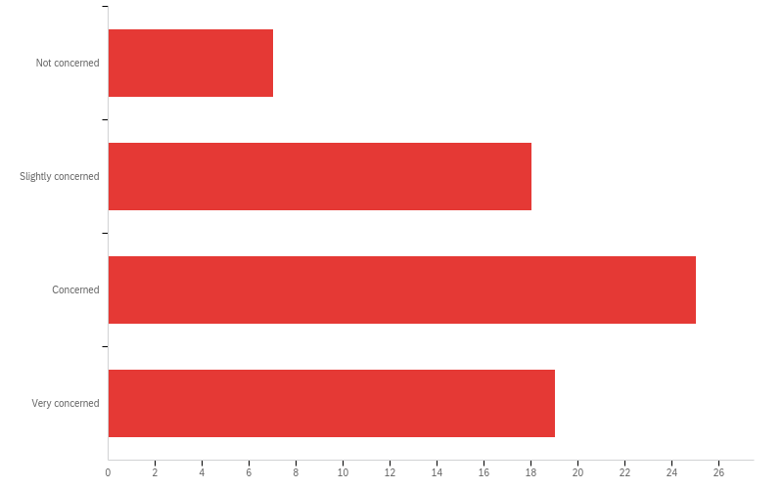
Are you concerned about managing your personal finances upon graduating from college?

Slide 14
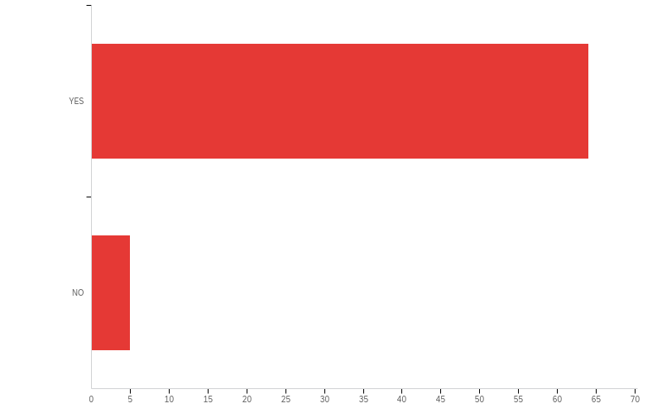
If Wagner offered a Financial Literacy course (for credit) focused on managing personal debt, expenses, saving for retirement and creating an affordable life style, would you enroll?

Slide 15
Concluding remarks
Research demonstrates the need for financial literacy
Survey confirms the desire for financial literacy
Benefits to the student and society as a whole are immeasurable

Slide 16
Next steps Survey students at various institutions Measure the economic impact of student debt

Slide 17
Thank you for your time

