Slide 1
Insights into African–led Startups and how they are thriving, using a qualitative approach.
Current Business Issues
in African Countries
2022
Pearl Kitcher
Chocolart Haus, Ghana.
April 7 – 8, 2022 WWW.CBIAC.NET

Slide 2
Presentation Overview
Current business trends in Africa
Business Trends in Ghana
Factors that are contributing to the trends
Business Case Studies
Chocolart Haus
The cocoa sector
Other food sectors
Cakes and Confections
Sustainable Agriculture

Slide 3
Introduction
African population ids about 60% youth
On average, a graduate is likely to get a paying job after 3 to 4 years of graduation
Therefore, most graduates resort to taking more academic courses
On average, a graduate is likely to land his or her first paying job after 3years of graduation.

Slide 4
Current Business Trends in Africa
Global attraction for emerging markets
Google AI lab in Ghana in 2019
Microsoft African Development Centre in Lagos in 2022
Support for Startups
Influx of business incubators
International business support programs - Orange Corners, SIYB
Avenues for business visibility – Social Media; IG,Facebook, etc.

Slide 5
Factors contributing to African business patterns
Inadequate source of capital and funding
Inadequate skills for current demands of work
Digital disruption, Technology-driven era.
Chronic youth unemployment
Mental Health

Slide 6
CHOCOLART HAUS
More than 60% of the world’s cocoa is supplied by Ghana and Cote D’Ivoire, which are in Africa. However, this cash crop is vastly underutilised in these countries.
ChocolArt is an artisanal chocolate business that adds aesthetic value to indigenous Ghanaian chocolate mainly.
ChocolArt aims at creating globally competitive brands of artisanal chocolate and through this, will also create livelihoods for people in Ghana.

Slide 7
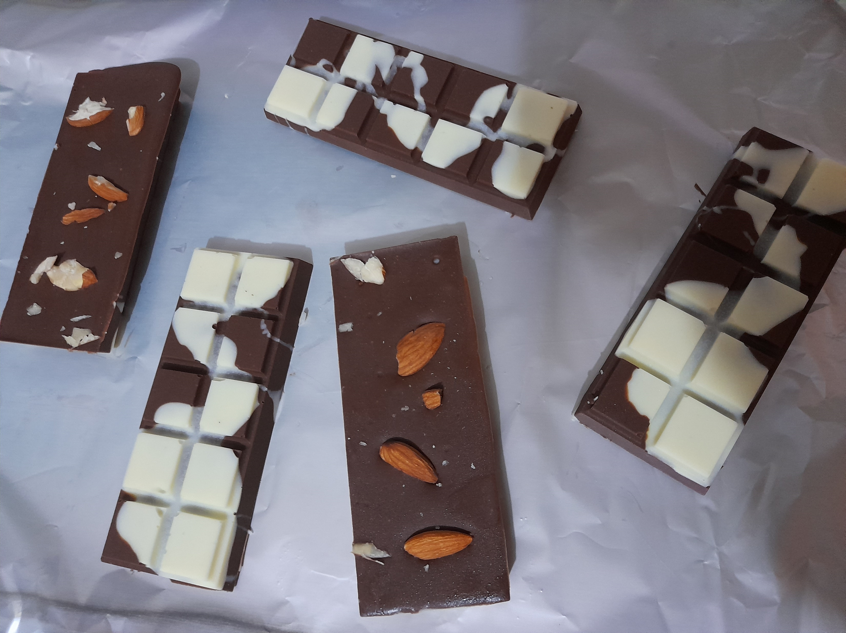
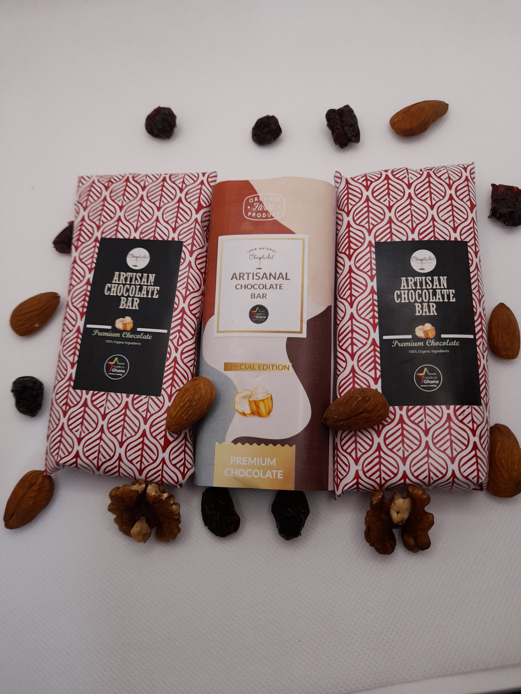
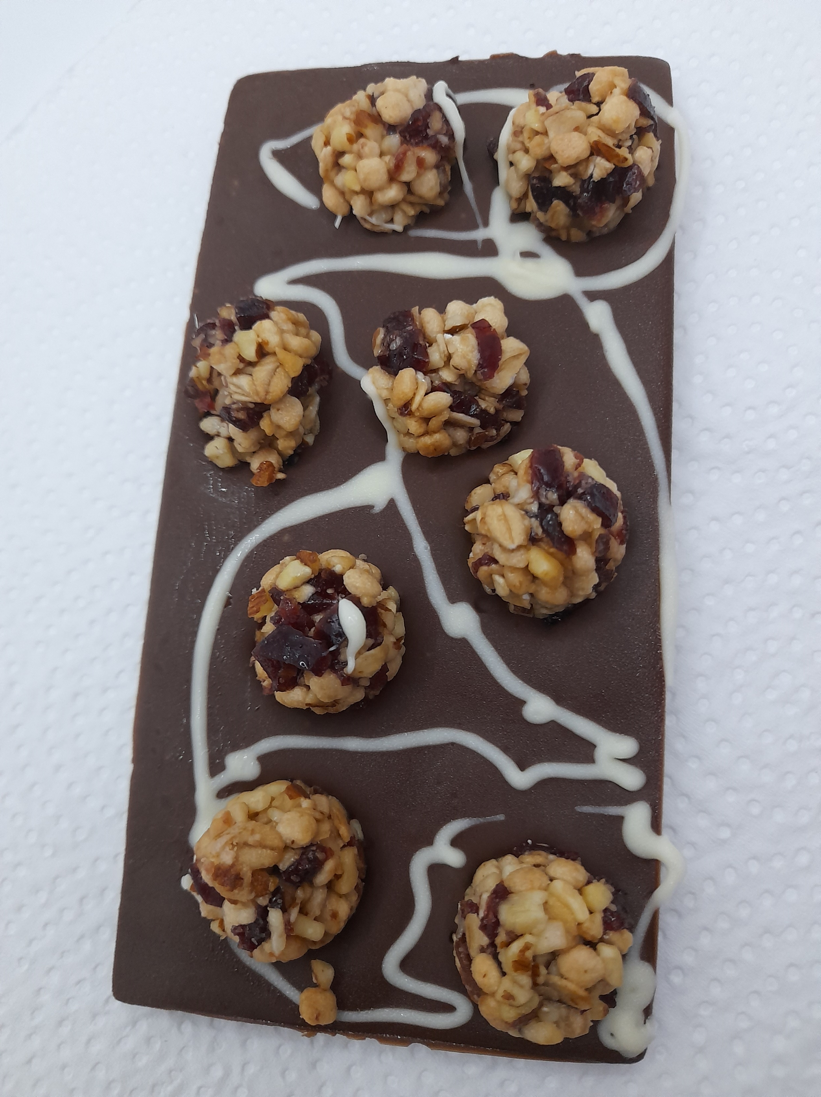

Slide 8
Other Business Cases
Wrapped Ghana
Started the business of wrapping custom-made gifts for people
during the Covid-19 pandemic.
These are edible and non-edible products
Tropical Growers
Started a fruits and vegetables growing company
To tackle SDG 2 mainly

Slide 9
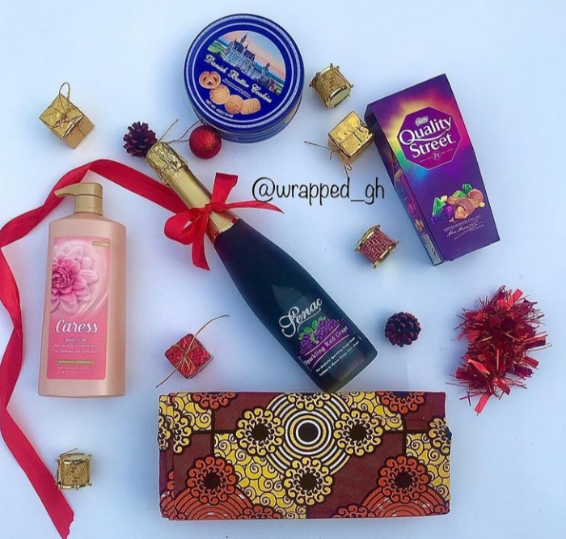
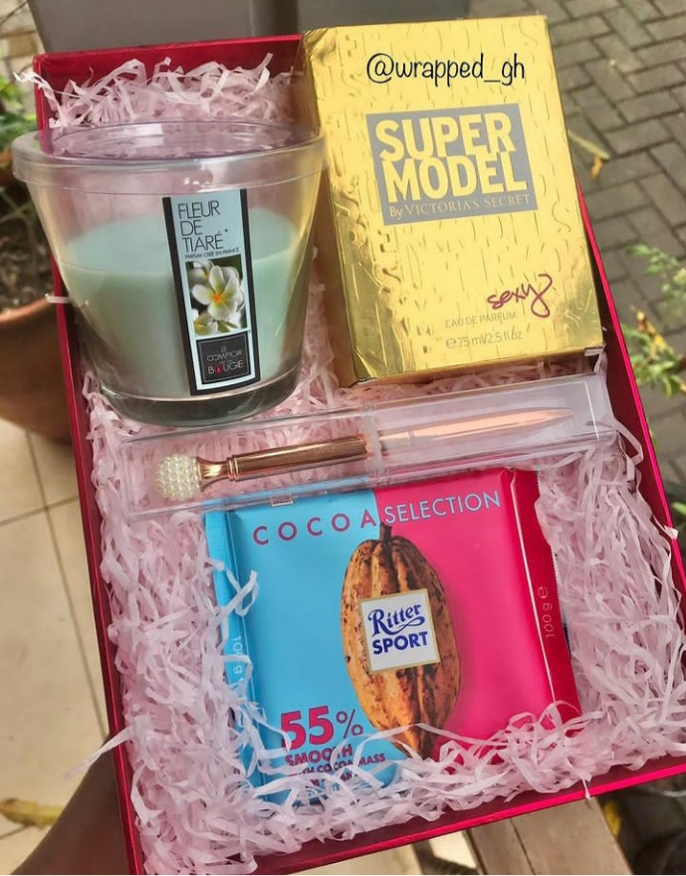

Slide 10
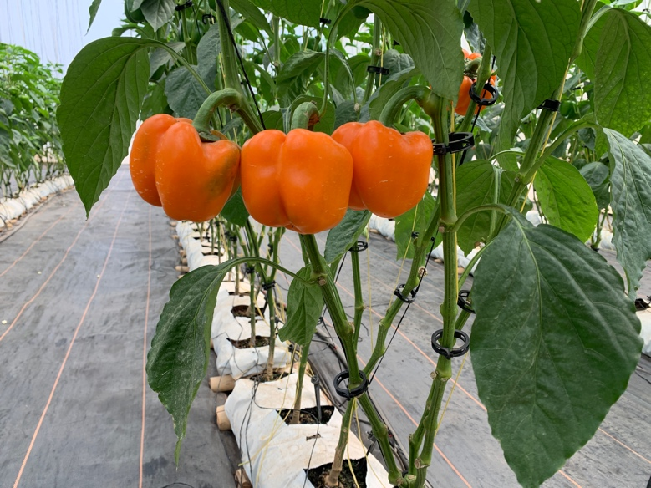
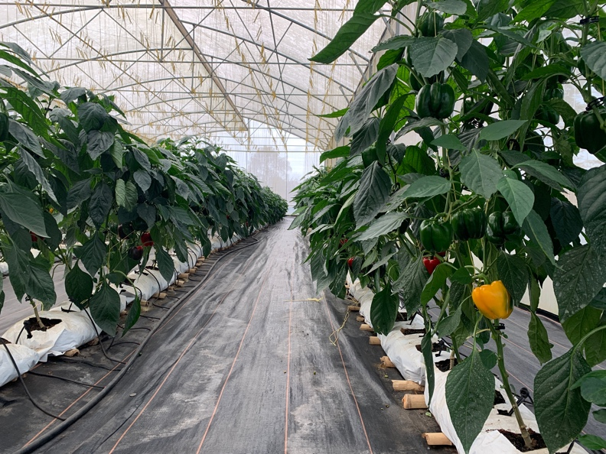
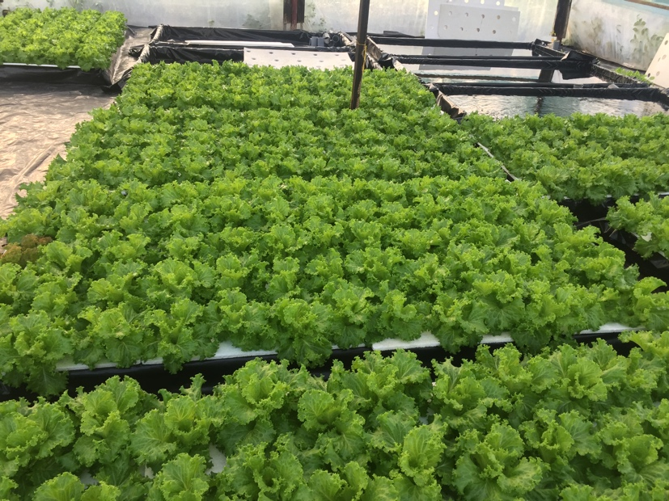
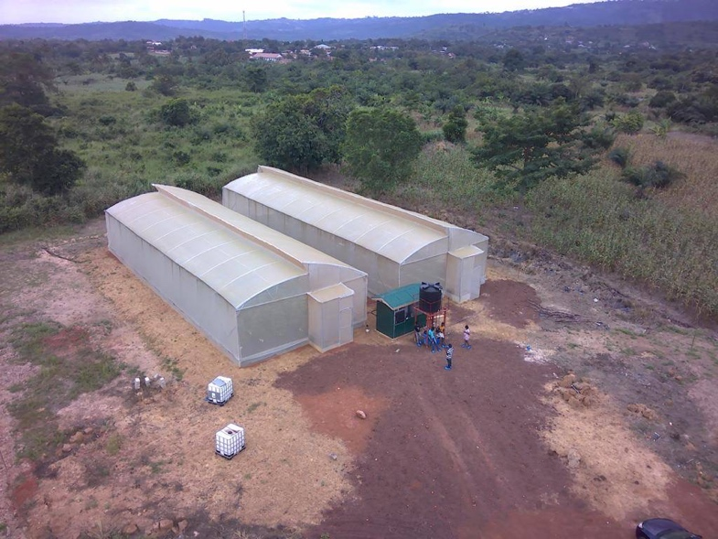

Slide 11
Themes | Answers
Motivation to Start the business | Passion to have access to high quality fruits and vegetables The vison to add value to locally-made Ghanaian chocolate I decided to start my business because I was going to stay a year at home which applying to medical school for the next academic year. I basically started it out of boredom although I had been interested in entrepreneurship for a while.
Challenges along the way | Cybersecurity issues as IG page was hacked and it cost money to restore it. Capability of boosting consumer confidence in the quality of fruits and vegetables on the current market. Challenges with setting up a strong working team of professionals

Slide 12
Themes | Answers
Current business Challenges | Sourcing manufacturing tools and packaging materials locally Achieving schoolwork and business balance Access to finance to scale up production
Vison for the next 5 yrs | Access funding to be able to increase production capacity and efficiency Scaling up from retail to wholesale
SDG that the business is tackling | SDG 2, SDG 8,
Words to a person considering to start a business in Africa | There are so many untapped opportunities that a yet to be explored I will advice them to put much effort into effective research on whichever field they choose to venture into. Have a back-up plan

Slide 13
Conclusions
Chronic Unemployment
Graduates barely get jobs to sustain themselves and their families.
Some resort to starting businesses on their own with little or no capital.
Access to Capital
Even though there are business incubators there is still a major challenge with accessing funds African businesses.
Inadequate sources of funding
Bank loans have high interest rates and ridiculous check list of eligibility requirements.
Scaling up Challenges
Job-fit Human resource, equipment, local sourcing, high import rate of raw materials

Slide 14
Questions and Discussion
United Nations Sustainable Development Goals
https://sdgs.un.org/goals
SDG 8
SDG 1
Discussion questions
In what ways can we deal with the problem of chronic unemployment in Africa?
How can African entrepreneurs access capital and adequate funding to help them scale up their businesses?
What cross-border collaborations do you think can help African business generate more revenue and sustain their local economies?
How do we address existing gender disparities in the science and manufacturing business sectors?

Slide 15
Email me at pearlkitcher@gmail.com

