Slide 1




Digital Transformation Strategy in SMEs: The Role of Entrepreneurs’ IEO
4th Current Business Issues
in African Countries
2023
Lahsen Oubdi, Oumaima El Mekkaoui
ENCG Agadir Business School, Ibn Zohr University
Laboratory of Research in Entrepreneurship, Finance, and Audit (LAREFA)
April 27 – 28, 2023 WWW.CBIAC.NET

Slide 2
Design of the presentation
Conceptual Framework and Hypothesis Development
Data Analysis and Research Findings
Introduction
Literature Review
Research Methodology
Conclusion

Slide 3
Introduction
Digital technology
The formulation and application of a digital transformation strategy have become a critical concern for enterprises prior to digital transformation (Chanias et al., 2019).
Digital skills
Key factors of digital transformation
A digital transformation strategy is like a personalized map that can bring great value to business transformation. (Teng et al., 2022).
Digital transformation strategy
Entrepreneurs must adapt to the digital evolution because they are those individuals whose decisions determine to a large extent the strategy of the organization (usually small- to medium-sized) (Corvello et al., 2021).

Slide 4
Introduction
Individual entrepreneurial orientation (IEO) is one of the micro-level psychological constructs that has received relative attention in entrepreneurship studies and specifically in SMEs researches (Irwin et al., 2018).
What makes those entrepreneurs more successful than others (Donbesuur et al., 2020; Watson et al., 2020), especially in small and medium-sized enterprises (SMEs), which typically struggle with their survival (Hyder & Lussier, 2016)?
SMEs owners with high IEO are likely to be more risk-taking, proactive, and innovative (Krauss et al., 2005), and these attitudes permit taking active actions to establish advantageous and strong collations for the success of the business (Shafi et al., 2020).
To our knowledge, IEO has been linked to SMEs performance, but rarely study in the context of SMEs’ digital transformation.

Slide 5
Literature Review
Entrepreneurial Orientation
(EO)
Individual Entrepreneurial Orientation
(IEO)
Miller (1983) ; Covin & Slevin (1989)
Lumpkin and Dess (1996)
Gerschewski et al. (2016)
Risk-Taking
Competitive Aggressiveness
Passion
Innovativeness
Autonomy
Perseverance
Proactiveness

Slide 6
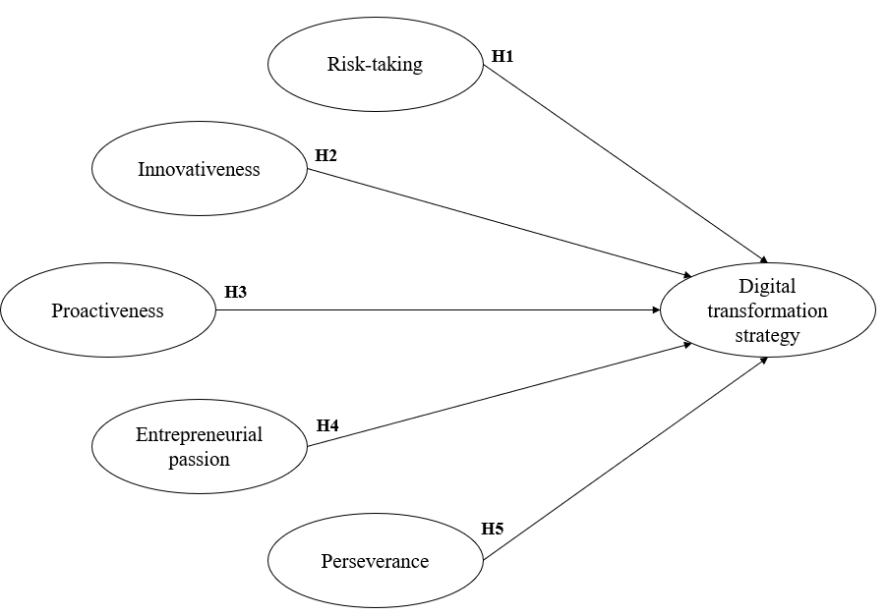
Conceptual Framework and Hypothesis Development
Figure . Hypothesized research model.

Slide 7
Research Methodology
Research environment | Morocco
Target population | Moroccan Entrepreneurs
Data collection tool | Questionnaire / 74 respondents /Administered via Google Forms for a one-month period Resulting in 22 adaptive questions (items) in the form of statements. A 5-point Likert scale has been carried out where ‘1’ represents ‘strongly disagree’ and ‘5’ represents ‘strongly agree’.

Slide 8
Research Methodology
The respondents’ demographic distribution reveals as follows:
Table . Descriptive statistics of the sample.
Category | Percentage | Sample Characteristics
Demographic distribution | 72% | Male
 | 28% | Female
Age | 60% | Between 18- 40 years
 | 35% | Between 41–60 years
 | 5% | Above 60 years
Education | 45% | Master’s degree
 | 20% | Bachelor’s degree
 | 15% | Ph.D. degree
 | 11% | Two years after baccalaureate
 | 9% | Baccalaureate
Category | Percentage | Sample Characteristics
Sector | 41% | Services
 | 39% | Industry and commerce
 | 9% | Tourism
 | 7% | Construction
 | 4% | Agriculture
Experience | 50% | Below 5 years
 | 27% | Between 5 and 10 years
 | 23% | Above 10 years
Moroccan regions | 39% | Souss-Massa
 | 34% | Casablanca-Settat
 | 8% | Rabat-Salé-Kénitra
 | 7% | Marrakech – Safi
 | 12% | Other Moroccan regions

Slide 9
Data Analysis and Research Findings
1. Measurement Model
Table . Measurement properties.
 | Items | Loading | Cronbach’s alpha | CR | AVE | Note
Digital Transformation Strategy (DTS) | DTS1 | 0.832 | 0.917 | 0.938 | 0.752 | DTS2 was excluded
 | DTS3 | 0.918
 | DTS4 | 0.922
 | DTS5 | 0.825
 | DTS6 | 0.834
Entrepreneurial Passion (EP) | EP1 | 0.863 | 0.751 | 0.887 | 0.798 | EP3 was excluded
 | EP2 | 0.922
Innovativeness (INN) | INN1 | 0.832 | 0.801 | 0.881 | 0.712
 | INN2 | 0.834
 | INN3 | 0.866
Perseverance (PER) | PER2 | 0.844 | 0.695 (≈ 0.7) | 0.866 | 0.765 | PER1 was excluded
 | PER3 | 0.903
Proactiveness (PRO) | PRO1 | 0.785 | 0.818 | 0.890 | 0.729
 | PRO2 | 0.858
 | PRO3 | 0.914
Risk Taking (RT) | RT2 | 0.731 | 0.722 | 0.841 | 0.639 | RT1 was excluded
 | RT3 | 0.837
 | RT4 | 0.826
Note: CR =composite reliability; AVE =average variance extracted

Slide 10
Data Analysis and Research Findings
1. Measurement Model
Table . Discriminant validity test.
 | AVE | DTS | EP | INN | PER | PRO | RT
DTS | 0.752 | 0.867
EP | 0.798 | 0.575 | 0.893
INN | 0.712 | 0.261 | 0.551 | 0.844
PER | 0.765 | 0.406 | 0.337 | 0.086 | 0.874
PRO | 0.729 | 0.353 | 0.681 | 0.555 | 0.317 | 0.854
RT | 0.639 | 0.379 | 0.305 | 0.517 | 0.223 | 0.327 | 0.499

Slide 11
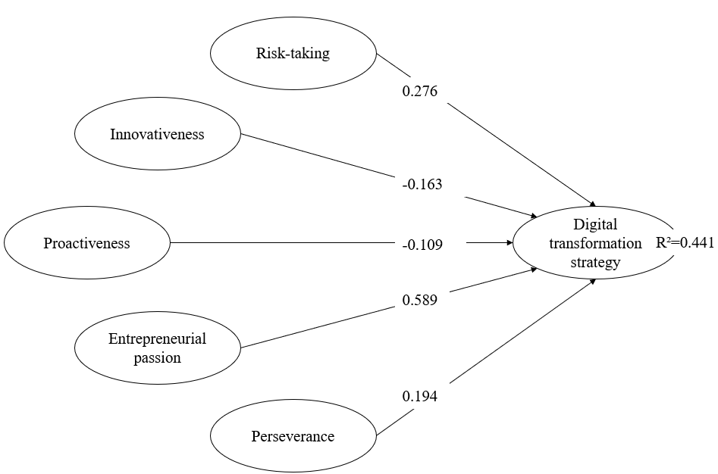
Data Analysis and Research Findings
2. Structural Model Analysis
Table . Structural model results.
hypothesis | relationship | bETA (pATH cOEFFICIENTS) | t-student (bootsrap) | p-value | accepted/ rejected
Hypothesis 1 (H1) | RT => DTS | 0.276 | 2.624 | *** | Accepted
Hypothesis 2 (H2) | INN => DTS | -0.163 | 1.071 | p >0.05 (ns) | Rejected
Hypothesis 3 (H3) | PRO => DTS | -0.109 | 0.852 | p >0.05 (ns) | Rejected
Hypothesis 4 (H4) | EP => DTS | 0.589 | 3.361 | ** | Accepted
Hypothesis 5 (H5) | PER => DTS | 0.194 | 1.485 | p >0.05 (ns) | Rejected
Figure . Assessment of the structural model.
Note: *p <.05; **p <.01; ***p <0.001

Slide 12
Conclusions
Limitations
  Due to the small sample size, the results cannot be generalized to all Moroccan entrepreneurs at large.
  A cross-cultural analysis of the proposed conceptual framework is anticipated to offer even more crucial information.
  The proposed conceptual model could be expanded by adding additional determinants in order to give a more robust research framework that may offer a more holistic approach to the topic’s research.

Slide 13
THANK YOU FOR YOUR ATTENTION

Slide 14
Digital Transformation Strategy in SMEs: The Role of Entrepreneurs’ IEO
4th Current Business Issues
in African Countries
2023
Lahsen Oubdi, Oumaima El Mekkaoui
ENCG Agadir Business School, Ibn Zohr University
Laboratory of Research in Entrepreneurship, Finance, and Audit (LAREFA)
April 27 – 28, 2023 WWW.CBIAC.NET

