Slide 1
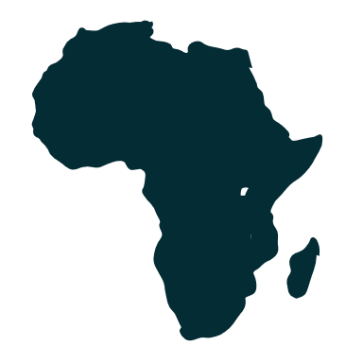



4th Current Business Issues
in African Countries
2023
Women Entrepreneurship Policy in Africa:
A Holistic Approach
Siti Nurhayati Khairatun, Ph.D.
Universiti Putra Malaysia, Malaysia
April 27 – 28, 2023 WWW.CBIAC.NET

Slide 2

CONTENTS
Introduction
Objectives
Methodology
Summary of Findings
Conclusions

Slide 3

INTRODUCTION
Mastercard Index of Women Entrepreneurs (MIWE) report
Botswana (38.5%)
Uganda (38.4%), and
Ghana (37.2%)
have the highest women involvement in business compared to other countries in Africa

Slide 4
Challenges faced by women entrepreneurs:
Work-life imbalance
Discrimination
Unequal rights in the workforce
Limited access to financial aid
Lack of access to essential services

Slide 5
Government policies
Introduction and implementation of policies relating to supporting women entrepreneurs by the governments and their agencies
Without these policies, the struggles experienced by women are far more complicated

Slide 6



OBJECTIVES
This paper aims to present how institutional policies promote and support the business growth and sustainability of women-owned enterprises in Botswana, Uganda, and Ghana

Slide 7



Three pillars of operating today’s business
financial
digital
human capital
development

Slide 8
METHODOLOGY
Secondary data collected from many websites and online media platforms including government publications, association bulletins, media reports,
and social media
Thematic content analysis was used to categorize each code and theme of the subject matter
Each theme was tabulated under each country for convenience reference

Slide 9
SUMMARY OF FINDINGS
The institutional policy and support in the three countries have been synergistically related to the success of women entrepreneurs.
Institutional policies should be the reference point for other African countries to support more women in business.

Slide 10
Financial Policy:
Women entrepreneurs received a number of business loans or grants provided by mandated financial institutions or NGOs to start a business, expand their market share, and explore more business opportunities abroad

Slide 11
Digital Policy:
Governments are committed to eradicating the digital gap among businesses
Digital inclusiveness policy plays a significant role in stimulating business networks, improving business performance, creating new competitive advantages, and developing positive customer relations

Slide 12
Human Capital Development Policy:
Governments through their work agencies and NGOs have implemented a wide range of training courses, workshops, seminars, and team-building activities to enable the beneficiaries to acquire knowledge, skills, and networks

Slide 13
CONCLUSIONS
The institutional business policies in Botswana, Uganda, and Ghana have synergically supported and accelerated their women entrepreneurs’ businesses to be more resilient and sustainable in facing the volatile, uncertain, complex, and ambiguous marketplace
Supporting women entrepreneurs can have a positive impact on economic growth and development

Slide 14


Slide 15
Questions and Discussion
United Nations Sustainable Development Goals
  https://sdgs.un.org/goals
  Topic.
  Topic
Discussion questions
How does the topic relate to issues of public concern or the common good?
What communities might be involved in or affected by the topic? What are the histories, social contexts, assets, and needs of these communities?
What community partners (e.g., public offices, nonprofit organizations, social enterprises, faith-based organizations) could collaborate on your topic for mutual benefit and growth?

