Slide 1



PRODUCT SEARCH MAPPING IN SUPPLY CHAIN MANAGEMENT FOR THE CUSTOMERS
4th Current Business Issues
in African Countries
2023
Dr Puneet Kumar
Professor, Kalinga University, New Raipur, Chhattisgarh, India
Ekansh Agarwal
MBA(Tech) Student, NMIMS University, Mumbai, Maharashtra, India
April 27 – 28, 2023 WWW.CBIAC.NET

Slide 2
Introduction
ABSTRACT
A supply chain's information, products, operations, and financial flow are all represented visually in product mapping in supply chain management. The usage of SC mapping tools is one of the major trends among businesses worldwide. After all, there are many diverse reasons for using it. The rise in the number of youthful workers is another significant factor in India's retail industry prospects. Large salaries, nuclear families in metropolitan regions, rising numbers of working women, and new prospects in the services industry are all present in India.
Purpose: To research the viability of product search management in retail industry and the significance of product search management.

Slide 3
Research Methodology: 400 employees of a company with a supply chain in India's retail sector participated in a self-made survey utilizing the theory of organizational effectiveness for employees working in corporations and a descriptive-evaluative survey technique of research with purposive sampling.
Result: Product mapping is an essential component of supply chain management. We spoke with the SCM directors of some of the most well-known retail chains in the nation to learn how they are improving supply chain management efficiency, the adjustments that need to be made, and the creative solutions they are coming up with to keep retail at an all-time high. As this sector has grown over time, so has the role of supply chain in organized retail in India.
Keywords: Product, SCM, Supply Chain Management, Customer, Retail.

Slide 4
Logistics academics place a lot of emphasis on supply chain management since it has a competitive advantage. The administration of resources, information, and financial movements in a network made up of suppliers, manufacturers, distributors, and customers is the subject of supply chain management. [3]
A supply chain can be thought of analytically as a network of material processing cells having supply, transformation, and demand characteristics. Management of a network of related companies that ultimately provides the product and service bundles needed by the end customer is known as supply chain management.
The movement and storage of raw materials, inventories for work-in-progress, and finished commodities from the site of production to the point of consumption are all covered by supply chain management. The achievement of an effective logistics and supply chain, which may be supplied by professionals as they combine the best methods and skills to manage a ready flow of goods and services, is essential for success in this cutthroat and fast-paced industry. [5, 9]
Many related industries hope to benefit from the retail boom, but the logistics sector, which forms the backbone of the retail sector, stands to gain the most. The logistics market is mostly associated with transportation in India. Nevertheless, transportation, warehousing, and other value-added services like packaging are the main components of logistics cost for industries. [4]
A corporation, its suppliers, and its consumers make up the simplest form of a supply chain. The link in the chain may be a producer of raw materials, manufacturer, distributor, retailer, and retail client.

Slide 5
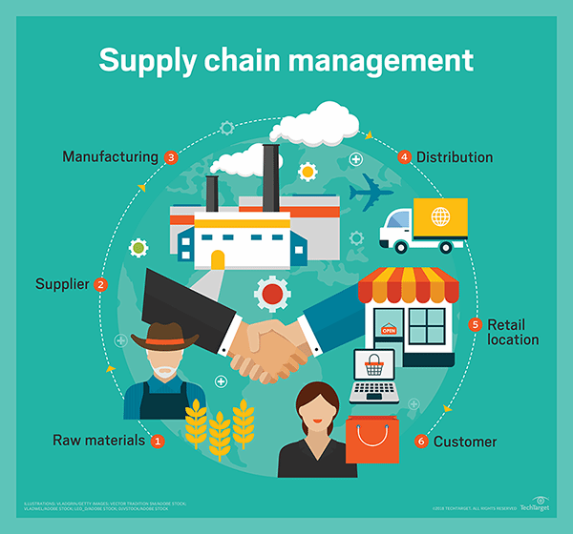
Figure 1: Supply Chain Management Considering Corporate

Slide 6
Many suppliers and suppliers' suppliers, many customers and customers' customers, or final customers, and all the companies that provide the services necessary to successfully get products to customers, such as third-party logistics providers, financial institutions, supply chain software vendors, and marketing research providers, will likely be included in a more complicated or extended supply chain. Some organizations likewise utilize services from additional suppliers. [11]
The combination of these organizations, which conjures up the image of an intricate web as opposed to a straight chain, sheds light on why supply chain management is so difficult. This complexity also gives a hint as to the kinds of problems that might occur, from demand management problems, like when a new iPhone is released and the demand for older iPhone cases is stifled, to natural supply chain disruptions, like the suspension of transportation in the United States in 2015 due to extreme winter weather, or California's drought and its impact on crops, to political unrest, like the strikes in India that slowed down activity at that country's busiest container port.

Slide 7
CHALLENGES & OPPORTUNITIES
Over the past ten years, retailing has undergone such a radical upheaval that its basic definition has changed. A manufacturer can no longer rely on the simple availability of his goods to generate sales. Today, retailing encompasses much more than just selling merchandise. It's about include clients in a narrative, expressing their wants and ambitions, and creating enduring connections. As the Indian customer develops, they have increasing expectations every time they enter a business. Selling a product or service in retail today has transformed to selling a consumer's hope, desire, and, most importantly, an experience they would like to repeat. [7,8]
The rising prospects in urban marketplaces for manufacturers and service providers appear to reside in capturing and providing higher value to the customers through retail. Examples of manufacturers and service providers who combine their own manufactured goods and services with those of others to create value that was previously unknown are Cavin Kares Limelight, Maricos Kaya Skin Clinic, and Apollo Hospitals Apollo Pharmacy in Chennai, to mention a few. The last mile connection appears to be getting more exciting and engaging. However, due to challenges with rural retailing, manufacturers and service providers face an expanding rural market that is only partially penetrated. Only cutting-edge ideas and models will stand the test of time and financial commitment. Manufacturers and service providers will, however, also increasingly compete with a variety of specialized shops who use cutting-edge management strategies and have access to virtually limitless financial resources. Retail organization seems inevitable. [12]

Slide 8
Conclusions
Retailers all around the country are brainstorming ways to take advantage of the opportunities that are available while the retail business is expanding rapidly. Product mapping is an essential component of supply chain management. We spoke with the SCM directors of some of the most well-known retail chains in the nation to learn how they are improving supply chain management efficiency, the adjustments that need to be made, and the creative solutions they are coming up with to keep retail at an all-time high. As this sector has grown over time, so has the role of supply chain in organized retail in India. The supply chain is crucial to the expansion of the Indian retail sector, hence Indian merchants must work to keep it in good working order. Hence, Indian merchants will increase their bottom lines through effective supply chain and logistics management by making extensive use of global and local experiences. Indian retailers like the Future Group, which operates Big Bazaar, Pantaloons, and Reliance Retail, will also demonstrate to the rest of the world how it may be managed in a more creative and effective way. [15]
Leadership in the supply chain has traditionally been essential to retailers' success. The demand for efficient Supply Chain capabilities and engagement is greater given the current economic cycle. Retailers must carefully monitor the overall cost of international sourcing, reduce inventories, and control transportation costs without compromising product availability or customer service. Retailers will be able to address their present and ongoing difficulties with the enhanced upstream and downstream engagement of leadership. Dissolving silos and sustaining top management support for Supply Chain leadership initiatives have allowed for this beneficial progress. The participants continue to place a strong emphasis on cost management and the pursuit of better efficiency. Finding the ideal combination of capabilities that enables the business to give the requisite degree of customer service for a decreasing cost appears to be the value-add for retail supply chain leadership. Supply chain managers carefully control the flow of merchandise through various pipelines to retail locations. To promote business profitability, it is necessary to evaluate and enhance both cost and service goals. Although the store is doing well in many areas, there is room for improvement in demand-driven fulfilment, return on assets, and inventory turns. The retail establishment actively engages in problem-solving and is commonly believed to be capable of meeting current organizational issues thanks to well-prepared leadership.

Slide 9
Questions and Discussion
Discussion on feasibility of product search management in supply chain management.
Importance of Product search management in retail market.

