Slide 1
Opportunity In The Face Of Adversity: How To Safeguard Your Retirement
Current Business Issues
in African Countries
2022
Dr. Donald Crooks, Roba Youssef, Audrey Paradis, Connor Stapleton, Vuk Bulajic
April 7 – 8, 2022 WWW.CBIAC.NET

Slide 2
Dollar-Cost Averaging
In a 401 (k) plan (retirement plan)
Systematically investing a percentage of your income in regular intervals, regardless of price.
Goal of dollar-cost averaging = reduce the overall impact of volatility on the price of the target asset
Aims to reduce risk while investing
Aims to invest more when the share price falls and less when the share price rises.

Slide 3
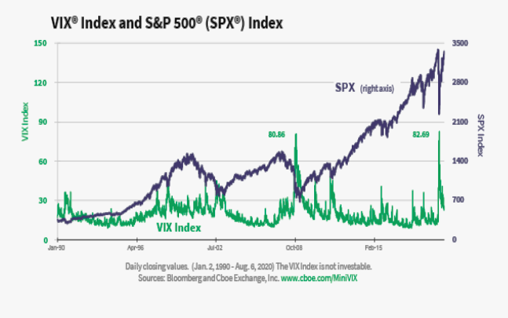
DOW.NASDAQ.S&P.SPY (ETF) and VIX

Slide 4
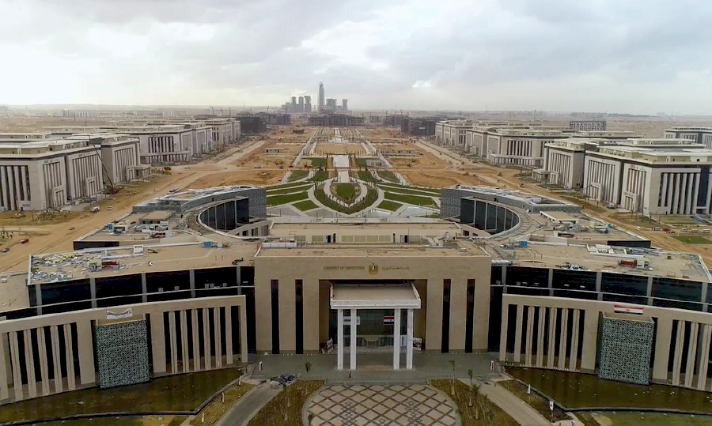
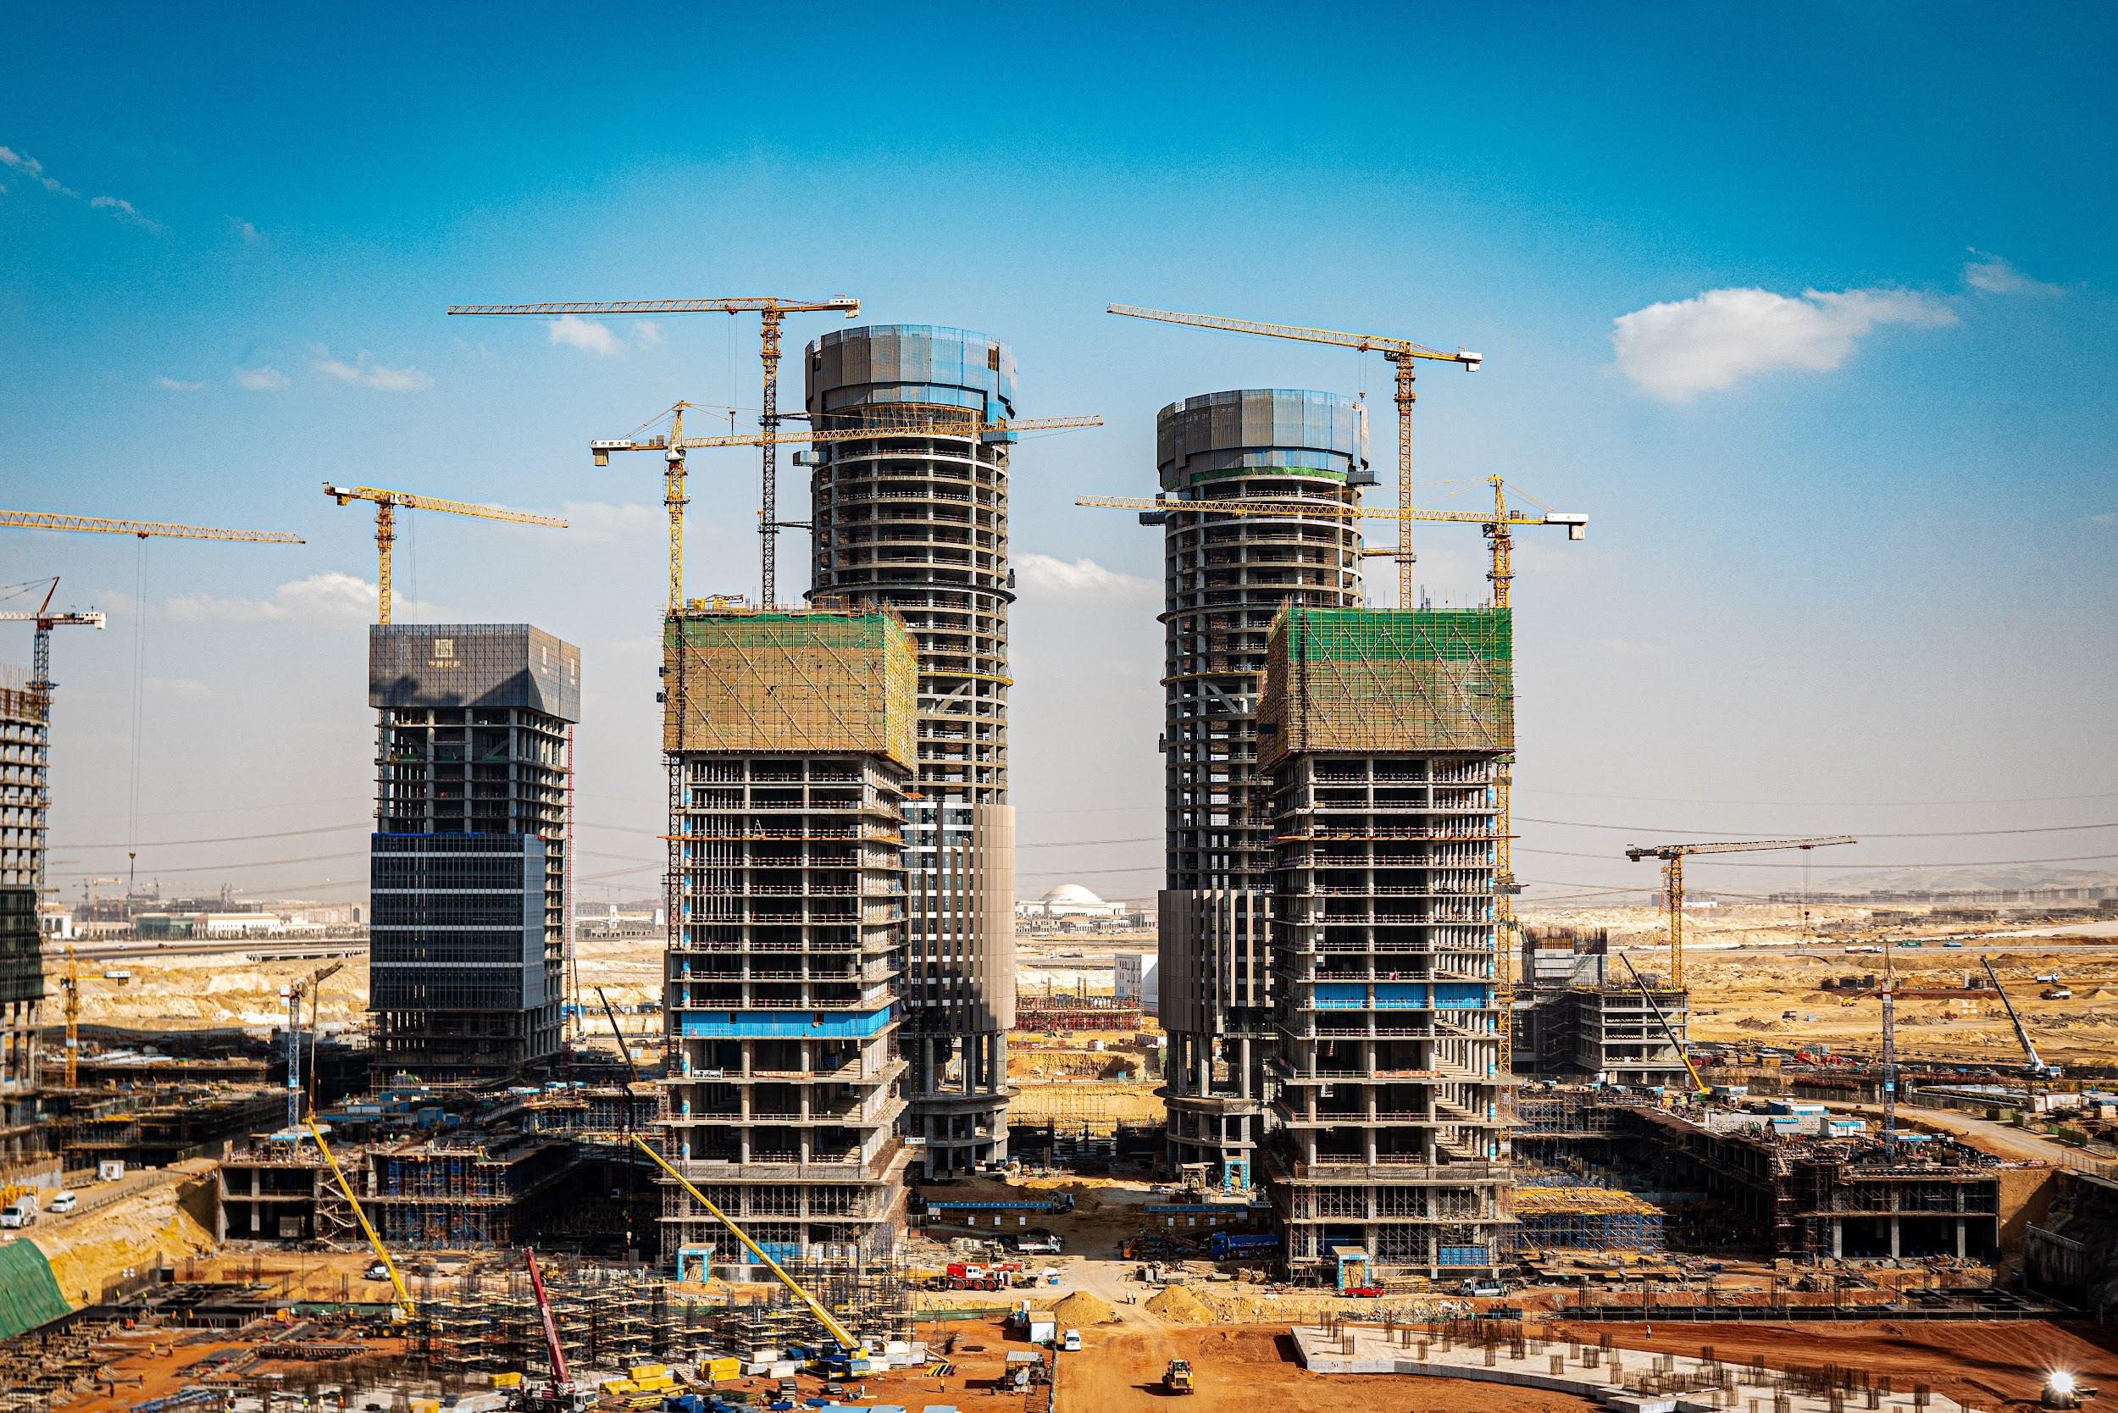
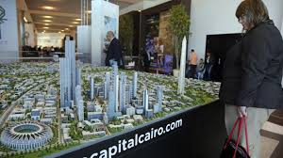

Slide 5
Egyptian Pension System
Egyptian Public Pension
Coverage
Contribution
Egyptian Private Pension (Voluntary Occupational)
Coverage
Contribution
Changes to social insurance pension system
Improvements

Slide 6
Egyptian Stock Market
The Egyptian Exchange (EGX)
Alexandria Stock Exchange (1883)
Cairo Stock Exchange (1903)
The Egyptian Stock Exchange (EGX )
EGX 100
EGX 30

Slide 7
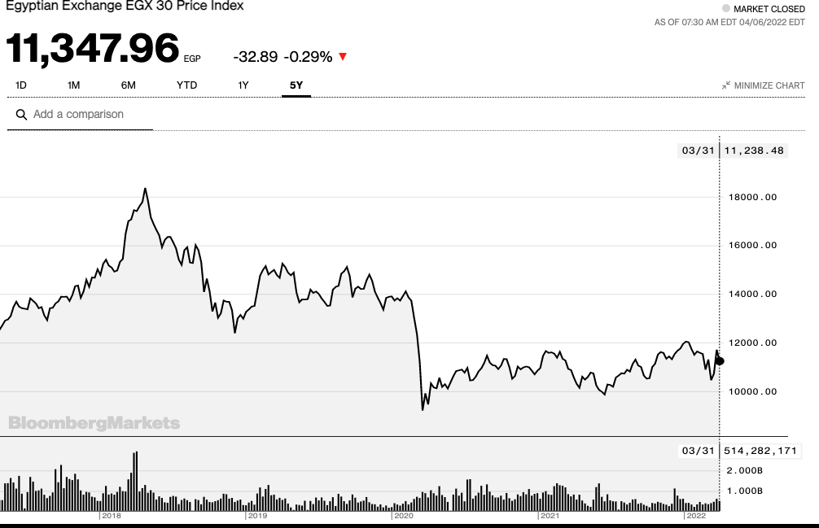

Slide 8
Serbian Pension Plan
PIO - Serbian Pension Organisation
Current Workforce Pays Current Pensions
Low Sustainability - Aging Population
Alternatives
Private Funds and Capital Investments
Serbian Mentality
Effects of Communism

Slide 9
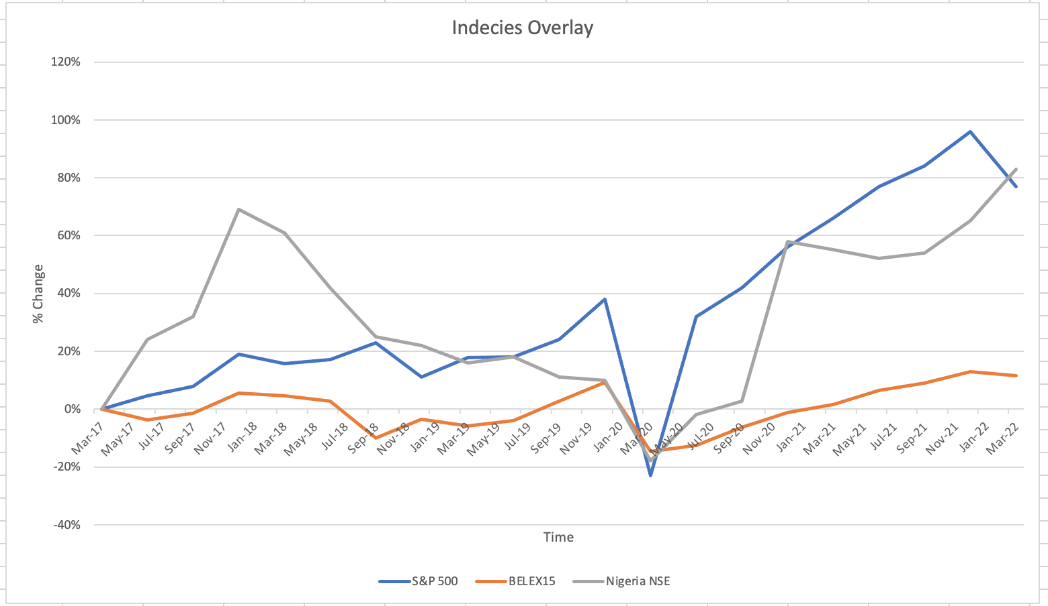
Serbian, Nigerian, and the US Stock Market Overlay

