Slide 1
Synergies between COVID-19, Supply Chain, Sustainable Development, and Climate Change: Lessons from UNCTAD
4th Current Business Issues
in African Countries
2023
Shani D. Carter, Ph.D.
Wagner College
April 27 – 28, 2023 WWW.CBIAC.NET

Slide 2
Introduction
United Nations Conference on Trade and Development
UNCTAD is held every 4 years
The focus is on using trade and development to promote world peace.
2016
Nairobi, Kenya
Focus on treaties and fair trade
2021
Barbados
Focus on Supply Chain, Climate Change, COVID-19, Sustainable Development,

Slide 3
Interdependence and Synergies
“The interdependence of the whole world must guide our roadmap.”
Isabelle Durant, Deputy Secretary-General, UNCTAD at the United Nations Conference on Trade and Development (UNCTAD15) on October 5, 2021.
Countries are interdependent.
Aspects of the global economy operate synergistically.
Covid-19 Pandemic
Given a renewed sense of urgency of the necessity of focusing on the synergies between Supply Chain, Climate Change, COVID-19, and Sustainable Development as they affect business.
What occurs in one part of the world, affects the whole world.

Slide 4
COVID19
Laid bare and exacerbated inequalities within and between countries.
Lack of sustainable development, trade inequalities, debt service, and lack of water are problematic for addressing the pandemic.
COVID19 debt for healthcare, vaccines, and PPE
hamper future development and will
push countries back into poverty
make it more difficult for them to hit sustainable development goals.
Many small countries lost 50% to 70% of their revenue due to the pandemic.
Wealthy countries ordered 5 times as many vaccine doses as they needed.
leaving few vaccine doses available to poor countries
vaccinated at only 2% to 5% of their populations, leading to the variants affecting the wealthy countries.

Slide 5
Climate Change
Small, developing countries are not the cause of COVID19 or climate change
But they are the ones suffering the most.
For many countries, climate change is an existential threat
Especially if the 1.5C degree limit of the Paris Accord is not reached.
https://unfccc.int/process-and-meetings/the-paris-agreement/the-paris-agreement
Climate change, trade, and peace are linked: for example,
In NE Nigeria, Lake Chad has decreased by 90% since 1960, and
The loss of fish and industry is thought to have given fertile ground to Boko Haram.

Slide 6
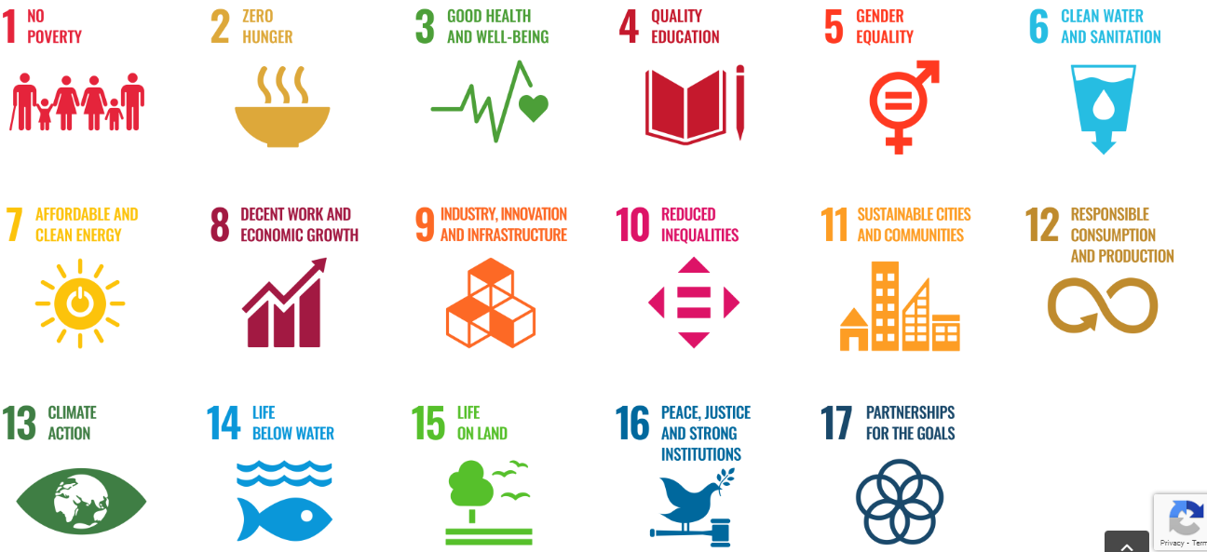
United Nations Sustainable Development Goals
https://www.un.org/sustainabledevelopment/

Slide 7
Sustainable Development
Annually, trillions of dollars in raw materials leave developing countries and are sent to developed countries.
Making advancement in developing countries unsustainable.
There are massive opportunities for FDI into Africa.
While exports from developed countries have returned to pre-pandemic levels,
Exports from developing countries have reached only 6% of pre-pandemic levels.
Intra-Africa trade via The African Free Trade Market and increased multilateralism between Africa and the Caribbean has
Helped African countries improve.
The multilateralism within Africa and between Africa and the Caribbean
can increase sustainable development and
can pressure large countries to have true global multilateralism.

Slide 8
Supply Chain
The pandemic uncovered problems in the supply chain in virtually all industries
e.g., PPE, medical, chip shortages.
Significant pressure was placed on supply chains.
Especially for companies that had single-source suppliers in other countries.
e.g., chip shortages in Asia negatively affecting automobile production in Europe.
Some companies pivoted
e.g., began making sanitizer and PPE; hotels became quarantine centers, etc.
Shipping costs are still skyrocketing raising serious inflationary concerns.
This inflation negatively impacts food insecurity in SIDS (Small Island Developing States.
Problems with production
new industrialization.
increasing nationalism.

Slide 9
Entrepreneurship
Barriers to Entrepreneurship in Africa
The power of large technology companies
hinders the work of small businesses and hampers creativity.
There is not a global framework for corporate tax
for countries to obtain revenue based on the activity that occurs in their countries,
which represents an unfair disadvantage against entrepreneurs.
Trade is now not just at shipping ports but is conducted digitally.
trade is now in private hands more than ever.
This private oligopoly must be addressed
if development is to be sustainable and entrepreneurship is to flourish.

Slide 10
Conclusions
Supply Chain, Climate Change, COVID-19, Sustainable Development, Entrepreneurship
All issues are interconnected.
Fair sharing of resources must be promoted
Medical
Trade treaties and contracts
Use of raw materials
Technology
Financing
Decreasing pollution
The UN SDG should be promoted and encouraged.

Slide 11
Questions and Discussion
United Nations Sustainable Development Goals
https://sdgs.un.org/goals
Discussion questions
How does the topic relate to issues of public concern or the common good?
What communities might be involved in or affected by the topic? What are the histories, social contexts, assets, and needs of these communities?
What community partners (e.g., public offices, nonprofit organizations, social enterprises, faith-based organizations) could collaborate on the topic for mutual benefit and growth?

