Slide 1

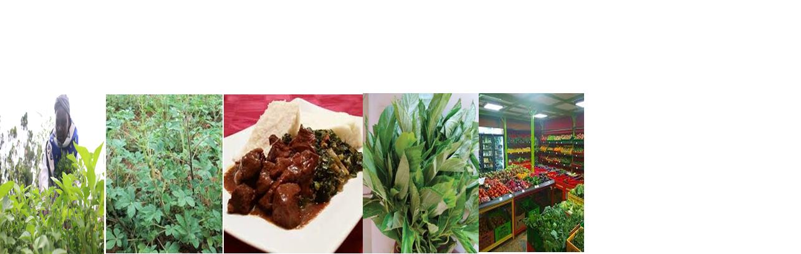

Developing Sustainable Fresh Produce Agriculture Value Chains: Case Study of African Indigenous Vegetables (AIVs) value chain in Uasin Gishu County, Kenya.
Current Business Issues
in African Countries
2022
Cynthia Onyangore
MD, Trade Up Commodities Ltd - Kenya and Student, Van Hall Larenstein University of Applied Sciences – Velp, Netherlands
April 7 – 8, 2022 WWW.CBIAC.NET

Slide 2
Introduction
Pumpkin leaves (Cucurbita pepo.), amaranth (Amaranthus spp.), nightshade (Solanum spp.), spider plant (Cleome gynandra), cowpea (Vigna unguiculata), and jute mallow (Corchorus olitorius).
AIVs were previously considered a “poor man’s food”
Why AIVs now?
  Grow in natural habitat
  Rich in nutrients
  Short growing periods
  Paradigm shifts in consumer preferences

Slide 3
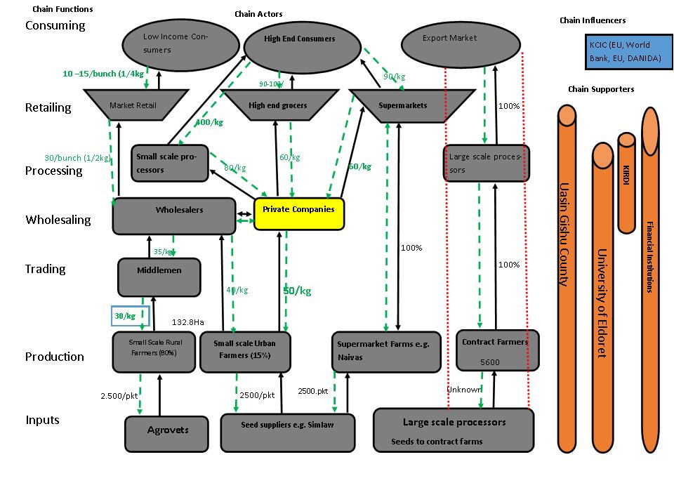
AIVs Value Chain

Slide 4
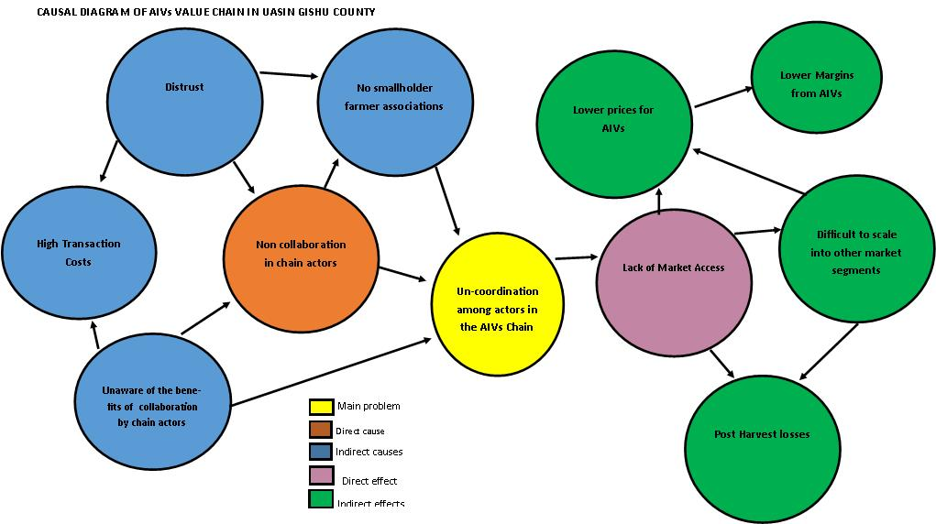
Context Analysis
Main Problem

Slide 5
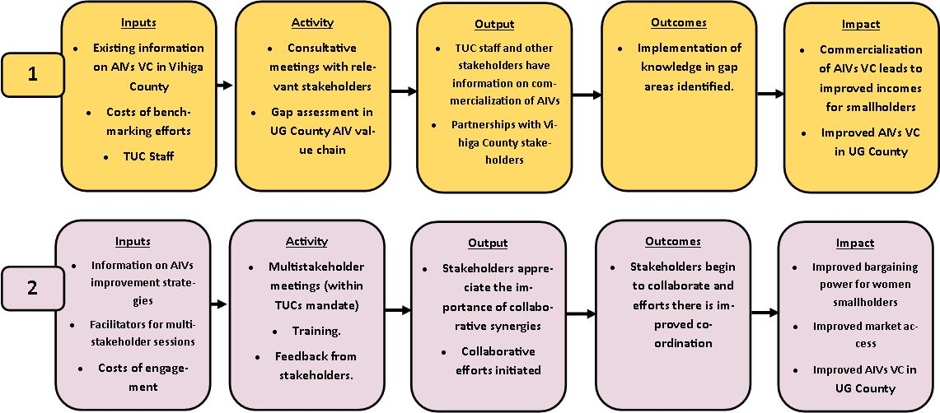
Value Chain Interventions
Intervention 1 – Benchmarking and gap assessment with Vihiga County (already implementing commercialization of AIVs in their operations)
Intervention 2 – Leverage existing relationships to improve collaboration and coordination in VC

Slide 6
Assessing the Impact of Interventions
Relevance: Mainstreaming of VC approach in the County
Effectiveness: Feasibility of interventions
Efficiency: Partnerships, collaborations and co-ordination in the VC
Sustainability:
  Can be tailored and replicated within the other VCs
  Addresses economic, social and environmental aspects in VC while building partnerships (3Ps)

Slide 7
Conclusion and Recommendations
Mainstreaming of the value chain approach requires interventions at personal, organizational and value chain levels.
Centrality of multistakeholder collaboration in mainstreaming the VC approach.
Leverage existing relationships to improve the performance in the value chain.

Slide 8
Questions and Discussion
United Nations Sustainable Development Goals
  SDG 1 - No Poverty
  SDG 2 – Zero Hunger
  SDG 5 – Gender Equality
  SDG 13 – Climate Action
  SDG 17 – Partnership for the goals

Slide 9
Thank you!
Asante!
Bedankt!

