Slide 1
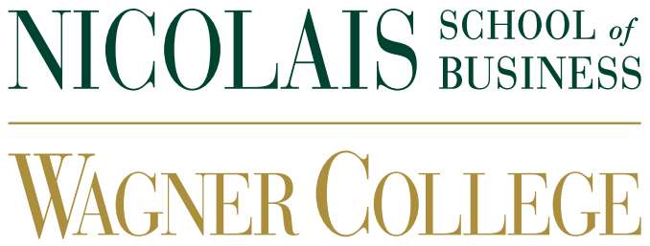
THE ONGOING EFFORTS TO STRENGTHEN ETHICS AND PROFESSIONALISM IN THE ACCOUNTING INDUSTRY, INCLUDING THE IMPORTANCE OF MAINTAINING HIGH STANDARDS OF INTEGRITY AND INDEPENDENCE IN FINANCIAL REPORTING
4th Current Business Issues
in African Countries
2023
SI MOHAMED BOUAZIZ ,Koukkous abdellatif TARIK MAALEMI
IBN ZOHR
April 27 – 28, 2023 WWW.CBIAC.NET

Slide 2
Introduction
The significance of ethics and professionalism in the accounting industry
The regulatory bodies responsible for overseeing the accounting profession
Professional organizations that support and promote ethical
The impact of technology on the accounting profession
Future trends and challenges in the accounting industry regarding ethics

Slide 3
The significance of ethics and professionalism in the accounting industry
The accounting industry plays a critical role in ensuring that financial information is accurate and reliable. To fulfill this role, accountants must uphold high standards of ethics and professionalism
High standards of integrity and independence in financial reporting is essential for several reasons.

Slide 4
The regulatory bodies responsible for overseeing the accounting profession
The Securities and Exchange Commission (SEC) and the Public Company Accounting Oversight Board (PCAOB) are two of the main regulatory bodies responsible for overseeing the accounting profession and enforcing ethical and professional standards.

Slide 5
Professional organizations that support and promote ethical
There are several professional organizations that support and promote ethical and professional behavior in the accounting industry. Two of the most prominent organizations are the American Institute of Certified Public Accountants (AICPA) and the Institute of Management Accountants (IMA).

Slide 6
The impact of technology on the accounting profession
The impact of technology on the accounting profession has been significant in recent years. The increasing use of technology in accounting has streamlined many processes and has allowed accountants to focus on higher-value tasks, such as analyzing financial data and providing strategic advice to clients. However, it has also created new challenges that accountants must be aware of to maintain their professional standards.

Slide 7
Future trends and challenges in the accounting industry regarding ethics
The accounting industry is constantly evolving, and future trends and challenges are likely to have an impact on ethics and professionalism. One such trend is the increasing focus on sustainability and ESG reporting.
Sustainability and ESG reporting are becoming increasingly important as investors and other stakeholders seek to evaluate companies based on their environmental and social impact, as well as their financial performance. Accountants will need to understand how to incorporate these factors into financial reporting and ensure that the information provided is accurate, reliable, and transparent.

Slide 8
Conclusions
Ethics and professionalism are essential components of the accounting industry, and maintaining high standards of integrity and independence in financial reporting is crucial for maintaining trust and credibility with stakeholders. The accounting profession is subject to regulatory oversight from organizations such as the SEC and PCAOB, and professional organizations like the AICPA and IMA also play a significant role in promoting ethical behavior.

